Slide 1
Audit and Reporting Requirements- Resources
Georgia Department of Audits & Accounts (DOAA) 2023
Jacqueline Neubert, CPA, CGFM

Slide 2
About the Presenter
Serves as Deputy Director of DOAA’s Professional Standards & Practices Division – Nonprofit and Local Government Team
37 Years in Governmental Auditing and Accounting
Certified Public Accountant (CPA) and Certified Government Finance Manager (CGFM)
Member of GSCPA’s Governmental Accounting & Auditing Conference Task Force
GFOA Special Review Committee (reviews of Annual Comprehensive Annual Reports)
Member of GFOA’s Special Review Executive Committee
AGA (Association of Government Accountants) served in various executive offices in the AGA Atlanta Chapter

Slide 3
Learning Objectives
Understand the reporting requirements of governmental entities to DOAA
Be aware of possible consequences of a non-compliance status for local governments
Understand the relationship between the compliance status and eligibility for state grant awards and programs
Be aware of tools available from DOAA

Slide 4
SECTION 1
Annual Financial Reporting

Slide 5
O.C.G.A. §36-81-7
Local Governments
Audits required if annual expenditures are $550,000 or more
Agreed-Upon Procedures maybe submitted if annual expenditures are less than $550,000
Submission of reports to DOAA

Slide 6
O.C.G.A. §36-81-7
DOAA/State Auditor
Review reports to ensure compliance with:
generally accepted government accounting principles
generally accepted government auditing standards
federal and state regulations

Slide 7
Submission of Financial Reports
Submitted to DOAA/State Auditor within 180 days after close of fiscal year
FYE Date | Due Date
December 31, 2022 | June 30, 2023
March 31, 2023 | September 30, 2023
June 30, 2023 | December 31, 2023
September 30, 2023 | March 31, 2024

Slide 8
Submission of Documents
Use the Nonprofit and Local Government Audit Report
Collection System
Upload all documents associated with fiscal year
Submit transmittal document with current email addresses for contacts
Upload Instructions
External Account Creation and Upload Instructions for the File Collection System
https://www.audits2.ga.gov/resources/orgs/local-government/?rpage=submissions

Slide 9
Extension Requests
Extension requests should be electronically submitted
Eligibility status determined before we respond
Determination of eligibility status – analysis of receipt dates for past two years
Not eligible if extended in previous 2 consecutive years
Reminder that late submissions are considered to be extensions
https://www.audits2.ga.gov/wp-content/uploads/2022/08/Extension-Request-Procedures.pdf

Slide 10
Desk Reviews – Noncompliance Issues
Valid firm license for independent audit firm
Submission of draft audit reports
Major fund presentation
Reconciliations – Governmental Fund Financial Statements to Government-Wide Financial Statements
Identical items noted in prior year desk review

Slide 11
Valid Firm License – Audit Firm
Audit firm must hold a valid Georgia firm license
State law requires an opinion certifying or attesting to the reliability of the financial statements
Certification by firm holding a license to practice in Georgia
Licenses can be verified at https://cpaverify.org

Slide 12
Draft Versions of Audit Reports
Reports submitted should be the final version
Final version approved by Council or Commission
DOAA unable to accept draft versions of reports

Slide 13
Major Fund Presentation
Focus of governmental or proprietary fund financial statements is major funds
Fund statements should present financial information of each major fund in a separate column
Major fund test performed during each review when non-major funds are presented
Major fund test included as a tool for local governments on our website
https://www.audits2.ga.gov/wp-content/uploads/2021/10/major_fund_test.xls

Slide 14
Prior Year Noted Items Uncorrected
Items cited during desk review of the prior year audit report
Granted one-year waivers for correcting these items
If same items cited during current year desk review, we are unable to accept the report until the corrections are made
In addition, your auditor will need to comply with the appropriate standards related to audit reports of corrected financial statements

Slide 15
Non-Compliance Status
Types of Non-Compliance
Report Not Submitted
Report Not Accepted by DOAA
Grant Certification Noncompliance
Local Retirement Law Noncompliance

Slide 16
Consequences of Non-Compliance
Possible Consequences
No state agency shall transmit any state grant funds
To any government which has failed to provide all audit or agreed-upon procedures reports
Required by law within the preceding five years

Slide 17
Non-Compliance Status & Consequences
Download Latest Non-Compliance Memo Document
https://www.audits2.ga.gov/resources/orgs/local-government/?rcat=technical-assistance

Slide 18
Verification of Compliance Status
Quarterly non-compliance list sent to State agencies
State grantor agency officials urged to contact DOAA to verify potential grantee’s eligibility
Verify eligibility to receive state grant fund transmittals prior to grant award and transmittal
Non-compliance list valid as of date prepared
DOAA will confirm compliance status upon request

Slide 19
Contact Information
Please contact the Nonprofit and Local Government Team at:
locgov@audits.ga.gov or (404) 656-9145
Jackie Neubert, CPA, CGFM, Deputy Director
Email address: neubertj@audits.ga.gov
Eric Moody, CPA, Manager
Email address: moodyen@audits.ga.gov

Slide 20
Resources Available
Auditing and Accounting Services
Request for Proposal for Audit Services https://www.audits2.ga.gov/resources/orgs/local-government/?rcat=technical-assistance
CPA Referral Search on Georgia Society of CPAs website https://www.gscpa.org (under the Professional Resources tab)
Verification of valid Georgia firm license – https://cpaverify.org

Slide 21
Resources Available
Resources for Local Governments on DOAA’s website – Technical Assistance - Other Guidance
Extension request procedures document
Uniform Chart of Accounts
Resources for Local Governments on DOAA’s website – Technical Assistance – Tools & Checklists
Compliance Auditing in Georgia Counties and Municipalities
Local Government Audit Office Review Checklist
Agreed-Upon Procedures Work Program

Slide 22
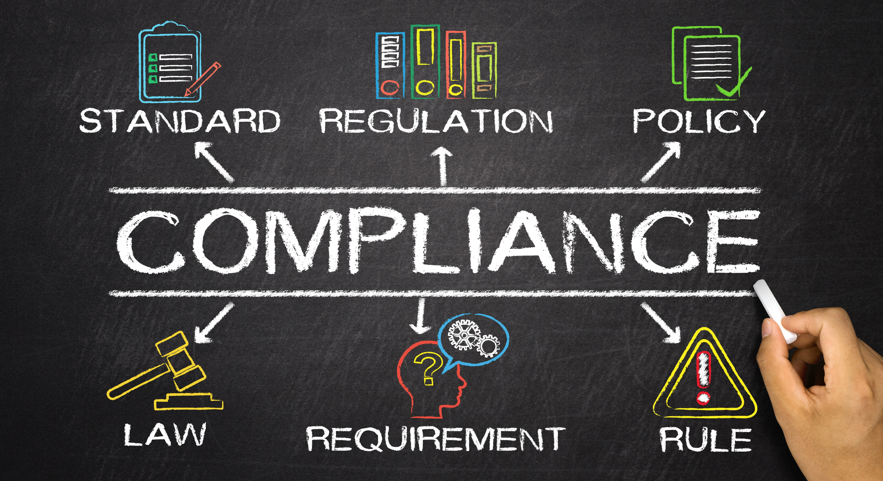
Section ii
Annual Immigration Compliance Reporting

Slide 23
Annual Immigration Compliance Reporting
Required by provisions of O.C.G.A. §50-36-4
All Georgia governmental entities required to submit annual immigration compliance report
Sometimes referred to as E-Verify reporting
Federal Work Authorization Program – which is commonly known as E-Verify program

Slide 24
E-Verify Program
E-Verify program is operated by the U.S. Citizenship and Immigration Services (USCIS)
Registration information available on the USCIS website – located at www.uscis.gov/e-verify

Slide 25
E-Verify Program (continued)
Registration information includes user identification number and authorization date
Records of E-Verify numbers and authorization dates are maintained by USCIS
E-mail address: E-Verify@dhs.gov

Slide 26
Five Reporting Areas
Confirm reporting government’s E-Verify number
Title 13 – Contract Reporting
Title 36 – Business Licenses
Sanctuary Policy – Compliance with O.C.G.A. §36-80-23
Title 50 – Public Benefits

Slide 27
Descriptions of Five Reporting Areas
Descriptions of information that the annual report collects for the five different immigration requirements
E-Verify Number – confirm the number in the collection system for your entity
Contractor Reporting – list of contractors the entity used during the period for “physical performance of services”
Business Licenses – listing of licenses issued during the period to businesses who were required to enroll in the E-Verify program

Slide 28
Descriptions (continued)
4. Public Benefits – listing of public benefits and whether or not the entity has received SAVE authorization for these benefits
SAVE – Systematic Alien Verification for Entitlements
27 “Public Benefits” – for all 27 refer to lists on next two slides
Examples of public benefits: employee retirement benefits, employee health benefits, employee disability benefits, alcoholic beverage licenses, business licenses, pawn broker licenses, billiard hall licenses, peddler and itinerant trader licenses, and transient business licenses

Slide 29
SAVE (continue)
There are 27 “Public Benefits”
Adult education;
Authorization to conduct a commercial enterprise or business;
Business certificate, license, or registration;
Business loan;
Cash allowance
Disability assistance or insurance;
Down payment assistance;
Energy assistance;
Food stamps;
Gaming license;
Grants;
Health benefits;
Housing allowance, grant, guarantee, or loan;
Loan guarantee;

Slide 30
SAVE (continue)
There are 27 “Public Benefits”
Medicaid;
Occupational license;
Professional license;
Public and assisted housing;
Registration of a regulated business;
Rent assistance or subsidy;
Retirement benefits;
State grant or loan;
State issued driver's license and identification card;
Tax certificate required to conduct a commercial business;
Temporary assistance for needy families (TANF);
Unemployment insurance; and
Welfare to work.

Slide 31
Descriptions (continued)
5. Sanctuary Policy – true/false question asking if the entity has
enacted a sanctuary policy
Confirmation that the government is in compliance with O.C.G.A. §36-80-23

Slide 32
Focus on Two of Five Areas of Reporting
1. Title 13 – Contract Reporting (O.C.G.A. §13-10-91)
2. Sanctuary Policy – (O.C.G.A. §36-80-23)

Slide 33
Title 13 or Contract Reporting
Report contracts that are over $2,499.99
Report contracts for the physical performance of labor and services
Report contracts for routine operation, repair and maintenance of existing structures and services needed for normal operations

Slide 34
Contract Reporting
List of contractors used during the period for physical performance of labor and services
Documentation of contractor compliance (obtain notarized affidavit that states the contractor used the E-Verify program)
Affidavit required even if contractor only has one employee
Contractors with no employees – verify eligibility to work in the United States

Slide 35
Contract Reporting (continued)
New affidavit required each time you contract with a vendor
Obtain affidavit in advance of awarding bid or contract
$2,499.99 threshold applies to non-bid contracts
Contracts using bid process require affidavits regardless of amount

Slide 36
Contract Reporting (continued)
Contractors must obtain similar affidavits from sub-contractors
Sub-contractor affidavits must be submitted to public employer within 5 days of receipt

Slide 37
Differences Between Title 13 and Title 36
Every private employer with more than 10 employees shall register with and utilize the federal work authorization program
Counties and municipalities may not issue a business license (or other documents required to operate a business) until
Provide evidence that they are authorized to use the Federal Work Authorization Program or
Provide evidence that the provisions do not apply

Slide 38
Differences Between Title 13 and Title 36 (continued)
O.C.G.A. §36-60-6 applies to counties and municipalities only
Required of business with more than 10 employees
Number of employees in business or company (not just employees located in Georgia)
Affidavit required at time of issuance only
Person needs to only provide E-Verify number upon renewal

Slide 39
Common Reporting Issues – Title 13
Affidavits should be obtained before services begin
Documents compliance of contractor(s)
Prevents trying to track down information at report submission time
Reporting is based on the contract date, not payment date
Contracts are reported based on the date contract was entered into rather than payment date

Slide 40
Common Reporting Issues – Title 13 (continued)
Services performed remotely (but within the U.S.) included in the report
Work can be performed anywhere in the U.S.
Work does not have to be performed in Georgia
Services performed in a different country
No requirement to obtain an affidavit or report contract since the purpose of the law is to ensure those working in the U.S. have the authority to do so

Slide 41
Other Reporting Issues
Locking yourself out of the collection system – choosing the “finished” option before you are finished
When entering contractor records manually, use the “new record” button to start a new entry rather than choosing the “finished” option
When multiple users are entering data and one user chooses the “finished” option and the others still need to enter data
Account creation and logging into your account
Collection system at www.audits.ga.gov/auth
Multiple people can have accounts
Control access or remove access
View data reported in a prior submission year

Slide 42
Possible Consequences of Noncompliance
Failure to complete the Title 13 – report contracts
May result in exclusion from the list of qualified local governments (QLG)
Provisions of O.C.G.A. §13-10-91(b)(7) require the Commissioner of the Department of Community Affairs (DCA) be notified of noncompliant municipalities and counties

Slide 43
Possible Penalties of Noncompliance
DCA should exclude municipalities and counties not in compliance from the list of qualified local governments (QLG)
Failure to be recognized as a QLG may jeopardize funding of any grants or loans made through DCA (including the State Community Development Program)

Slide 44
Sanctuary Policy Reporting
No local governing body shall enact, adopt, implement or enforce any sanctuary policy
Provisions of O.C.G.A. §36-80-23 require confirmation that governments did not enact any sanctuary policy
Annual report includes a question that asks the local government to confirm that no sanctuary policies were enacted

Slide 45
Sanctuary Policy Definition
“Sanctuary Policy” defined as
any regulation, rule, policy or practice adopted by a local governing body
which prohibits or restricts local officials or employees from communicating or cooperating with federal officials or law enforcement officers with regard to reporting immigration status information
while acting within the scope of their official duties

Slide 46
Sanctuary Policy Annual Report
Question: This organization has not enacted a sanctuary policy and is in compliance with O.C.G.A. §36-80-23
Indicate True or False
True if: Entity does not have any policy that prohibits employees from notifying federal officials of a person’s immigration status while acting within the scope of their official duties
False if: Entity has any type of policy that would prohibit or discourage employees from notifying federal officials

Slide 47
Sanctuary Policy Key Points
Confirmation of compliance with provisions of O.C.G.A. §36-80-23
Two compliance issues:
Not reporting or status of no response/need response
Report enactment of sanctuary policies

Slide 48
Possible Consequences of Noncompliance
Governments will be reported as noncompliant if:
Sanctuary policies enacted
Failed to confirm (no response)
DOAA required to notify all state agencies that provide funding of noncompliance
Commissioners of DCA and Georgia Department of Transportation (GDOT) notified specifically and separately as required

Slide 49
Immigration Compliance Reporting Reminders
Reporting deadline: December 31
Reporting period: December 1 – November 30
Immigration & Reform Act Collection System opens on November 1
O.C.G.A. §50-36-4 requires all Georgia governmental entities to submit an annual immigration compliance report

Slide 50
Submission Reminders
Report is filed each year by December 31 (due date)
No provision in O.C.G.A. §50-36-4 authorizes the Department of Audits & Accounts (DOAA) to waive the due date
Reporting completed online through our Immigration & Reform Act Collection System
Compliance status may be confirmed at any time
Please consult your legal counsel if you have specific questions on whether a particular contract, license, or benefit should be included

Slide 51
Resource and Contact Information
Resources on our webpage at
https://www.audits.ga.gov/resources/other/immigration
Please contact the Nonprofit & Local Government Team at:
locgov@audits.ga.gov or (404) 656-9145
Jackie Neubert, CPA, CGFM, Deputy Director
Email address: neubertj@audits.ga.gov
Eric Moody, CPA, Manager
Email address: moodyen@audits.ga.gov

