Slide 1
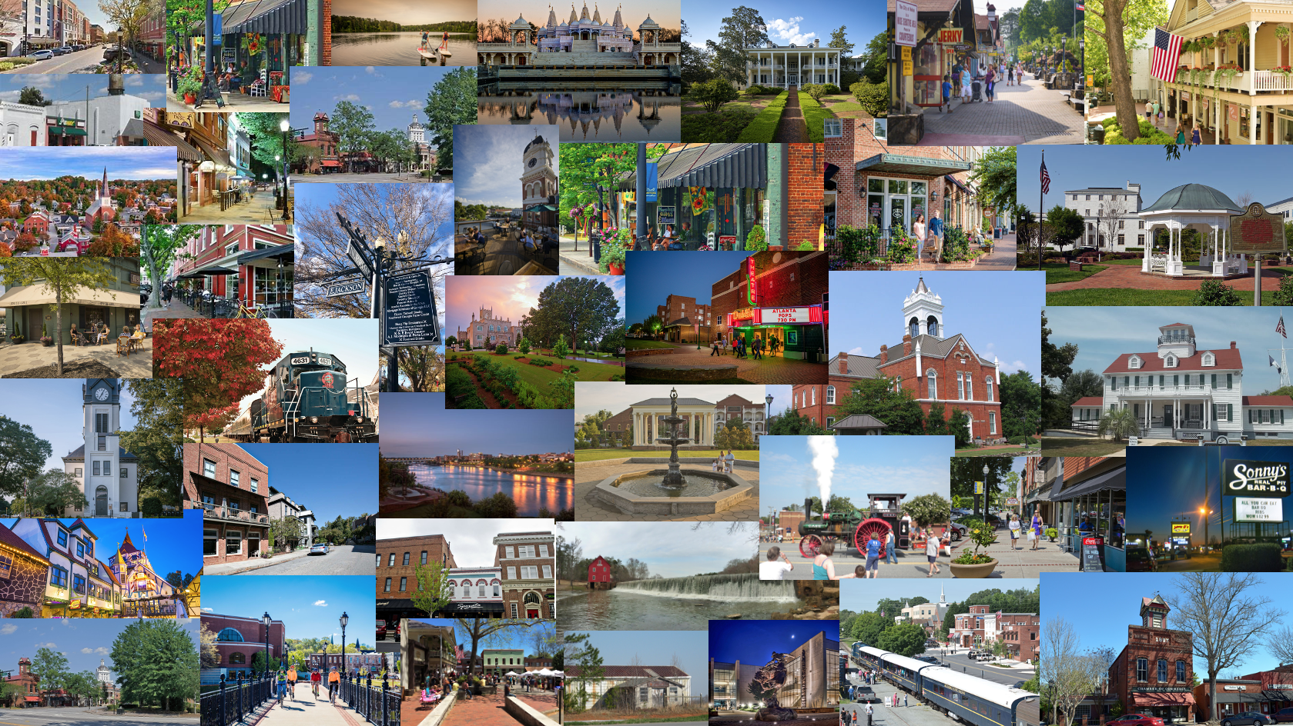
ARPA: Ideas for Cities
GMA Annual Convention
August 9, 2021

Slide 2
Where are we?
$1.4 billion in ARPA Local Fiscal Recovery Funds for Georgia’s cities
23 Metro cities – funding direct from Treasury
515 NEU cities – funding direct from Treasury via OPB portal
ARPA LFRF are now in the bank for most cities

Slide 3
Okay, now what?

Slide 4
Competing needs

Slide 5
What’s the next step?

Slide 7
Things to keep in mind
Treasury’s Interim Final Rules are NOT final
Treasury is continuing to update FAQs
This is NOT CARES CRF – no urgency to spend immediately
Deadline to incur costs = 12/31/2024
Deadline to spend funds = 12/31/2026
Treasury Compliance and Reporting Guidance is NOT final

Slide 9
Things to keep in mind
Rush to spend funds without a plan
Fail to read and understand all Treasury guidance, Award Terms and Conditions, the ARPA statute, the Interim Final Rule, and other requirements
Make premature commitments
Take risks that could require the city to pay back funds

Slide 10
Things to keep in mind
Take your time – wait for final rules
Read the IFR and FAQ
Remember ARPA includes many “pots” of funding, not just LRF
Rely on GMA and partner organizations for training, best management practices, sample policies, etc.
Remember the city is responsible for spending and reporting on ARPA funds, not subrecipients
Work with your county and community to assess needs
Plan, plan, plan

Slide 11
Community Planning
Be visionary, decide what will be meaningful
Include stakeholders at the table
Don't make commitments or finalize spending plans until you fully understand ARPA and guidelines are final
Prepare to document spending
Send GMA your city’s ideas for how to use ARPA funds
Learn from your peers

Slide 12
How can my city use ARPA SLRLF funds?
To respond to the public health emergency with respect to the Coronavirus Disease 2019 (COVID–19) or its negative economic impacts, including assistance to households, small businesses, and nonprofits, or aid to impacted industries such as tourism, travel, and hospitality.
Premium Pay for workers performing essential work during the COVID-19 public health emergency or through providing grants to eligible employers with essential workers.
For the provision of government services on revenue loss due to COVID-19 in most recent full fiscal year.
To make necessary investments in water, sewer, or broadband.

Slide 13
How can my city use ARPA SLRLF funds?
Treasury Compliance and Reporting Guidance lists over 60 eligible uses: https://home.treasury.gov/system/files/136/SLFRF-Compliance-and-Reporting-Guidance.pdf

Slide 14
How can my city use ARPA SLRLF funds?
Public Health
COVID-19 Vaccinations
COVID-19 Testing
COVID-19 Contact Tracing
Prevention in congregate settings (nursing homes, jails, schools)
PPE
Medical Expenses
Capital Investments or Physical Plant Changes to Public Facilities that respond to the COVID-19 Public health emergency
Other COVID-19 public health expenses (communications, enforcement, isolation/ quarantine)
Payroll costs and benefits for public health, safety, and other public sector staff responding to COVID-19
Mental Health Services
Substance Use Services
Other Public Health Services

Slide 15
How can my city use ARPA SLRLF funds?
Negative Economic Impacts
Household assistance: food programs
Household assistance: rent, mortgage, and utility aid
Household assistance: cash transfers
Household Assistance: internet access programs
Household Assistance: eviction prevention
Unemployment benefits or cash assistance to unemployed workers
Job training assistance
Small business economic assistance
Aid to non profit organizations
Aid to tourism, travel, hospitality, other impacted industries
Rehiring public sector staff

Slide 16
How can my city use ARPA SLRLF funds?
Services to Disproportionately Impacted Communities (Services are eligible uses when provided in a Qualified Census Tract)
Education Assistance: early learning
Education Assistance: aid to high-poverty districts
Education Assistance: academic services
Education Assistance: social, emotional, and mental health services
Healthy childhood environments: childcare
Healthy childhood environments: home visiting
Healthy childhood environments: services to foster youth or families in child welfare system
Housing support (affordable housing, services for unhoused persons)
Improvements to neighborhoods
Social determinants of health (community health workers, lead remediation, community violence interventions)

Slide 17
How can my city use ARPA SLRLF funds?
Premium Pay
Essential workers are those in critical infrastructure sectors who regularly perform in-person work, interact with others at work, or physically handle items handled by others
Additional pay of up to $13 per hour
May be used to pay workers retroactively since the start of pandemic
Prioritize premium pay for lower income workers
Private sector grants to other employers

Slide 18
Investments in Water, Sewer & Broadband
Infrastructure
Projects eligible under Clean Water State Revolving Fund (CWSRF) or Drinking Water State Revolving Fund (DWSRF)
Clean water (wastewater treatment, collection, conveyance, combined sewer overflows)
Clean water: Stormwater
Clean water: energy conservation, water conservation, nonpoint source
Drinking water: treatment, transmission & distribution, lead remediation, source; storage
Broadband: “last mile” and other projects
Recipients may use SLFRF award funds to cover costs incurred for eligible projects planned or started prior to March 3, 2021, provided that the project costs covered by the SLFRF award funds were incurred after March 3, 2021.

Slide 19
How can my city use ARPA SLRLF funds?
Reduce court backlogs by:
Implementing safety measures to facilitate court operations
Hiring additional court staff
Additional equipment or expenses to expedite cases
Reduce and respond to increased violence due to pandemic:
Restoring public sector staff to pre-pandemic staffing levels
Community violence intervention programs
Additional enforcement efforts to reduce gun violence
Overtime costs directly related to combatting increased violence
Investing in technology and equipment to efficiently and affectively respond to gun violence

Slide 20
How can my city use ARPA SLRLF funds?
Parks and recreation
Public safety equipment
Grant administration
Assist private residents with home repairs
Food banks
Technology improvements
Cyber security
Partnership with non-profit agency to administer programs
GMA List of Project Ideas
NLC Project Ideas NLC Local Action Tracker - Ideas from Cities Across the US by State

Slide 21
Project Ideas….
• Clean-up of wastewater holding ponds
• Community development (i.e., housing rehabilitation, loan forgiveness, transitional housing, and other programs for underserved areas of the community)
• Mental health training for first responders and creation of a crisis intervention system
• Private/public partnership with internet service provider, county, school system, and healthcare for comprehensive broadband connectivity
• Replacement of asbestos and lead water distribution lines
• Replacement of utility meter system with AMI system for consumption management and cost control
• Replacement of water meters and handheld readers
• Replacement of water pumps at water treatment facility
• Revenue replacement (incl. for projects related to parks, sidewalks, etc.)
• Sewer facility upgrades
• Solid waste disposal related to PPE
• Utility (water and sewer) billing software

Slide 22
Other Sources for Project Ideas
NLC Local Action Tracker - Ideas from Cities Across the US by State
American Institute of Architects: Reopening America: Strategies for Safer Buildings
American Society of Heating, Refrigerating and Air-Conditioning Engineers: Resources to Address COVID-19
Better Block Foundation: Covid-19 Guides
Citizens’ Institute on Rural Design: Community Resources
FEMA: Local Government Solutions Guide for COVID-19 and Beyond: Adaptive Design
Knight Foundation: Adaptive Public Space: Places for People in the Pandemic and Beyond
NACTO: Streets for Pandemic Response & Recovery
Neighborhood Design Center: The Design for Distancing Ideas Guidebook
Strong Towns: The Local Leader's Toolkit: A Strong Towns Response to the Pandemic

Slide 23
How can other ARPA funds be used to address my community’s needs?
IRS Child tax credits: ChildTaxCredit.gov
DCA Rental/ utility assistance: Georgia RAP
DCA Mortgage Assistance
Food Access and Jobs (NLC)
Early childhood: support for vulnerable children and families

Slide 24
How can other ARPA funds be used to address my community’s needs?
FEMA
Disaster Relief Fund: $50 billion
Funeral Assistance: Use of DRF funds authorized for funeral assistance.
Emergency Food and Shelter Program: $400 million
Humanitarian Relief: $110 million
Assistance to Firefighter Grants: $100 million
SAFER Grants: $200 million
Emergency Management Performance Grants: $100 million
Karyn D. Swoopes
External Affairs Specialist | External Affairs | FEMA Region 4
Office: (770) 220-8764 | Mobile: (202) 716-4136
karyn.swoopes@fema.dhs.gov

Slide 25
Georgia SBDC: Help for Small Businesses
First Stop: UGA Small Business Development Center (SBDC)
Expert staff in all 18 offices
Personalized assistance
No cost to business owners for one-on-one assistance
Minimal cost for most training programs
SBDC staff available to meet with city council/ staff/ development authority to discuss local business needs

Slide 26
Georgia SBDC: Help for Small Businesses
Technical assistance
Marketing data
Digital marketing resources
Training (in-person, webinars)
Local lenders (bank and non-bank)
Workforce
Vendors
Finding new customers
Public and private assistance
Relief programs

Slide 27
Georgia SBDC: Help for Small Businesses
https://www.georgiasbdc.org/state-office/
706-542-2762
Headquarters in Athens
UGA operated
All 18 offices have access to experts and services organization-wide
Staff has access to national and state resources

Slide 28
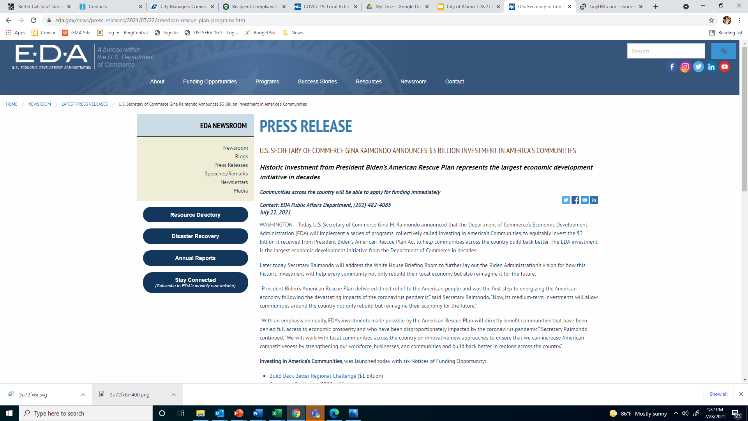
Department of Commerce: EDA

Slide 29
EDA – ARPA Investing in America’s Communities
Investing in America’s Communities includes:
Build Back Better Regional Challenge ($1 billion) will capitalize on American ingenuity and American workers by providing a transformational investment to regions across the country to revitalize their economies.
Good Jobs Challenge ($500 million) is designed to help get Americans back in good-paying jobs. The program will develop and strengthen regional workforce training systems and sector-based partnerships with a focus on programs targeted at women, people of color and historically underserved communities.
Economic Adjustment Assistance ($500 million) grants will help hundreds of communities across the nation plan, build, innovate, and put people back to work through projects tailored to meet local needs.
Indigenous Communities ($100 million) program will work hand-in-hand with Tribal Governments and Indigenous communities to develop and execute economic development projects they need to recover from the pandemic and build economies for the future.
Travel, Tourism and Outdoor Recreation ($750 million) program will focus on revitalizing the hard-hit travel, tourism, and outdoor recreation industries and accelerate the recovery of communities that rely on these sectors.
Statewide Planning, Research and Networks ($90 million) grants include funding for state planning efforts as well as grants to build Communities of Practice to extend technical assistance to support EDA’s work with grantees.
As part of the six programs, EDA is making a Coal Communities Commitment, allocating $300 million to ensure support for these communities as they recover from the pandemic and create new jobs and opportunities, including through the creation or expansion of a new industry sector.
To learn more about EDA and our American Rescue Plan Funding Opportunities sign up for our webinar, EDA 101 and America Rescue Plan Overview, which will be held on July 27 and July 29.
For more information, visit www.eda.gov/ARPA for the latest news on EDA’s implementation plans.

Slide 30
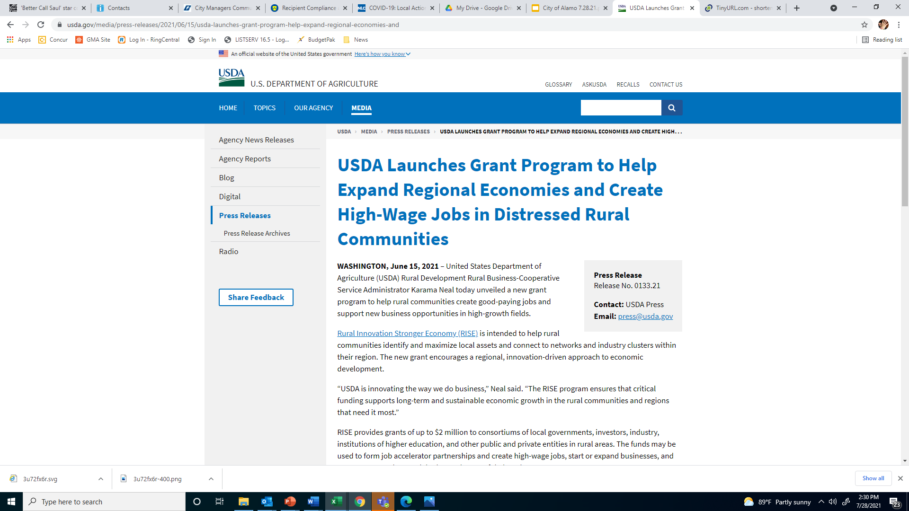
USDA Rural Development

Slide 31
USDA – Rural Innovation Stronger Economy (RISE)
How may funds be used?
Grant amounts are awarded competitively with a minimum of $500,000 and a maximum grant amount of $2,000,000.
RISE grant funds can be used to:
Build or support a business incubator facility
Provide worker training to assist in the creation of new jobs
Train the existing workforce with skills for higher-paying jobs
Develop a base of skilled workers and improve their opportunities to obtain high-wage jobs in new or existing local industries
For more information, https://www.rd.usda.gov/programs-services/business-programs/rural-innovation-stronger-economy-rise-grants.

Slide 32
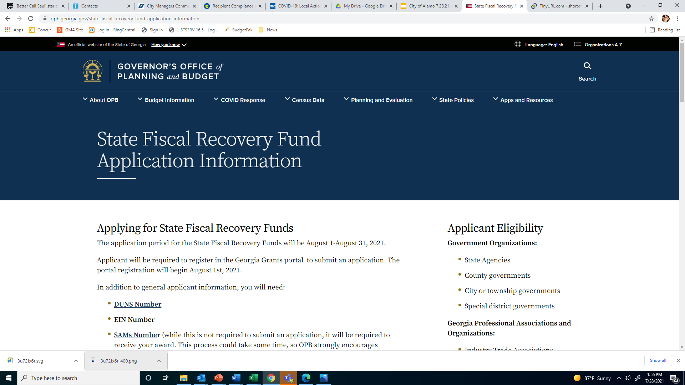

Slide 33
Georgia’s State Fiscal Recovery Funds
Georgia Jobs and Infrastructure Committees
Governor Brian Kemp has named members of the Georgia Jobs and Infrastructure Committees, which will be responsible for receiving applications and making recommendations to the Governor regarding federal coronavirus relief funds allocated to Georgia through the American Rescue Plan. State government entities, units of local government, industries, and nonprofits will be eligible to apply.
Updates regarding the application process and eligibility will be posted on OPB's website at https://opb.georgia.gov/state-fiscal-recovery-fund.
The application period for the State Fiscal Recovery Funds is August 1-August 31, 2021.

Slide 34
Reporting Requirements
Treasury SLFRF Reporting Guidance addresses priority areas for an equitable economic recovery.
Treasury will begin to accept recipients' reports through the Treasury Submission Portal and will issue a User Guide and other reference materials before reporting deadlines.
Metro cities will provide an interim report by August 31, 2021 with expenditures by category.
Metro cities will provide a project and expenditure report by October 31, 2021 and then 30 days after the end of each quarter thereafter.
Metro cities over 250,000 will provide an annual performance report.

Slide 35
NEU Reporting Requirements
Each NEU will also be asked to provide the following information with their first report submitted by October 31, 2021:
Copy of the signed award terms and conditions agreement (which was signed and submitted to the State as part of the request for funding)
Copy of the signed assurances of compliance with Title VI of the Civil Rights Act of 1964 (which was signed and submitted to the State as part of the request for funding)
Copy of actual budget documents validating the top-line budget total provided to the State as part of the request for funding

Slide 36
REPORTING GUIDANCE
Uniform Administrative Requirement
• Generally subject to Uniform Administrative Requirements, Cost Principles, and Audit Requirements (Uniform Guidance)
• Implement robust internal controls and effective monitoring to ensure compliance
Administrative Costs
• Supporting effective management and oversight
• Ensuring compliance with legal, regulatory, and other requirements
• Including cost of consultants
Cash Management
• SLFRF can be placed in interest-bearing accounts
• Interest does not need remitted to Treasury
• Interest is not subject to SLFRF eligible uses

Slide 37
ARPA Reporting Resources and Updates
Check Treasury website for links to webinars with details on reporting requirements
NLC Webinar June 24 on Treasury Reporting Requirements (with slides)
CVIOG ARPA Webinars

Slide 38
What's Next? Infrastructure!
Congress is working on bipartisan infrastructure legislation
Bipartisan Infrastructure Framework
$579 billion in new spending; $1.2 trillion over 8 years for transportation, clean water, broadband, clean power, infrastructure financing authority
GMA has worked with Congress and White House to ask for infrastructure funds for Georgia’s cities

Slide 39
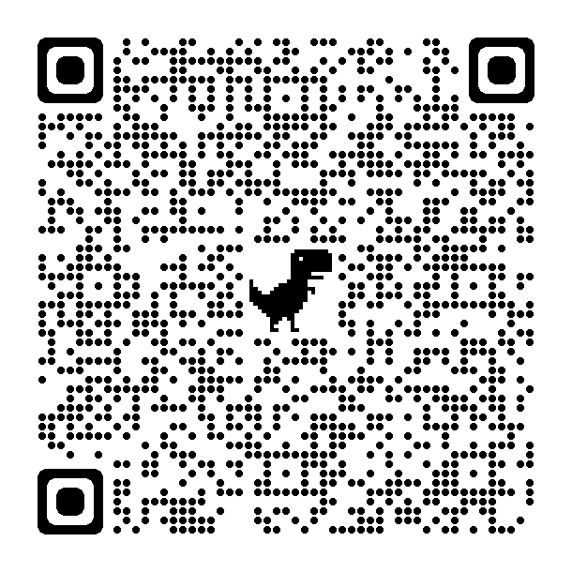
Questions?
Becky Taylor
404-402-6110
btaylor@gacities.com

