Slide 1
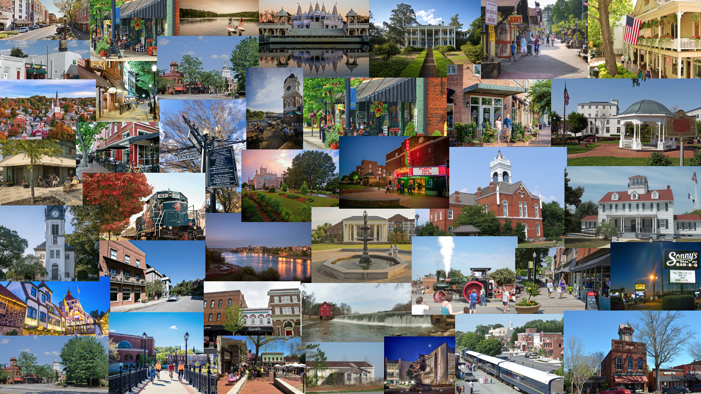

The American Rescue Plan Act
May 19, 2021

Slide 2
American Rescue Plan Act - Overview
Urgent Funding to Stabilize Government Operations, Households, and Small Businesses
ARPA became law on March 11th, 2021 (P.L. 117-2)
For the first time, all 19,000 municipal governments are entitled to a direct, non-competitive federal formula grant from the U.S. Treasury Department.
Direct funding means:
  All cities, towns, and villages are entitled to a federal grant from the new Coronavirus Local Fiscal Recovery Fund.
  Aid obligated to municipalities is not in any way mingled with aid obligated to state or county governments.

Slide 3
American Rescue Plan Act – Georgia State and Local
Georgia State and Local COVID Relief – American Rescue Plan Act
Cities over 50,000 pop | $ 551,779,893
Cities below 50,000 pop | $ 856,598,577
Total for counties | $ 2,071,268,896
Total all cities | $ 1,408,378,471
Total local govt. Georgia | $ 3,479,647,366

Slide 4
American Rescue Plan Act - Overview
Final allocations for Metropolitan cities (populations over 50k) have been released and they can begin requesting funds.
Guidance for Non-Entitlement Units of Local Government (populations below 50K), including allocations and receiving instructions, is expected to be released in the coming days.
Framework for Interim Rule is divided into three categories:
  non-exclusive lists of allowable expenditures
  encouraged expenditures
  prohibited expenditures.

Slide 5
ARPA Fiscal Recovery Funds Guidance Highlights
U.S. Department of Treasury has released:
  Guidance/Interim Final Rule
  Frequently Asked Questions (FAQ)
  Allocations for Metropolitan cities (over 50,000 pop. And 14 MSA cities)
  Opened the Portal for Metropolitan cities (over 50k pop and 14 MSA cities) to apply for funding
All information and updates can be found on the Treasury ARPA site.
Many of the points that GMA and NLC advocated for were adopted in the Interim Final Rule.

Slide 6
ARPA Fiscal Recovery Funds Guidance Highlights
Framework of Interim Rule
  Non-exclusive lists of allowable expenditures
    Categories include intervention for Qualified Census Tracts, public health, direct aid, community & economic development, infrastructure
  Encouraged Expenditures
    Categories include addressing racial disparities, inequities, disproportionate harm
  Prohibited Expenditures
    Categories include pension funds, legal settlements, federal match requirements

Slide 7
ARPA Fiscal Recovery Funds Guidance Highlights
Framework to Assess Eligibility for Projects and Services
  Identify the harmful effect of COVID-19 the activity will address
  Assess the causal or compounding connection
  Assess for disproportionate impact on distressed sectors or populations
  Determine how to prove the expense produces the expected outcome

Slide 8
ARPA Fiscal Recovery Funds Guidance Highlights
Key Dates to Remember
January 27, 2020: effective date of “public health emergency”
March 3, 2021: “covered period” referenced in eligible uses
July 16, 2021: comment period closing date for Interim Final Rule
December 31, 2024: date by which Fiscal Recovery Funds must be incurred/obligated
December 31, 2026: “period of performance” end date – deadline to complete projects funded by Fiscal Recovery Funds

Slide 9
Receiving Funds: General Information for Cities
Metropolitan cities includes all cities with populations over 50,000, including cities that relinquish or defer their status as entitlement cities for CDBG. Cities under 50,000 that qualify and accept annual CDBG grants also appear on the Metro list (14 MSA cities in GA). In Georgia, there are 23 cities in the Metropolitan category that will obtain funds directly from Treasury.
Non-entitlement Units of Local Governments (NEUs) are the remaining municipalities (generally all cities under 50,000 in Georgia). Most Georgia cities are in the NEU category.
The funds will go out in two tranches. 50% provided beginning in May 2021 and the balance delivered approximately 12 months later.
Metropolitan cities may begin applying for the funds through Treasury’s online portal. Metropolitan cities will receive their second round of funds 12 months after they receive their first funds.
NEUs will receive their money from their respective states within 30 days of the states receiving the money. NEUs will receive their second payment 12 months after receiving their first payment.

Slide 10
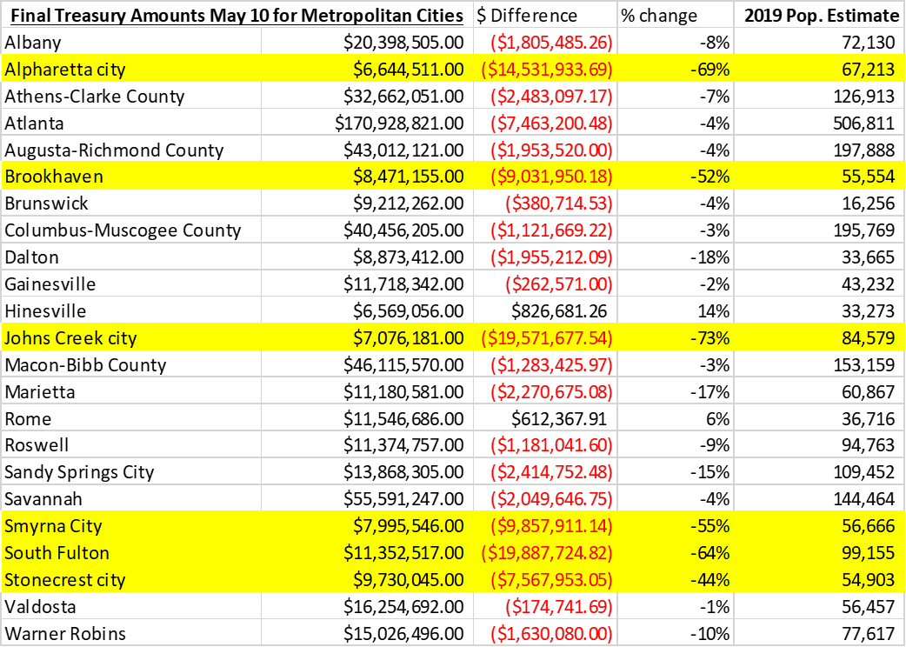
Georgia Metropolitan Cities Allocations
6 GA cities allocations are significantly lower than estimates
GMA and NLC are working with Treasury to get transparency and clarification to explain the final numbers
NEU cities allocation will also be less than estimates (TBD)
“distributions to NEUs may not exceed 75 percent of the NEU’s most recent budget. The most recent budget is defined as the NEU’s most recent annual total operating budget, including its general fund and other funds, as of January 27, 2020”

Slide 11
Receiving Funds: Metro Cities
To complete a submission on behalf of your jurisdiction, you will be asked to provide the following information:
Jurisdiction name, taxpayer ID number, DUNS Number, and address
Authorized representative name, title, and email
Contact person name, title, phone, and email
Funds transfer information, including recipient's financial institution, address, phone, and routing number and account number
Completed certification document (to be signed by the authorized representative)

Slide 12
Receiving Funds: Metro Cities
Jurisdictions must submit a request to receive funding even if they have previously applied for other programs through the Treasury Submission Portal.
Eligible jurisdictions will receive further communications regarding the status of their submission via the email address provided in the Treasury Submission Portal.

Slide 13
Receiving Funds: NEU’s
Treasury is expected to release guidance and allocations for NEUs in the coming days
Under the Interim Final Rule, the total allocation and distribution to an NEU, including the sum of both the first and second tranches of funding, cannot exceed the 75% budget cap
  NEUs may not receive more than 75% of the most recent budget for the NEU as of January 27, 2020.
NEUs will receive grants as a pass through from their State governments
  States cannot further restrict the use of funds beyond the Treasury’s guidance
NEUs will need a valid DUNS number, banking information, and representative contact information
  DUNS number - https://fedgov.dnb.com/webform/ or call 1-866-705-5711 to begin the registration process

Slide 14
Georgia NEUs: Office of Planning and Budget
Jurisdictions under 50,000 populations should have received an email from OPB with instructions to get your city prepared for the forthcoming process to draw funds.
Complete Sections 2-5 on the vendor management form and attach your city’s W-9
The DUNS number does not need to be sent to OPB at this time but will be required on the application in the next steps of the process.
If your city does not have a DUNS, please get started ASAP as this can take weeks.
OPB would like to get information from all NEUs this week.

Slide 15
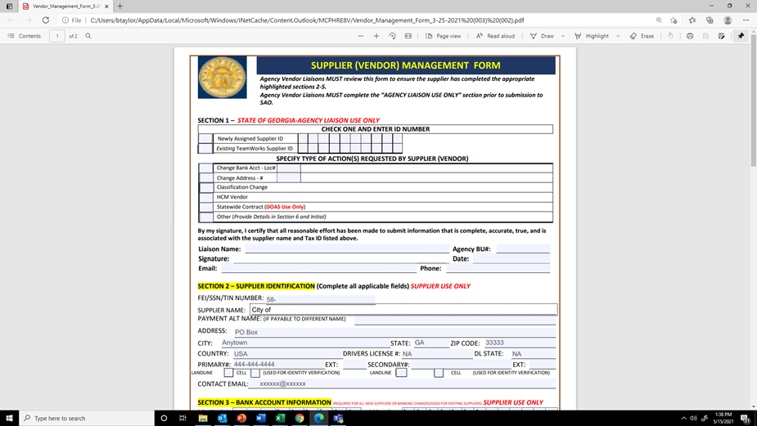
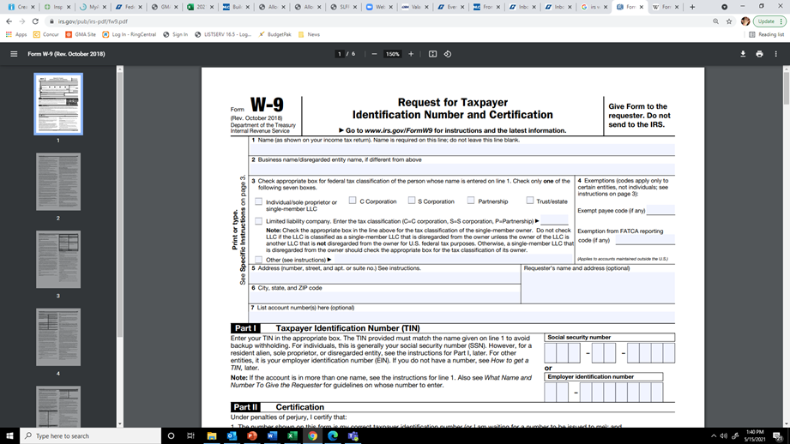
ARPA – NEUs: OPB Info to Submit

Slide 16
Eligible Uses
To respond to the public health emergency with respect to the Coronavirus Disease 2019 (COVID–19) or its negative economic impacts, including assistance to households, small businesses, and nonprofits, or aid to impacted industries such as tourism, travel, and hospitality;
  No more restrictive than the CARES Act Coronavirus Relief Fund
To respond to workers performing essential work during the COVID–19 public health emergency by providing premium pay to eligible workers of the metropolitan city, nonentitlement unit of local government, or county that are performing such essential work, or by providing grants to eligible employers that have eligible workers who perform essential work;
  Allows a municipality to provide up to $13 per hour above regular wages. (NOTE: THE COVERED PERIOD BEGINS March 3, 2021)
For the provision of government services to the extent of the reduction in revenue of such metropolitan city, nonentitlement unit of local government, or county due to the COVID–19 public health emergency relative to revenues collected in the most recent full fiscal year of the metropolitan city, nonentitlement unit of local government, or county prior to the emergency; or
  Allows revenue replacement. The base year to measure lost revenue against is not the most recent full fiscal year, but the most recent full fiscal year prior to the emergency.
To make necessary investments in water, sewer, or broadband infrastructure.
  Treasury will provide additional guidance

Slide 17
Eligible Uses: COVID-19 Pandemic Response
To respond to the public health emergency with respect to the Coronavirus Disease 2019 (COVID–19) or its negative economic impacts, including assistance to households, small businesses, and nonprofits, or aid to impacted industries such as tourism, travel, and hospitality.
  COVID-19 Mitigation and Prevention
  Medical Expenses
  Behavioral Health Care Including Addiction Treatment
  Public Health and Public Safety Employees
  Data, Design, and Execution of Health Programs
  Health Disparities
  Survivors Benefits

Slide 18
Eligible Uses: COVID-19 Pandemic Response
Presumption of Eligibility inside Qualified Census Tracts (QCT)
  Direct cash and loan interventions
  Assistance to business and non-profits
  Impacted industries and workers
  Housing and Community Development
  Homelessness
  Childcare and Education
Treasury’s Interim Final Rule (beginning p. 18) and the FAQ provide some types of activities: https://home.treasury.gov/system/files/136/SLFRPFAQ.pdf.

Slide 19
Eligible Uses: Workforce/Personnel
Fiscal Recovery Funds payments may be used by recipients to provide premium pay to eligible workers performing essential work during the COVID-19 public health emergency or to provide grants to third-party employers with eligible workers performing essential work.
The Interim Final Rule defines "essential work" as work involving regular in-person interactions or regular physical handling of items that were also handled by others.
Such workers include:
  Staff at nursing homes, hospitals, and home care settings
  Workers at farms, food production facilities, grocery stores, and restaurants
  Janitors and sanitation workers
  Truck drivers, transit staff, and warehouse workers
  Public health and safety staff
  Childcare workers, educators, and other school staff
  Social service and human services staff

Slide 20
Eligible Uses: Workforce/ Personnel
Note: While the Interim Final Rule (p.99) primarily permits funds to be used to cover costs incurred during the “covered period” [beginning on March 3, 2021], it should be noted that p.50-51 of the Interim Final Rule states that,
“The definition of premium pay also clarifies that premium pay may be provided retrospectively for work performed at any time since the start of the COVID-19 public health emergency, [January 27, 2020] where those workers have yet to be compensated adequately for work previously performed. Treasury encourages recipients to prioritize providing retrospective premium pay where possible, recognizing that many essential workers have not yet received additional compensation for work conducted over the course of many months. Essential workers who have already earned premium pay for essential work performed during the COVID-19 public health emergency remain eligible for additional payments, and an essential worker may receive both retrospective premium pay for prior work as well as prospective premium pay for current or ongoing work.”

Slide 21
Eligible Uses: Necessary Water, Sewer Projects
Coronavirus State and Local Fiscal Recovery Funds – “necessary investments in water, sewer, or broadband infrastructure.”
Projects eligible under the Clean Water State Revolving Fund
  Construct, improve, and repair wastewater treatment plants; control non-point sources of pollution; create green infrastructure; manage and treat stormwater; water reuse; protect waterbodies from pollution.
Projects eligible under the Drinking Water State Revolving Fund
  Build or upgrade facilities to improve water quality; transmission, distribution, and storage systems; consolidation or establishment of drinking water systems
Cybersecurity
Climate Change and Resilience
Lead Service Line Replacement

Slide 22
Eligible Uses: Necessary Water, Sewer Projects
FAQ#32. May construction on eligible water, sewer, or broadband infrastructure projects continue past December 31, 2024, assuming funds have been obligated prior to that date?
Yes. Treasury is interpreting the requirement that costs be incurred by December 31, 2024 to only require that recipients have obligated the funds by such date. The period of performance will run until December 31, 2026, which will provide recipients a reasonable amount of time to complete projects funded with Fiscal Recovery Funds.

Slide 23
Eligible Uses: Broadband
Eligible projects must:
"be designed to provide service...to unserved and underserved households and businesses.“
  Unserved and underserved = lacking access at least 25/3 Mbps wireline service
Specific service areas and locations may be defined by community
Provide service that "reliably meets or exceeds symmetrical speeds of 100 Mbps" (megabits per second) or, if impossible, at least 100/20 Mbps with the ability to scale to 100 Mbps symmetrical
Eligible projects are encouraged to:
consider affordability
avoid investing in locations with "existing agreements to build reliable wireline service with minimum speeds of 100/20 Mbps by December 21, 2024“
"deliver a physical broadband connection by prioritizing projects that achieve last mile connections“
prioritize municipal, nonprofit, and cooperative-owned networks
Digital inclusion: assistance to households, including internet access and digital literacy assistance, are eligible uses

Slide 24
Eligible Uses: Lost Revenue – Steps to Follow
“COVID-19 public health emergency” means the period beginning on January 27, 2020
Page 58 of Interim Final Rule details steps for lost revenue calculation:
  Recipients should calculate the extent of the reduction in revenue as of four points in time: December 31, 2020; December 31, 2021; December 31, 2022; and December 31, 2023.
  To calculate the extent of the reduction in revenue at each of these dates, recipients should follow a four-step process:
    Step 1: Identify revenues collected in the most recent full fiscal year prior to the public health emergency (i.e., last full fiscal year before January 27, 2020), called the base year revenue.
    Step 2: Estimate counterfactual revenue, which is equal to base year revenue * [(1 + growth adjustment) ^( n/12)], where n is the number of months elapsed since the end of the base year to the calculation date, and growth adjustment is the greater of 4.1 percent and the recipient’s average annual revenue growth in the three full fiscal years prior to the COVID-19 public health emergency.
    Step 3: Identify actual revenue, which equals revenues collected over the past twelve months as of the calculation date.
    Step 4: The extent of the reduction in revenue is equal to counterfactual revenue less actual revenue. If actual revenue exceeds counterfactual revenue, the extent of the reduction in revenue is set to zero for that calculation date

Slide 25
Eligible Uses: Lost Revenue
For the provision of government services to the extent of the reduction in revenue of such metropolitan city, nonentitlement unit of local government, or county due to the COVID–19 public health emergency relative to revenues collected in the most recent full fiscal year of the metropolitan city, nonentitlement unit of local government, or county prior to the emergency (January 27, 2020)
General Revenue draws on the Census definition of General Revenue of Own Sources.
Recipients should sum across all revenue streams covered as general revenue
What is excluded from General Revenue:
    refunds and other correcting transactions
    proceeds from issuance of debt or the sale of investments
    agency or private trust transactions
    utilities and insurance trusts
NLC is working with Treasury to add utilities and get more flexibility to reflect local revenues.

Slide 26
Eligible Uses: Lost Revenue (NLC Example)
City X has $100 in revenue in the base year, the last full year before Jan. 27, 2020.
City X finds that 4.1 percent is greater than City X's average annual revenue growth in the three full fiscal years prior to the public health emergency.
The base year ends June 30, 2019
City X has 18 months from the end of its base year (June 2019) to December 31, 2020, and its projected revenue would have been $106.2.
      100*[(1+.041)^(18/12)]
City X had $80 of actual revenue in 2020
The revenue loss for 2020 is $106.2-$80=$26.2
If actuals collected exceeds calculated projected, then no revenue loss for that year

Slide 27
Ineligible Uses
Federal Matching Requirements
Pensions
Infrastructure Not Directly Addressed in ARPA
Rainy Day Funds, Financial Reserves, and Outstanding Debt

Slide 28
Reporting Requirements
Metropolitan cities must submit an interim report and quarterly
Project and Expenditure reports thereafter.
Metropolitan cities with a population in excess of 250,000 will also be required to submit an annual Recovery Performance Plan to Treasury.
NEUs are not required to submit interim reports or Recovery Performance Reports.
However, NEUs will be required to submit annual Project and Expenditure reports.

Slide 29
Reporting Requirements
FAQ #44. What records must be kept by governments receiving funds?
Financial records and supporting documents related to the award must be retained for a period of five years after all funds have been expended or returned to Treasury, whichever is later. This includes those which demonstrate the award funds were used for eligible purposes in accordance with the ARPA, Treasury’s regulations implementing those sections, and Treasury’s guidance on eligible uses of funds.

Slide 30
Reporting Requirements
Local governments bear the responsibility for deciding if projects fall under eligible categories
Additional reporting requirements are under consideration and will be released soon. Treasury is inviting comments on all aspects of the reporting and recordkeeping requirements and comments will be accepted until July 10, 2021.

Slide 31
Coronavirus State and Local Recovery Fund
Treasury will provide technical assistance to mitigate administration burden
For general questions about the Coronavirus State and Local Fiscal Recovery Funds, email SLFRP@treasury.gov

Slide 32
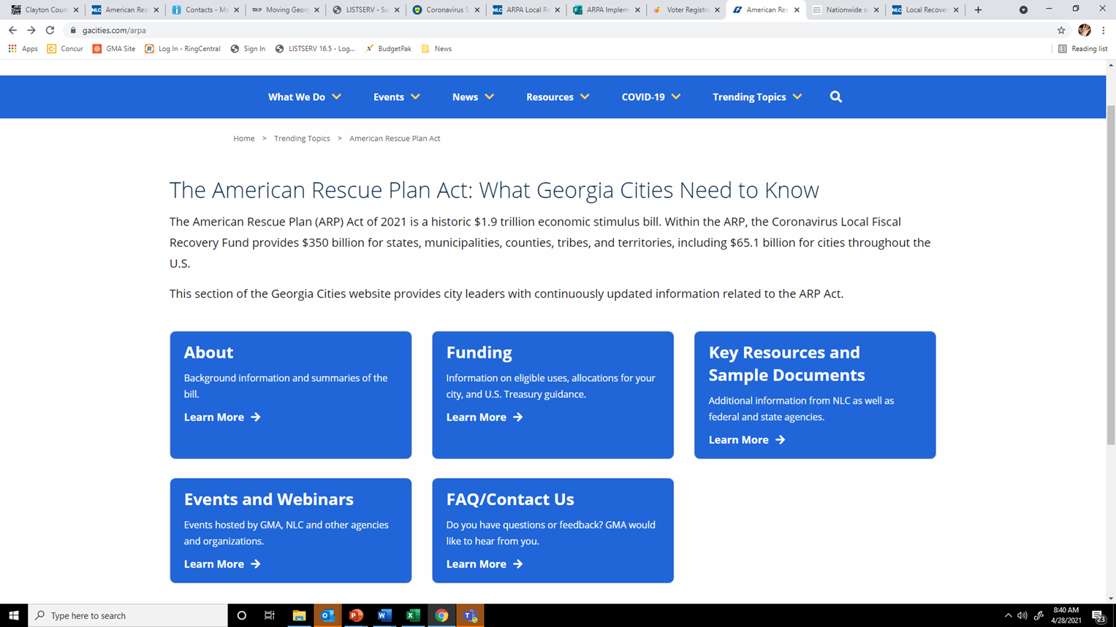
GMA ARP Web Page: www.gacities.com/arpa

Slide 33
Local Fiscal Recovery Funds: Just one part of ARPA!
As you plan how to use ARPA funds, remember this $1.9 trillion legislation includes many pots of funds
Look for ARPA funds in existing grant programs
For example: DCA received $1 billion in federal assistance for landlords and utility customers (visit georgiarentalassistance.ga.gov call 833-827-RENT or email grafinanceservices@dca.ga.gov.)
Consider using these other pots of funds to pay for community needs for residents and businesses before using your city’s Local Fiscal Recovery Funds

Slide 34
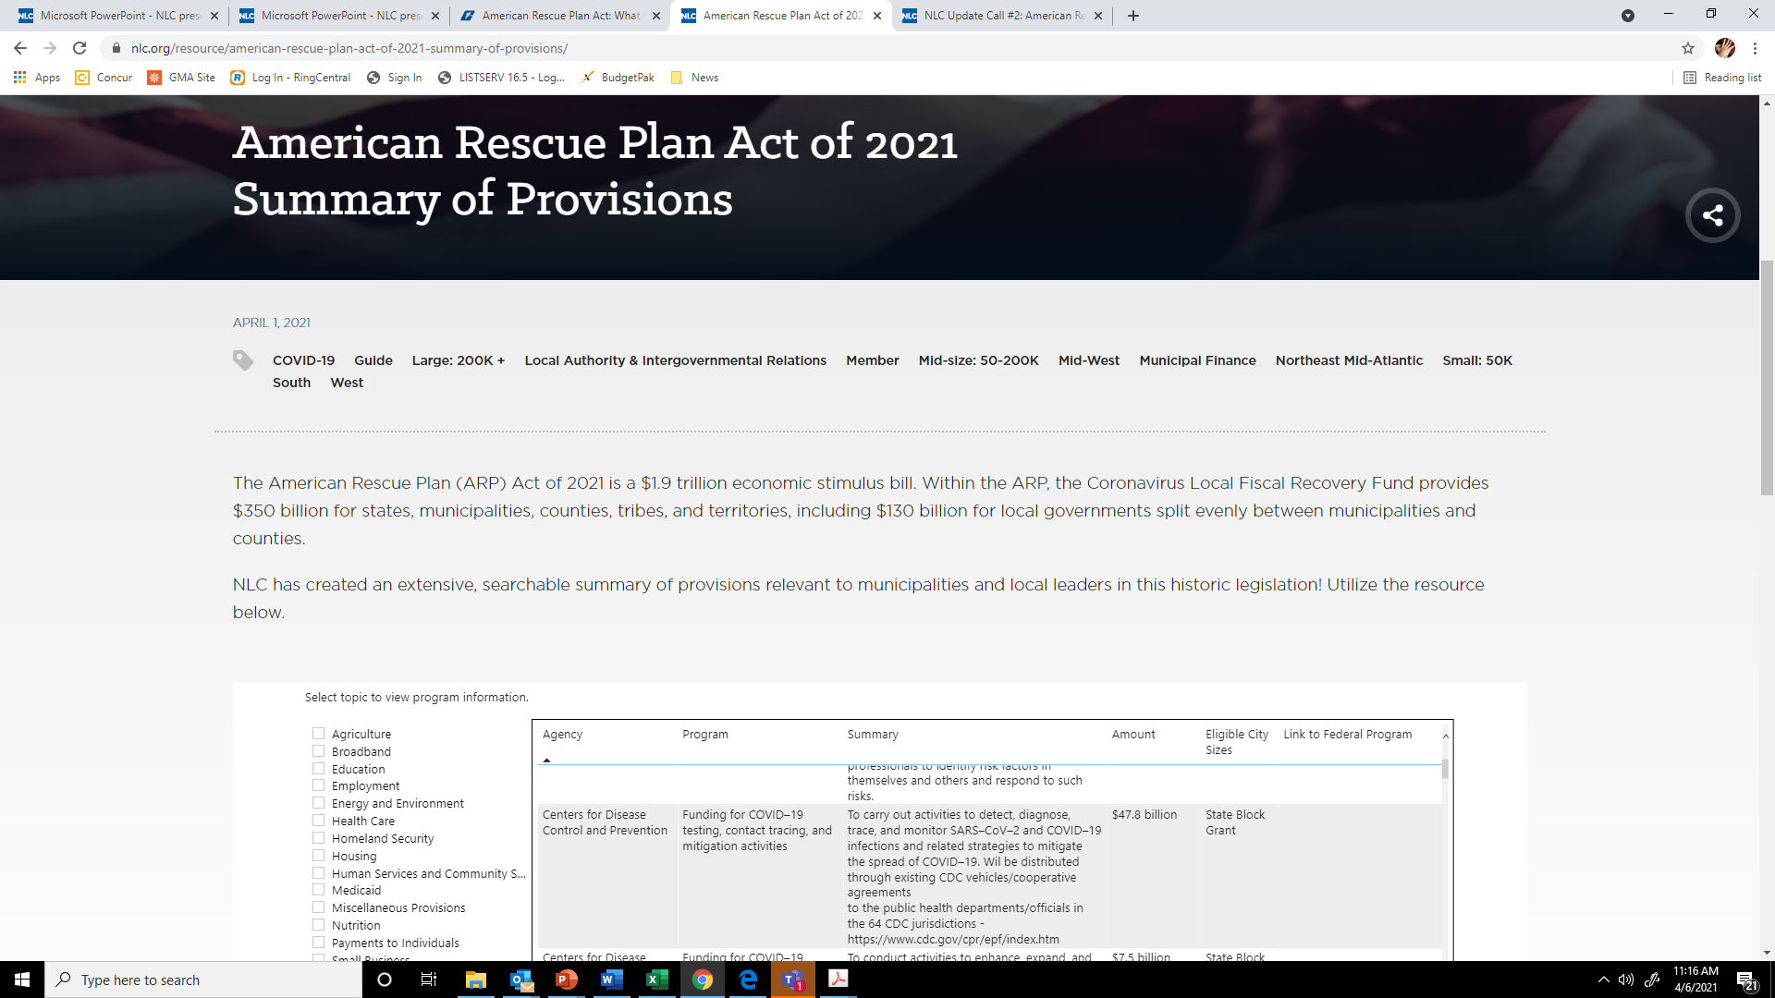
ARPA –Local Fiscal Recovery Funds FAQ

Slide 35
What’s next?
Stay in touch with GMA, ACCG, NLC, NACO - we are at the beginning of this journey and working closely with Treasury staff to update guidance to clarify definitions, simplify processes, and respond to all questions.
Immediate fixes needed: definition of broadband service; public utilities in calculations of lost revenue (Treasury is open to making suggested changes)
Open comment period on Interim Final Rule until July 16 before Final Rule is issued
Send questions and comments to GMA staff
NLC Fact Sheets on Unpacking Interim Final Rule *COMING SOON*
Treasury is planning a call with city officials this week
Another Treasury call following NEU guidance release
GMA Training Webinar 5/26 at 4:00 pm: www.gacities.com/arpa

Slide 36
ARPA Resources and Updates
GMA Resources: https://www.gacities.com/arpa
NLC Resource Hub: https://www.nlc.org/covid-19-pandemic-response/#arp
  ARP Summary of Provisions: NLC has created an extensive, searchable summary of provisions relevant to municipalities and local leaders in this historic legislation. You can find the link here.
  Local Recovery: Five Principles for ARP Implementation: NLC staff has written a blog on five principles for ARP implementation. You can access it here.
  NLC FAQ: https://www.nlc.org/resource/arp-local-relief-frequently-asked-questions/
  Weekly NLC Calls: Fridays at 1:30 pm. Archives and registration here.
U.S. Treasury Coronavirus State and Local Fiscal Recovery Fund Page is here.

Slide 37
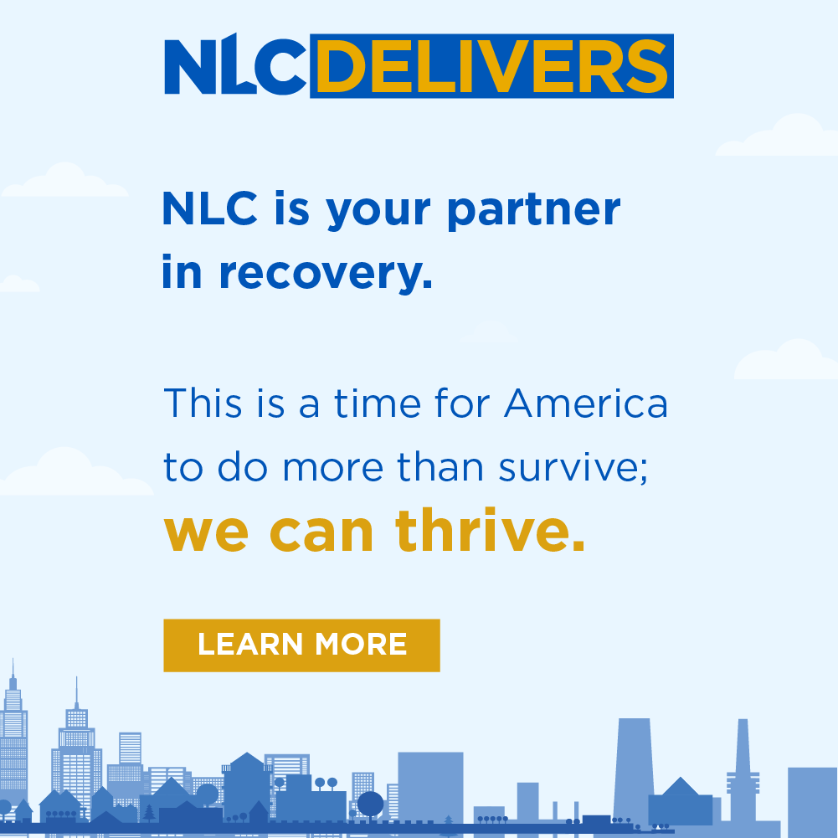
NLC Membership
ARPA would not have been possible without cities working united around the country in partnership with NLC. NLC was directly responsible for helping to pass this legislation - they have the experts, resources, and relationships with Administration, Congressional, and agency leadership and staff to help all cities succeed.
GMA is proud to partner with NLC to help deliver needed funding through the #AmericanRescuePlan.
Learn more about how NLC is continuing to deliver resources for local leaders at https://bit.ly/3gAoyi2 #NLCDelivers .

Slide 38



Questions?
Becky Taylor
404-402-6110
btaylor@gacities.com

