Slide 1


Georgia Department of Behavioral Health & Developmental Disabilities
Commissioner Kevin Tanner
February 13, 2024
Notes:
Intro and background
Introduction – how did you get here?

Slide 2
BE DBHDD
$1.5 Billion agency serving as Georgia’s leader in prevention and behavioral crisis response and Georgia’s safety net provider of mental healthcare, substance use treatment and disability support.

Slide 3
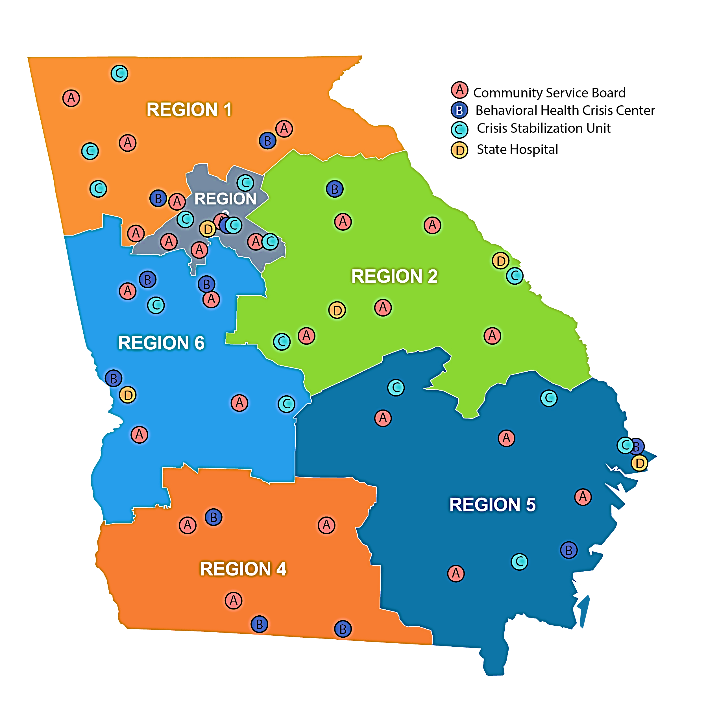
DBHDD: The Provider Network
4500 Staff
274 Behavioral Health Providers
581 Intellectual and Developmental Disability Providers
22 Community Service Boards
5 State Hospitals
641 Forensic Beds
298 Adult Mental Health Beds
Crisis Stabilization Units
Adults: 13 Behavioral Health Crisis Centers
9 Crisis Stabilization Units
Children: 4 Crisis Stabilization Units
Autism: 1 Crisis Stabilization Unit
Notes:
How do we accomplish this Mission? - Provider Network (Who we serve)
DBHDD operates five state hospitals and provides community-based services across the state through contracted providers. The department serves people living with mental health challenges, substance use disorders, intellectual and developmental disabilities, or any combination of these. As Georgia’s public safety net, our primary responsibility is to serve people who are uninsured. We also serve individuals on Medicaid and others with few resources or options.
Over 4,500 state employees
855 providers in BH and DD
274 BH providers
581 DD providers
13 BHCCs, 9 CSUs
Agency background
Why is this work important to you?
What is your mission and vision for the agency?
(Give example of family member that has mental illness)

Slide 4


Right now, in Georgia, anyone experiencing a suicidal crisis or emotional distress should
call GCAL at 1-800-715-4225 or download the My GCAL app,
available on both iOS and Android devices, to access GCAL via text and chat.
GCAL is available 24 hours a day, 7 days a week.
DRAFT
WHAT IS
988?
988 is a direct, national three-digit line that will connect individuals with suicide prevention and mental health crisis resources.
988 calls in Georgia ARE being answered by the Georgia Crisis and Access Line (GCAL), 24 hours a day, 7 days a week, 365 days a year.
Some of 988’s key features include:
Connect a person with immediate and ongoing resources
Promote cost efficiency
Reduce burden on safety resources
Help end stigma of seeking care
Notes:
A direct, national three-digit line, 9-8-8, will open the door for millions of Americans to seek the help they need, while sending the message to the country that healing, hope and help are happening every day. In Georgia, the 9-8-8 calls will be answered by the Georgia Crisis and Access Line (GCAL), 24 hours a day, 7 days a week, 365 days a year.
Some of 9-8-8’s key features include:
Connecting a person in a behavioral health crisis to someone who can address their immediate needs and help connect them to ongoing care
Promote cost efficiency by providing the most appropriate response
Reducing burden on law enforcement, public health and other safety resources when not appropriate
Helping end stigma of seeking or accessing behavioral healthcare

Slide 5

Notes:
I want to tell you about this today, because only 16% of Georgians are aware of 988… You can change someone’s life by dialing 988.

Slide 6
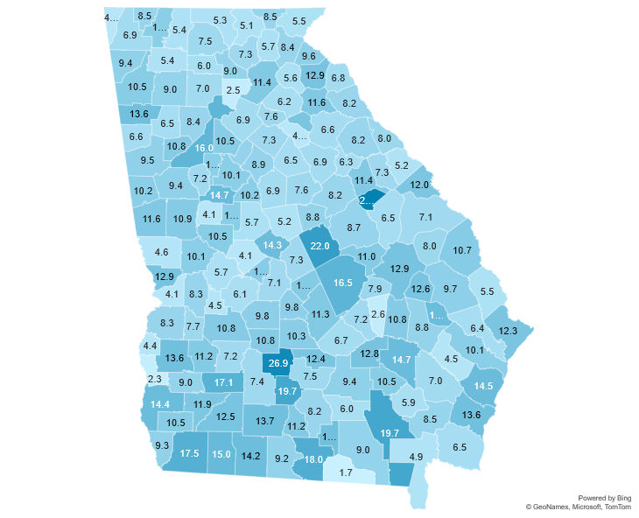
Crisis Episodes by Prevalence
Call volume 14% lower in June-August 2023 compared with same time period in 2022.
Rural south Georgians are reaching out for help at higher rates than urban areas.
  The suicide death rate in rural Georgia counties increased by 7% between 2017 and 2021.
  Suicide death rates in rural areas of Georgia are 26% higher than in suburban/urban areas.
June – August 2023

Slide 7
Crisis Episodes by Age
Notes: Crisis episodes with “unknown” demographic information include episodes where the caller chose not to provide the information and episodes where the information was not gathered due to the acuity of the call.
June – August 2023
Preliminary data | Source: Behavioral Health Link

Slide 8
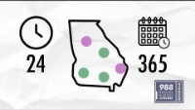

Slide 9
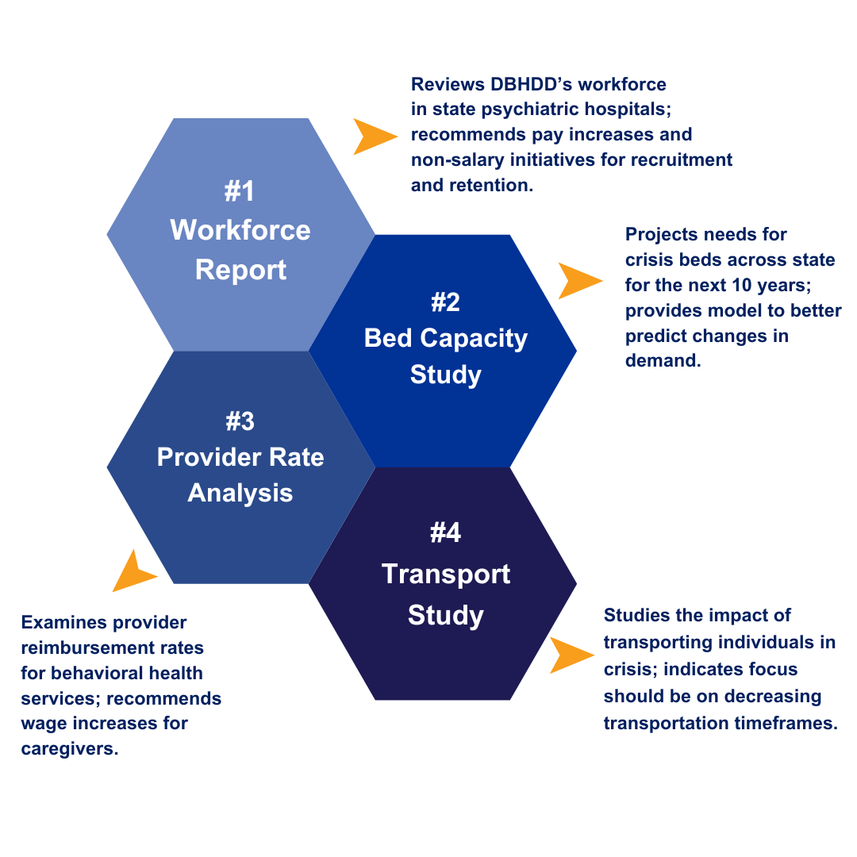
Data-Driven Decision-Making: Shaping Our Department's Priorities
Notes:
DBHDD recently completed three studies to create a roadmap for how to further improve our behavioral health care delivery system.
#1: Workforce: Examines how to address workforce shortages, recruitment and retention at our five state hospitals
#2: Provider Rates: Long overdue analysis on how our state pays providers using Medicaid funds
#3: Bed Capacity: Projects our crisis bed needs for next 10 years.
#4: Transport Study: Studies impact of transporting individuals experiencing a crisis to an Emergency Receiving Facility.

Slide 10
#1: Workforce Innovations Report
Recruitment Hurdles: Recruiting state hospital staff in rural areas is challenging, with long recruitment times and increased market competition.
Retention Concerns: 29% of employees eligible for early retirement within 5 years.
Compensation Gap: On average, DBHDD salaries are 19% below national market median data.
On average, the DBHDD minimums for Psychiatrists, Forensic Psychiatrists and Physicians (Board Certified and Eligible) are 24% below market median salaries.
Notes:
Give an overview on why this report was commissioned by the Department.
The challenges faced by DBHDD, along with below-market compensation, present an imminent threat to retaining its existing workforce and ensuring the sustainability of the future workforce.
Provide examples of successes and challenges you've seen first hand in recent Governing body meetings
In May of 2023, the Rural Health Information Hub (supported by the U.S. Department of Health and Human Services) identified 151 of the state’s 159 counties as suffering a county-wide mental health professional shortage.
The challenges faced by DBHDD, along with below-market compensation, present an imminent threat to retaining its existing workforce and ensuring the sustainability of the future workforce.
Discuss your recent visits with the Governing Body.
What are some successes you've seen and what are existing challenges.

Slide 11
#2 Provider Rates for NOW/COMP Waiver Programs
Impact
On average, rate study recommendations would result in a 40 percent increase in provider revenue, if enacted.
Rate models assume an average direct service professional (DSP) wage which is inclusive of the following:
  Increase of $12 to $16.70 for DSPs per hour PLUS comprehensive benefits
  Appendix K extension
Notes:
Speak to potential impact of rate study on provider network
Comprehensive benefits (not detailed on slide)
25 days paid leave
Access to health insurance
On average, rate study recommendations would result in a 40 percent increase in provider revenue, if enacted.
Appendix K extension
Pending DCH and CMS approval, DBHDD and DCH propose to amend the NOW and COMP waivers effective November 10, 2023 when the current public health emergency expires.
The Amendment will sustain targeted rates within the waivers determined previously through the Appendix K which ends (sunsets) November 11, 2023.
This Appendix K-level rate extension will be initially funded through ARPA.
Following full expenditure of ARPA funding, the state match for this rate extension is being requested (which is generally appropriated to DBHDD).
This Appendix K-level rate extension is our first post-PHE measure in stabilizing the intellectual/developmental disabilities workforce and provider network.
We anticipate that this amendment, along with the rate studies that will be under consideration by the General Assembly, will further stabilize the workforce and the NOW/COMP benefits provided by those crucial staff.

Slide 12
#2: Provider Rates for Behavioral Health
Position | 2008 Salary | Future Salary (if funded)
Psychiatrists/Physicians | $160,605 | $237,012
Advanced Practice Registered Nurses, PhD. Psychologists | $69,165 | $135,184
Licensed Clinical Social Worker, Registered Nurse, Licensed Professional Counselor, etc. | $48,827 | $76,945
Licensed Master Social Worker, Bachelor’s Level Certified Staff, etc. | $36,025 | $53,518
Non-Bachelor’s Level Certified Staff, Paraprofessionals | $26,850 | $43,040
Notes:
Describe your idea for DeKalb County
BH Rate
Some health techs (including Certified Peer Specialists) may see a wage increase of as much as 40%
this is crucial as these tech level positions can easily find jobs in non-healthcare settings making significantly more than they are currently paid.
Nurses, one of the practitioner types in highest demand due to the pull from other health care systems who pay at market rates, may see wage increases around 35%
Suppressed rates mean that salaries for BH providers have also been low when compared to the market value for these staff.
Lower salaries lead to staff vacancies, high turnover rates, and recruitment barriers.
Staff vacancies lead to suppressed access – fewer appointment slots, bed closures, more time between needed appointments, wait times for medication appointments, etc.

Slide 13
#3: Bed Projections for Behavioral Health Crisis Care
  t
Projected Facility Demand: To meet the growing demand for crisis beds, Georgia will require the addition of 8 new facilities over the next 10 years. Five out of these eight facilities are needed before 2025.
Addressing Temporary Gaps: It's crucial to acknowledge that Georgia will need to address temporary service gaps before new facilities become operational. This may involve continuing to use state-contracted private hospital beds in the short term while the state works to address workforce issues to reopen offline beds.
Notes:
Optimal Occupancy: The projected need assumes that Georgia can achieve optimal occupancy levels (85%) in all existing facilities. It's important to recognize that failure to achieve this may necessitate even more additional beds and facilities.

Slide 14
#3: Bed Projections Forensic Treatment
Statewide Gap in 2025: The projected statewide gap for 2025 is estimated to be 119 in-patient hospital beds.
Bed Occupancy Data: Out of a total of 641 forensic beds, half are currently occupied by individuals for an average duration of 9 years, highlighting the long-term nature of the bed occupancy challenge.
Recommendations: Address the bed shortage by
    converting excess state hospital Adult mental health (AMH) beds into forensic beds,
    reevaluating individuals on waiting lists,
    expanding jail-based competency restoration programs and,
    increasing the utilization of forensic step-down facilities.
Notes:
Bed study also looked at our hospital bed capacity for forensics.
Optimize staffing at state facilities to achieve the target occupancy rate of 95% over the next decade.
Describe how this may impact community-based services and their providers…

Slide 15
#4 Georgia Sheriffs’ Mental Health Transport Study
DBHDD worked directly with the Sheriffs’ Association to study the impact of transporting individuals experiencing a crisis to an Emergency Receiving Facility.
STUDY #1 GOAL = Decrease the impact of mental health transports for law enforcement.
Out of 30 counties requested to participate, DBHDD was able to collect data from 15 counties in South and Southwest Georgia; two additional counties agreed to participate but did not have any transports to report during the study period.
Data Encompassed: 316 transports from Aug. 1 – Oct. 31, 2023.
Disproportionate Representation: 36% (113 transports) were from Colquitt County, impacting the overall study results, which heavily reflected Colquitt County's transport processes and outcomes.
Notes:
DBHDD has been engaged in a transportation study in partnership with sheriffs across 30 southwest and central Georgia counties to determine the impact of mental health transports on local law enforcement. The study is expected to be completed by December 31, 2023, with findings shared with sheriffs in January 2024.
This initiative seeks to test alternatives to current procedures whereby an individual in mental health crisis who is ordered for evaluation by a physician or a probate judge must be transported by a local sheriffs department.
Local law enforcement have expressed concerns that the current procedure is burdensome and mental health advocates are interested in options that do not require individuals who are sick to be handcuffed and transported in a patrol car, due to their illness.

Slide 16
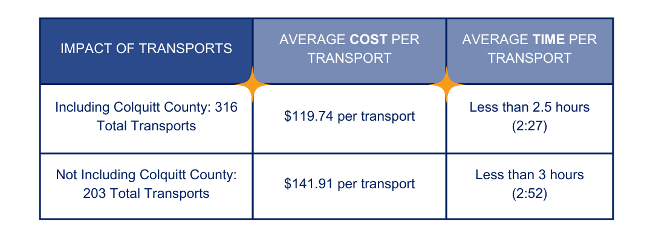
#4 Transport Study: Preliminary Findings
Notes:
Financial Impact (including Colquitt Co.): Estimated cost to the 15 sheriff departments for the 316 transports averages $119.74 per transport.
Without Colquitt County’s data, the average cost per transport is $141.91.
Time Commitment (including Colquitt Co.): Average time per transport is less than 2.5 hours.
Without Colquitt County’s data, the average time per transport is less than three hours (2:52).

Slide 17
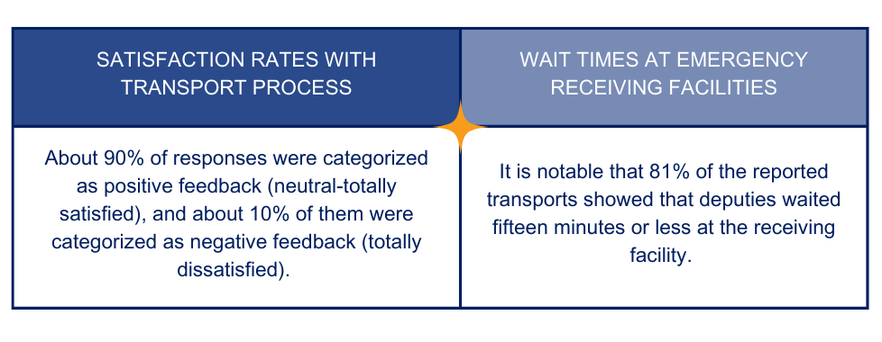
#4 Transport Study: Preliminary Findings
Notes:
Negative feedback examples focus on issues with medical clearance protocols.

Slide 18
#4 County-Level Mental Health Transport Findings (All Data)
County | Reported Transports | Corresponding GCAL Episodes | Average Time per Transport (hh:mm) | Average Miles per Transport | Average Cost per Transport
Ben Hill* | 10 | 9 | 05:55 | 226.3 | $291.52
Berrien | 5 | 2 | 02:22 | 65.6 | $100.15
Colquitt* | 113 | 47 | 01:40 | 60.5 | $79.92
Decatur | 36 | 14 | 02:50 | 118.6 | $146.31
Dodge* | 4 | 3 | 05:08 | 174.8 | $238.24
Dougherty* | 17 | 13 | 01:32 | 18.9 | $49.22
Early | 12 | 9 | 03:30 | 154.3 | $186.04
Echols | 0 | - | - | - | -
Irwin | 5 | 1 | 04:49 | 235.0 | $270.80
Lanier | 6 | 4 | 02:37 | 106.7 | $133.43
Lee | 11 | 7 | 02:00 | 16.5 | $58.74
Mitchell | 33 | 14 | 02:29 | 107.8 | $130.95
Seminole* | 9 | - | 03:23 | 167.6 | $192.07
Terrell | 0 | - | - | - | -
Tift | 24 | 14 | 02:35 | 109.9 | $134.69
Turner | 8 | 8 | 03:23 | 119.4 | $159.94
Worth | 23 | 13 | 02:31 | 88.9 | $119.17
Total | 316 | 158 | 02:27 | 92.6 | $119.74
*At least one in-county ERF
^{[1]}Average Time per Transport = (∑Weighted Full Process Time)/316 Transports. Accounts for time of additional deputies assigned to transports.
^{[2]}Average Miles per Transport = (∑Total Miles Driven)/316 Transports
^{[3]}Average Cost per Transport used the following figures for calculation: State of Georgia mileage reimbursement rate @$0.665/mile. State Accounting Office. Accessed 12.22.2023. Cost of deputy time @$23.81 per hour 50th percentile salary for sheriffs' deputies in Georgia. Police and Sheriff's Patrol Officers (bls.gov). Accessed 12.12.2023.
Notes:
This slide shows all the participating counties
THANK the participating counties for dedicating time to complete this study. Their participation is invaluable.
We wanted to collect data directly from Sheriffs, especially in more rural areas.
Transition: Stress Ben Hill’s length of time as an area for concern, especially since Ben Hill has an ERF in their county.

Slide 19
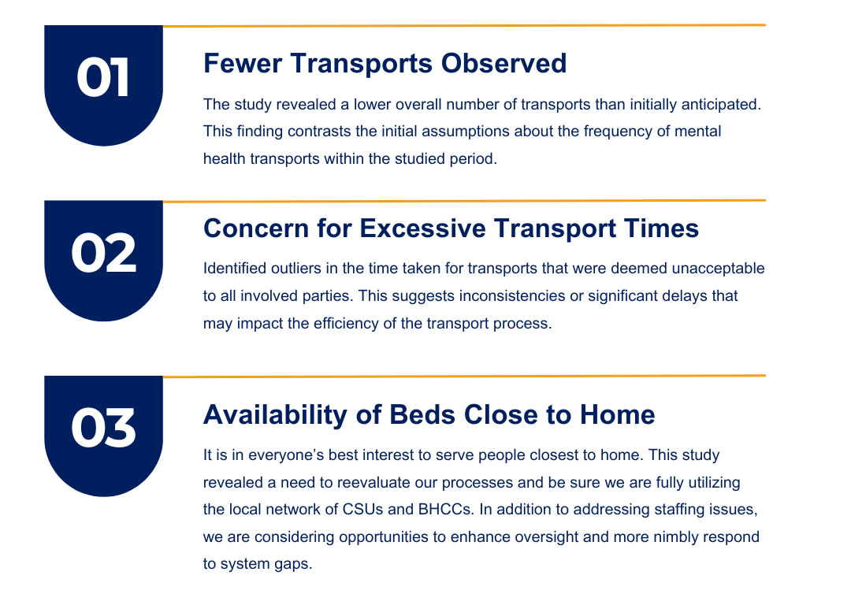
#4 Transport Study: Looking Ahead
Notes:
Lower Than Expected Transports: The study revealed a lower overall number of transports than initially anticipated. This finding contrasts the initial assumptions about the frequency of mental health transports within the studied period.
Unacceptable Time Outliers: Identified outliers in the time taken for transports that were deemed unacceptable to all involved parties. This suggests inconsistencies or significant delays that may impact the efficiency of the transport process.
Availability of Beds Close to Home: Almost 80% of transports had a round-trip milage of 120 miles or less. However, we saw some instances of trips into metro Atlanta and farther north. We know that is not the best use of your time and often removes the individual from their natural support systems.
DBHDD Challenge: We are looking deeper into the results of this preliminary data. Our main focus will be looking at how we can decrease the transportation timeframes.
Reducing transportation time = more time for officers to focus on public safety emergencies.

Slide 20
Forensic Code Update
The Behavioral Health Reform and Innovation Commission is examining state laws, rules and policies that impact people dealing with behavioral health issues in the criminal justice and mental health systems.
Goals:
Decrease waiting times for competency evaluations by finding effective methods.
Understand the available services for individuals in the criminal justice system who are deemed incompetent to stand trial.
Create suggestions to handle the rising number of individuals found incompetent to stand trial, including focusing on prevention and diversion programs.
Notes:
The Behavioral Health Reform and Innovation Commission is currently reviewing state forensic laws, regulations and policies affecting the interaction of individuals with behavioral health issues between the criminal justice system and the behavioral health system.
Goals:
Identify best practices for reducing wait times for competency evaluations
Identify current services and resources available for individuals in the criminal justice system who have been found incompetent to stand trial
Develop recommendations to address the growing number of individuals deemed incompetent to stand trial, including increasing prevention and diversion efforts

Slide 21
Jail In-Reach Programming
Create partnerships between Community Service Boards and local jails to assess and support individuals with severe mental illness in the criminal justice system.
Reducing recidivism through case managers and peer mentors who assist with reentry and connect to local resources, including supportive housing.
Current Programs: Hall, DeKalb, Walton, Chatham and Lowndes counties.
Pilot Outcomes: 55% of discharged individuals successfully enter behavioral health services after release.
Budget request submitted for four new pilot programs.
Notes:
Takeaway: How we are working with local partners to reduce recidivism.
Jail-in Reach Pilots
In April 2023, DBHDD began work on expanding the Jail In-Reach program to increase engagement within the jail and provide the opportunity of a warm hand-off at the point of reentry
Goal: decrease hospitalization incarceration, homelessness, and reduce recidivism
Five sites: Hall, DeKalb, Walton, Chatham and Lowndes counties.
Collaboration between Behavioral Health and Judicial Partners from the onset (Courts, Sherriff, Jails, CSB, DBHDD, Universities, etc.)
Utilization of a standardized and validated screening tool will allow us to collect and compare data across sites.
Providing a team approach will increase engagement within the jail.
Utilizing the strengths of the FPM as a valuable member of our workforce.

Slide 22
Questions?
Georgia Department of Behavioral Health & Developmental Disabilities
Notes:
Make note of community outreach team that may be in audience

