Slide 1
Georgia’s Regional Commissions
A Technical Assistance Resource for Local Governments
with American Rescue Plan Act Opportunities

Slide 2
62 Years of Service
1959
1989
2009
Regional Commission (RC)
Area Planning Commission (APC)
1973
Area Planning and Development Commission (APDC)
Regional Development Center (RDC)
Georgia Planning Act of 1989
HB 1216 (2007-2008 session)
General Planning Enabling Act of 1957

Slide 3
12 regions covering every city and county in Georgia

Slide 4
Regional Commissions Scope of Services
Aging Services
Technology Services / GIS
Small Business Loans
Local Government Assistance (Compliance, Grant Administration)
Workforce Development
Planning
Transportation
Economic Development (Grant Administration)

Slide 5
Services – Local Government/ Public Administration
Service Delivery Strategy Agreements
Ordinance Development /Charter Revisions
Financial / Administrative
Budget Development
RFP for Services
Human Resources
Compensation Systems
Policies
Key Personnel Recruitment
Housing Assessments
Citizen Surveys/Stakeholder Processes
Data and Analysis
AN EXTENSION OF
LOCAL GOVERNMENT STAFF

Slide 6
Services – Planning
Local Comprehensive Planning
Regional Planning
Specialty Community Planning
Downtown Development
Redevelopment
Recreation or Greenspace
Historic Preservation
Pre-Disaster Hazard Mitigation
Specialty Environmental Planning
Water Quality
Brownfields
Solid Waste
Specialty Transportation Planning
Wayfinding
Transit Development
Bike/Ped
Safe Routes to School

Slide 7
Services – Grant Writing/Administration
Grant Services
Project Development
Application Preparation
Administration
_________
Community Development (CDBG, OneGeorgia, USDA, GEFA)
Housing
Recreation
Transportation
Law Enforcement (AFG, COPS, Byrne JAG, OJJDP)

Slide 8
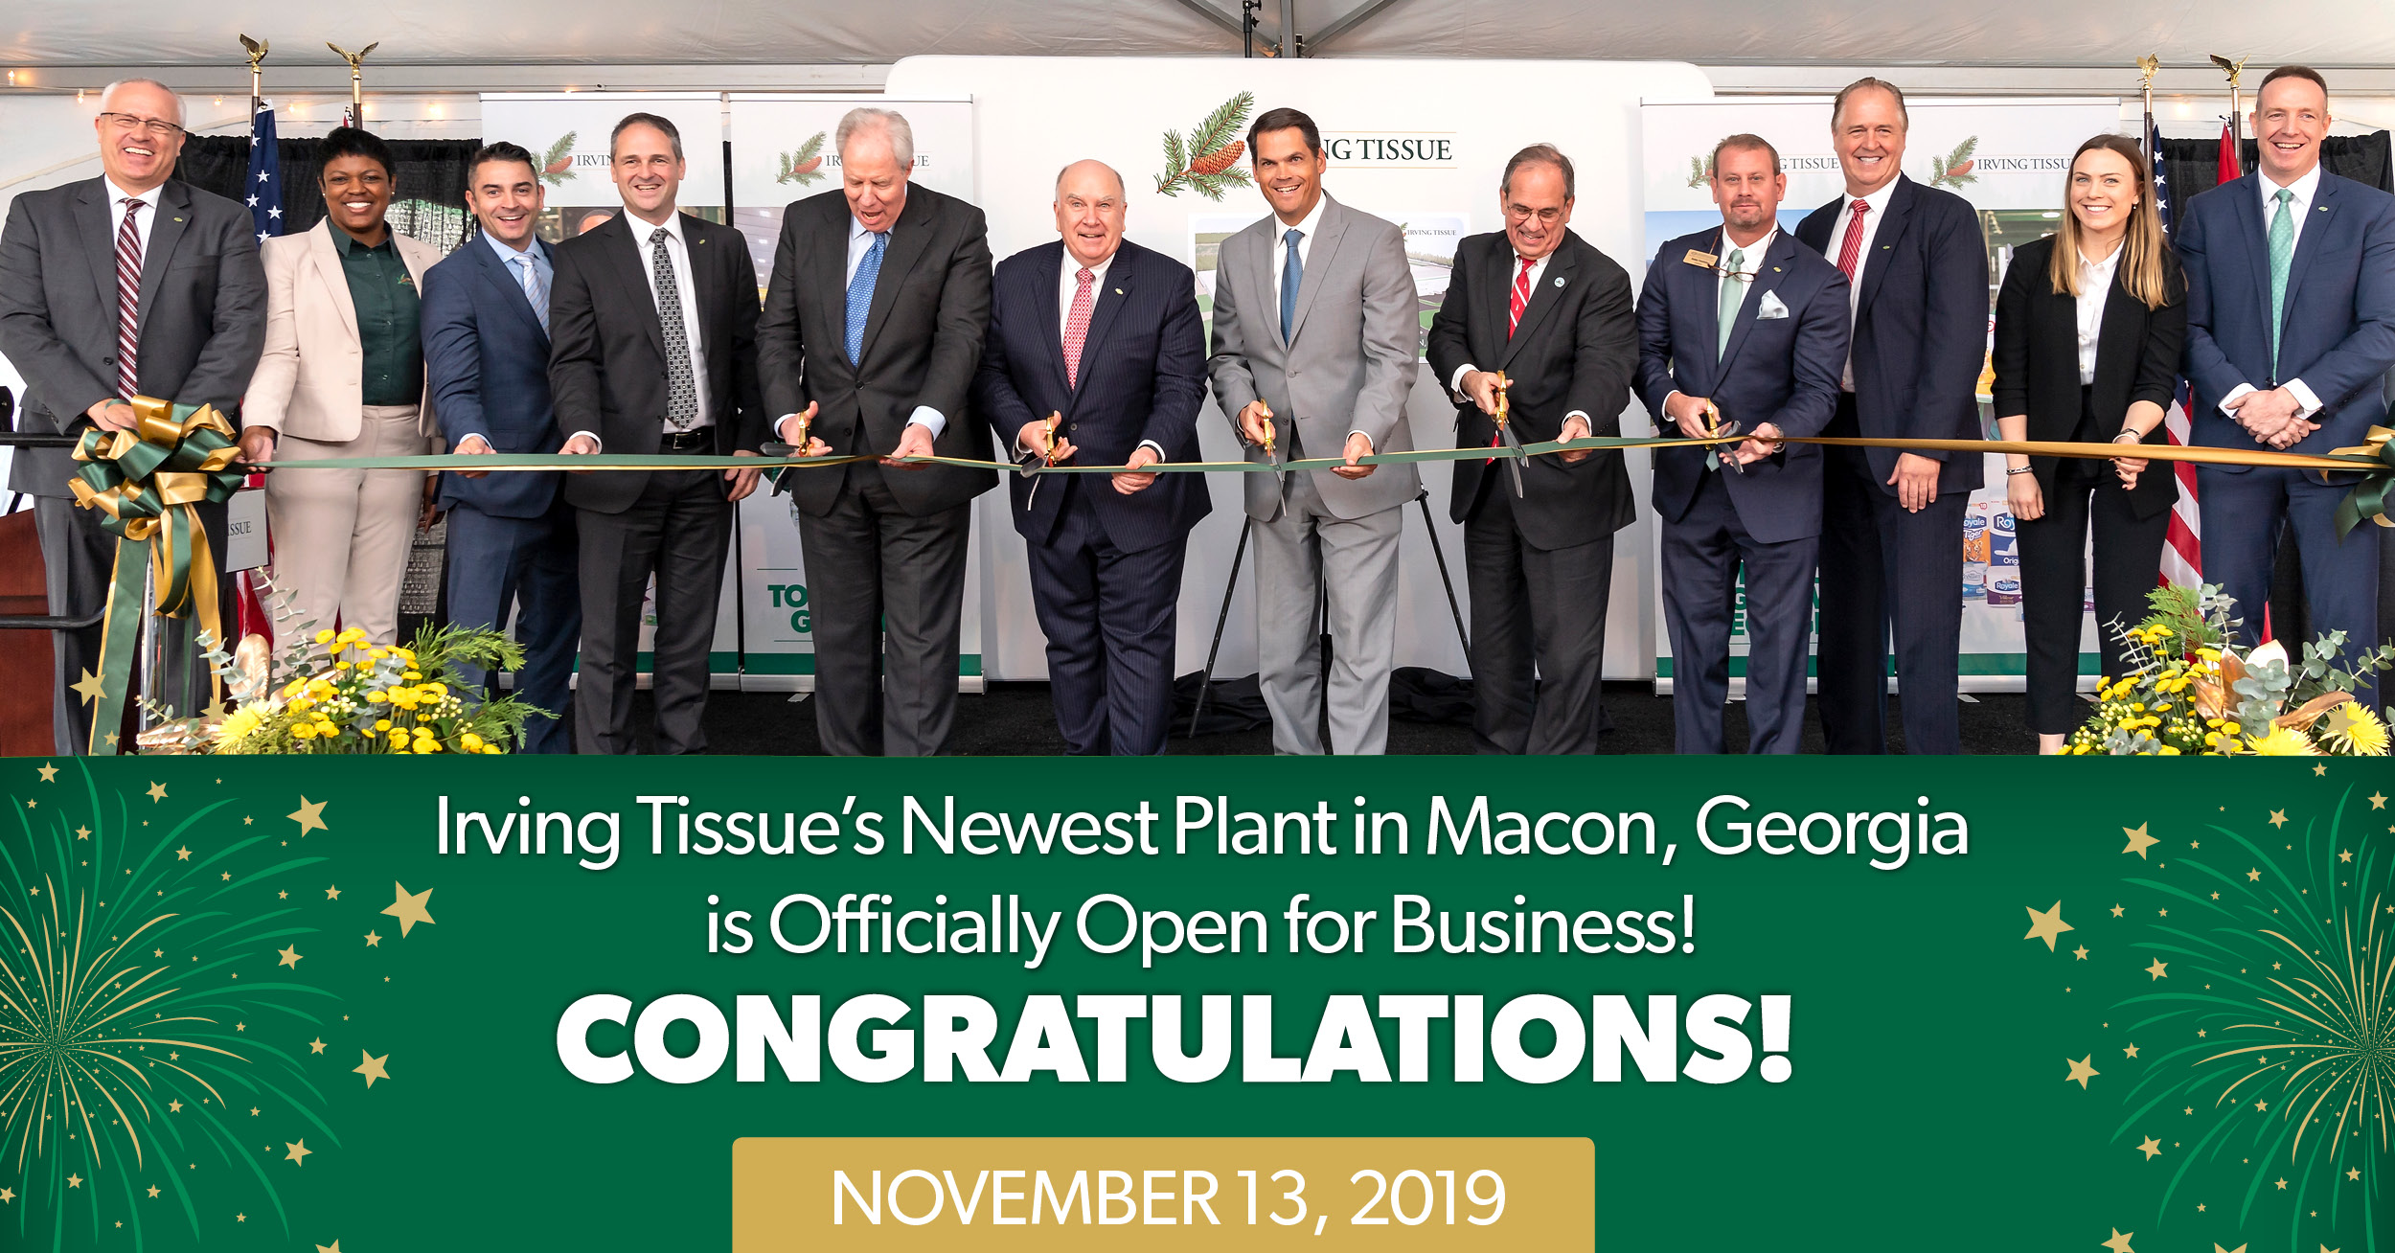
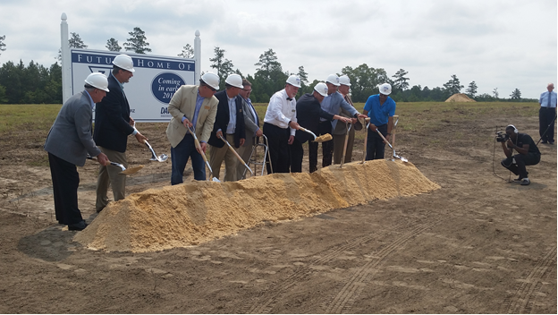
Services - Economic Development
Grant writing and administration to support economic development
Comprehensive Economic Development Strategy (CEDS)
COVID Resiliency Plan
Incentive Development and Deal Structuring
Prospect Inquiries and Site Visits
Strategic Planning
Local Area Economic Impact Analysis
Revolving Loan Funds

Slide 9
ARPA Assistance
Planning for Use of Funds
Project Development
Community Listening Sessions
Determining which ARPA funds to use for which need (State, Local, Other Agency)
DUNS and SAM Registration and maintenance
Record Keeping
Reporting to Treasury or other agencies
Procurement of Services (2 CFR)
Davis-Bacon Compliance
Certified Payrolls, Interviews, Restitution

Slide 10
Closing Thoughts
Planning before committing to use the funds is critical
Rules not final yet – could decide now on something that isn’t consistent with final rules
Obligation Deadline: December 31, 2024
Spending Deadline: December 31, 2026
Regional Commission’s
Primary role is supporting local governments - we are here to serve you!
Experienced in
Planning
Stakeholder sessions
Managing federal grant programs
Supporting Georgia’s cities and counties

