Slide 1
METRO ATLANTA CITIES WELLBEING INITIATIVE
Carrie Oliver, MPH, CHES, CNP, PMP
Co-Leader, Metro Atlanta Cities Wellbeing Initiative (MACWI)
Rebecca Baskam, MPH Co-Leader, Metro Atlanta Cities Wellbeing Initiative (MACWI) Research Professional, University of Georgia, College of Public Health, Health Policy and Management

Slide 2
METRO ATLANTA CITIES WELLBEING INITIATIVE
Initiative will support participants to integrate well-being metrics into local decision making that creates actionable policies.
Initiative Timeline
8-month course with bimonthly meetings
Cohort focused on cities in metro Atlanta area
Strengthen their capacity and provide resources for using data for policy action
Resources included: Wellbeing glossary, wellbeing metric informational pages, and policy road map guide
Initiative Goals
Collaboration
Data Incorporation
Notes:
Carrie

Slide 3
INITIATIVE SUPPORT
Research Professionals
Carrie Oliver, MPH, CHES, CNP, PMP
Rebecca Baskam, MPH
University of Georgia: Health Equity Fellows
Caleb Snead
Melat Mekonnen
Henry Kitiabi
Abraham Adokwei
Abigail Ventimiglia
Rylee Dickerson
Notes:
Rebecca

Slide 4
INITIATIVE PARTICIPANTS
21 Participants named initially and 16 participants actively completed the initiative
Elected Officials
City Staff
Advisory Board Members,
Fire Captain
Parks and Rec positions,
Community Health worker
Reverend
GIS coordinator
5 cities completed the initiative
City of Atlanta
City of Chamblee
City of College Park
City of Decatur
City of East Point
Notes:
Rebecca

Slide 5
INITIATIVE SESSIONS
Most relevant sessions
Topic | Facilitator | Description
Stewardship | Rippel Foundation’s ReThink Health team | Defining and operationalizing concepts of stewardship related to well-being​
Social Determinants of Health | Dr. Grace Bagwell Adams, UGA College of Public Health | Overview on the social determinants of health​
Health Equity | Freddie Broome, Georgia Municipal Association | Understanding health equity in policy implications​
Systems Thinking | Carrie Oliver, Atlanta Regional Collaborative for Health Improvement | Interconnectedness of systems that help Metro-Atlanta citizens thrive
Wellbeing Metrics | Nikolai Elneser, Neighborhood Nexus | Using wellbeing metrics and indicators in Atlanta, Identifying ways to use data and assess change and impact​
Peer Learning | Natalie Bomstad, Executive Director, Wello Joseph Faulds, COO, City of Green Bay Chelsea Talbert, Strategic Initiatives Coordinator Christina Chelf, GIS Lead, City of Tacoma T. Benicio Gonzales, Director, Center for Health Equity (CHE), City of Louisville Rebecca Hollenbach, Executive Administrator, CHE, City of Louisville | Input on success and challenges from city leaders and decision makers using wellbeing metrics in their cities​
Communications | Anita Chandra. RAND Social and Economic Wellbeing Jennifer Messenger, Metropolitan Group | Communicating about city-level wellbeing efforts and making the case for these policy changes
Notes:
Carrie

Slide 6
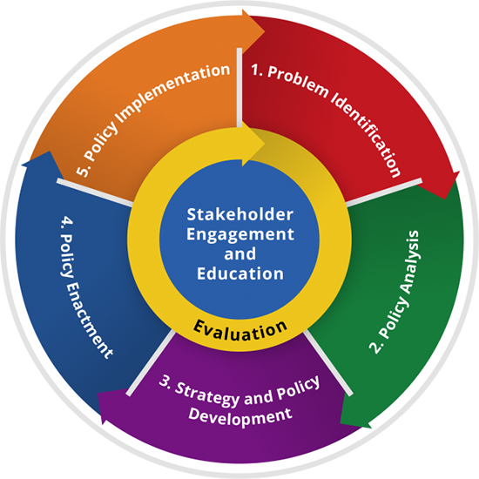
INITIATIVE WORK SESSIONS
Each session was an opportunity to review the policy process
Review of each step of the policy action plan template using Athens Wellbeing Project as an example
Designated time for each city to work on section of the policy action plan
Content source: Centers for Disease Control and Prevention, Office of Policy, Performance, and Evaluation
Notes:
Rebecca

Slide 7
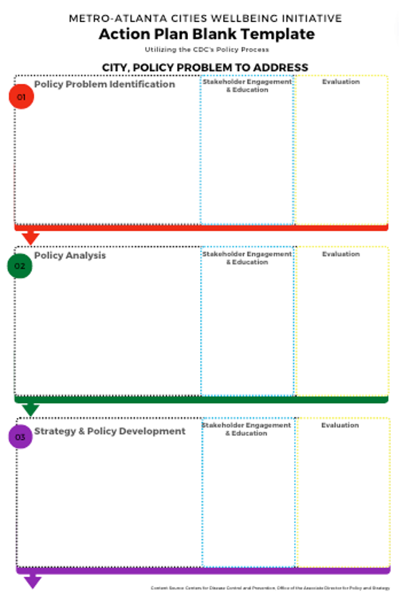
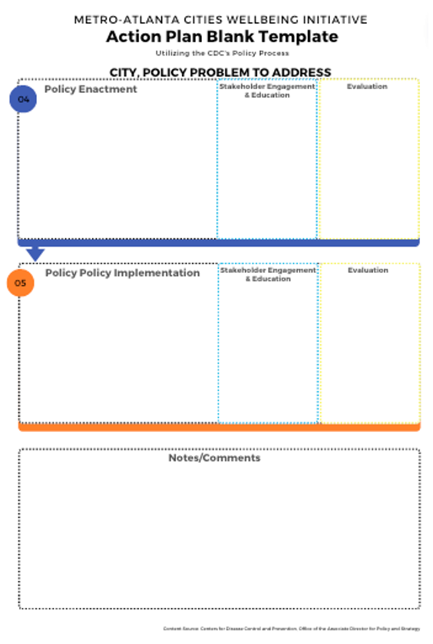
ACTION PLAN TEMPLATE
Content source: Centers for Disease Control and Prevention, Office of Policy, Performance, and Evaluation
Notes:
Rebecca

Slide 8
CITY OF COLLEGE PARK
Notes:
Carrie

Slide 9
COLLEGE PARK’S FOOD DESERT
People, Policy, Public Wellbeing
This presentation seeks to highlight the problems, strategies, and potential solutions to College Park’s food desert.
Identify the Problem
Policy Analysis
Strategy & Policy Development
Policy Buy-in from Governing Body
City Plan for Development
Notes:
Carrie

Slide 10
CITY OF DECATUR
Notes:
Carrie

Slide 11
Decatur Action Plan
Increase well being by increasing access to movement
Created by:
Decatur Mayor Patti Garrett
Fire Captain Gary Menard
Decatur Parks & Rec Program Supervisor Jada Jordan
Clarity Fitness Owner Abbey Griffith
Notes:
Carrie

Slide 12
CITY OF ATLANTA
Notes:
Carrie

Slide 13
Notes:
Carrie

Slide 14
CITY OF EAST POINT
Notes:
Carrie

Slide 15
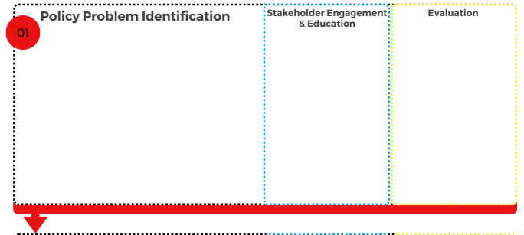
Equitable Growth and Inclusion Strategic Plan (2021)
City Agriculture Plan (2021)
East Point Community Needs Assessment (2022)
Public input at listening sessions, City Council Meetings, etc.
Health Equity Community Advisory Board
Healthy Point Initiative participants
East Point Thriving for All Equity Survey
East Point Community Needs Assessment
City Health Dashboard
Stakeholder Assessments (e.g., Health Equity Community Advisory Board, Healthy Point Initiative)
High burdens of chronic diseases & social determinants of health
Health inequities compared with Fulton County/ State
Housing
Healthy Food Access/City Agriculture
Land Use/Development/Environmental Justice
Notes:
Carrie

Slide 16
CITY OF CHAMBLEE
Notes:
Carrie

Slide 17
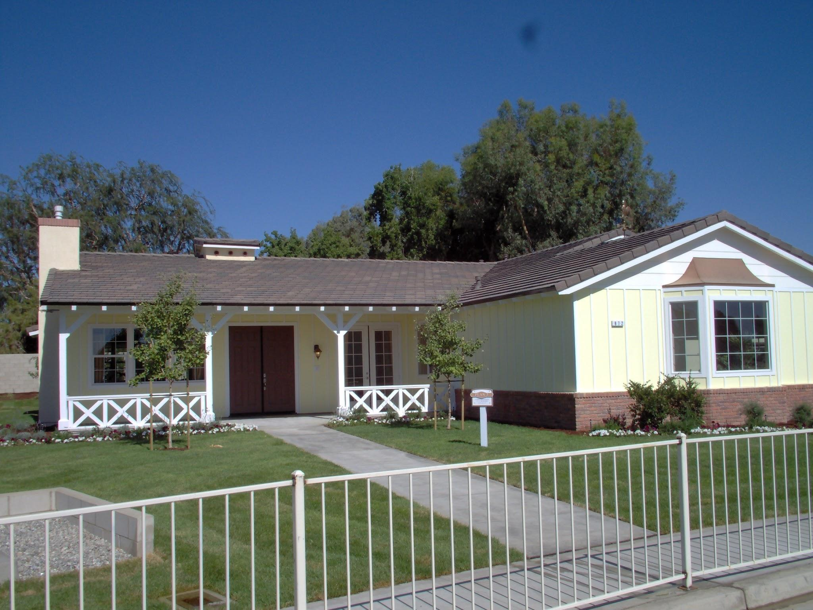
Problem Identification
Affordable Housing
Supply of Housing
Preservation of Housing
Homeownership
Protected Affordable Housing
Notes:
Carrie

Slide 18
EVALUATION – STEWARD EXPERIENCE
90% agreed they felt more confident in utilizing wellbeing data metrics
80% agreed they learned information in the initiative that will be useful to their work
100% agreed that the initiative was useful in learning how to utilize data for local policy
40% agreed the initiative aligned with their expectations
100% agreed they were provided opportunities to interact with and felt supported by the initiative leaders
Notes:
Rebecca
N=10 – 9 city staff and 1 elected official
16 active participants

Slide 19
EVALUATION – SESSION & RESOURCE FEEDBACK
70% agreed the timing of communication was appropriate
40% agreed that the research fellow was helpful
80% agreed the information was pitched at the right level
100% agreed the action map template was clearly explained, 70% agreed it was useful and easy to follow
80% agreed the work sessions were helpful
80% agreed that the resources would be helpful to use after the initiative and 90% agreed they plan to share the city plans with their colleagues
Notes:
Rebecca
N=10 – 9 city staff and 1 elected official

Slide 20
Evaluations: Most Relevant Sessions
Social Determinants of Health (4 Participants on Evaluation)
100% reported enhanced knowledge from participating in this session.
100% found the session’s topic was relevant and applied to the work in their city
100% felt more confident in using the information to inform policy change in their city
Health Equity (4 Participants in Evaluation)
75% said their knowledge was enhanced from participating in this session.
100% found this session’s topic relevant and applied to the work in their city.
50% felt confident using the information to inform policy change in their city.
Systems Thinking (4 Participants in Evaluation)
75% reported enhanced knowledge from participating in this session.
100% found this session’s topic relevant and applied to the work in their city.
75% felt confident using the information to inform policy change in their city.
Estimated a total of 10 participant per initiative session
Notes:
Rebecca

Slide 21
Evaluations: Most Interesting Sessions
Social Determinants of Health, Health Equity & Stewardship
Stewardship (4 Participants on Evaluation)
100% reported enhanced knowledge from participating in this session.
100% found the session’s topic was relevant and applied to the work in their city
75% felt more confident in using the information to inform policy change in their city
Estimated a total of 10 participant per initiative session
Notes:
Rebecca

Slide 22
Evaluations: Most Helpful Sessions
Social Determinants of Health, Health Equity & Wellbeing Metrics
Wellbeing Metrics (MAREA Tool): (5 Participants in Evaluation)
100% reported enhanced knowledge from participating in this session.
100% found the session’s topic was relevant and applied to the work in their city
60% felt more confident in using the information to inform policy change in their city
Wellbeing Metrics (Available Data Metrics):
33% reported enhanced knowledge from participating in this session.
66.7% found the session’s topic was relevant and
33% applied to the work in their city
33% felt more confident in using the information to inform policy change in their city
Estimated a total of 10 participant per initiative session
Notes:
Rebecca

Slide 23
Evaluation Takeaways
Best practices for choosing well-being stewards:
Universal initiative topic or Completing the initiative regionally
More clarification on expectations early on in the initiative
Ex: Action Map Template expectations
Include ways to measure participant’s capacity in future iterations
Choosing the timeline of the initiative
A lot can happen in eight months
Complete session evaluations within the time of each session
Steward focus and recall is most present
Notes:
Rebecca

Slide 24
Contact Information
Carrie Oliver, MPH, CHES, CNP, PMP
Georgia Health Policy Center
coliver@gsu.edu
Rebecca Baskam, MPH Research Professional University of Georgia, College of Public Health, Health Policy and Management rbaskam@uga.edu

