Slide 2
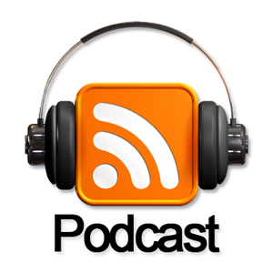
Podcasting for Local Government 101:
Notes:
Welcome to Podcasting for Local Government 101
As Kellie told you, I’m Steve Jones, Digital Media Manager for the City of Douglasville.
Not sure how I got selected to be speaking again this year but, thanks for having me!
A couple of questions:
Who listens to podcasts? Where do you get them from? Why do you listen to them?
Any likes or dislikes about them?
Last question, has anyone here every thought about doing a podcast, but didn’t know where to start?

Slide 3
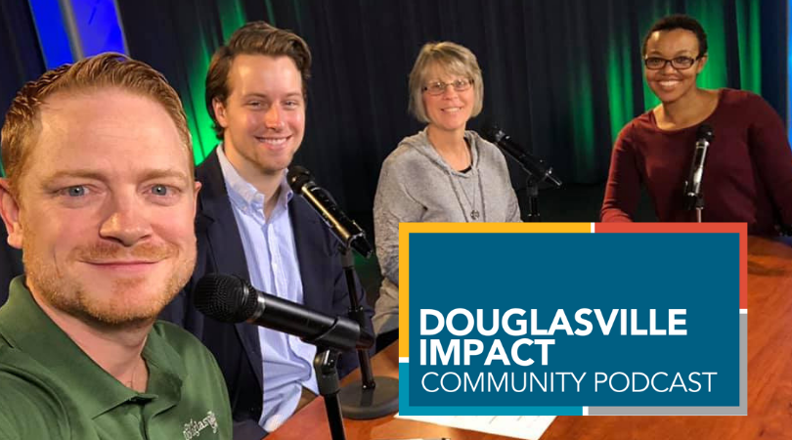
Douglasville Impact
Community Podcast
Notes:
A little background:
Our podcast is called Douglasville Impact. The name comes from our branding study of a couple of years ago where adopted an internal moto, “Impact That Matters”.
Our Director, Jason Post, and myself are both big Disney geeks. We keep up to date on what’s happening down there by listing to a podcast called the Dis Unplugged.
So, we loosely based our new podcast on their format.
Here is a shot of our crew on set.

Slide 4
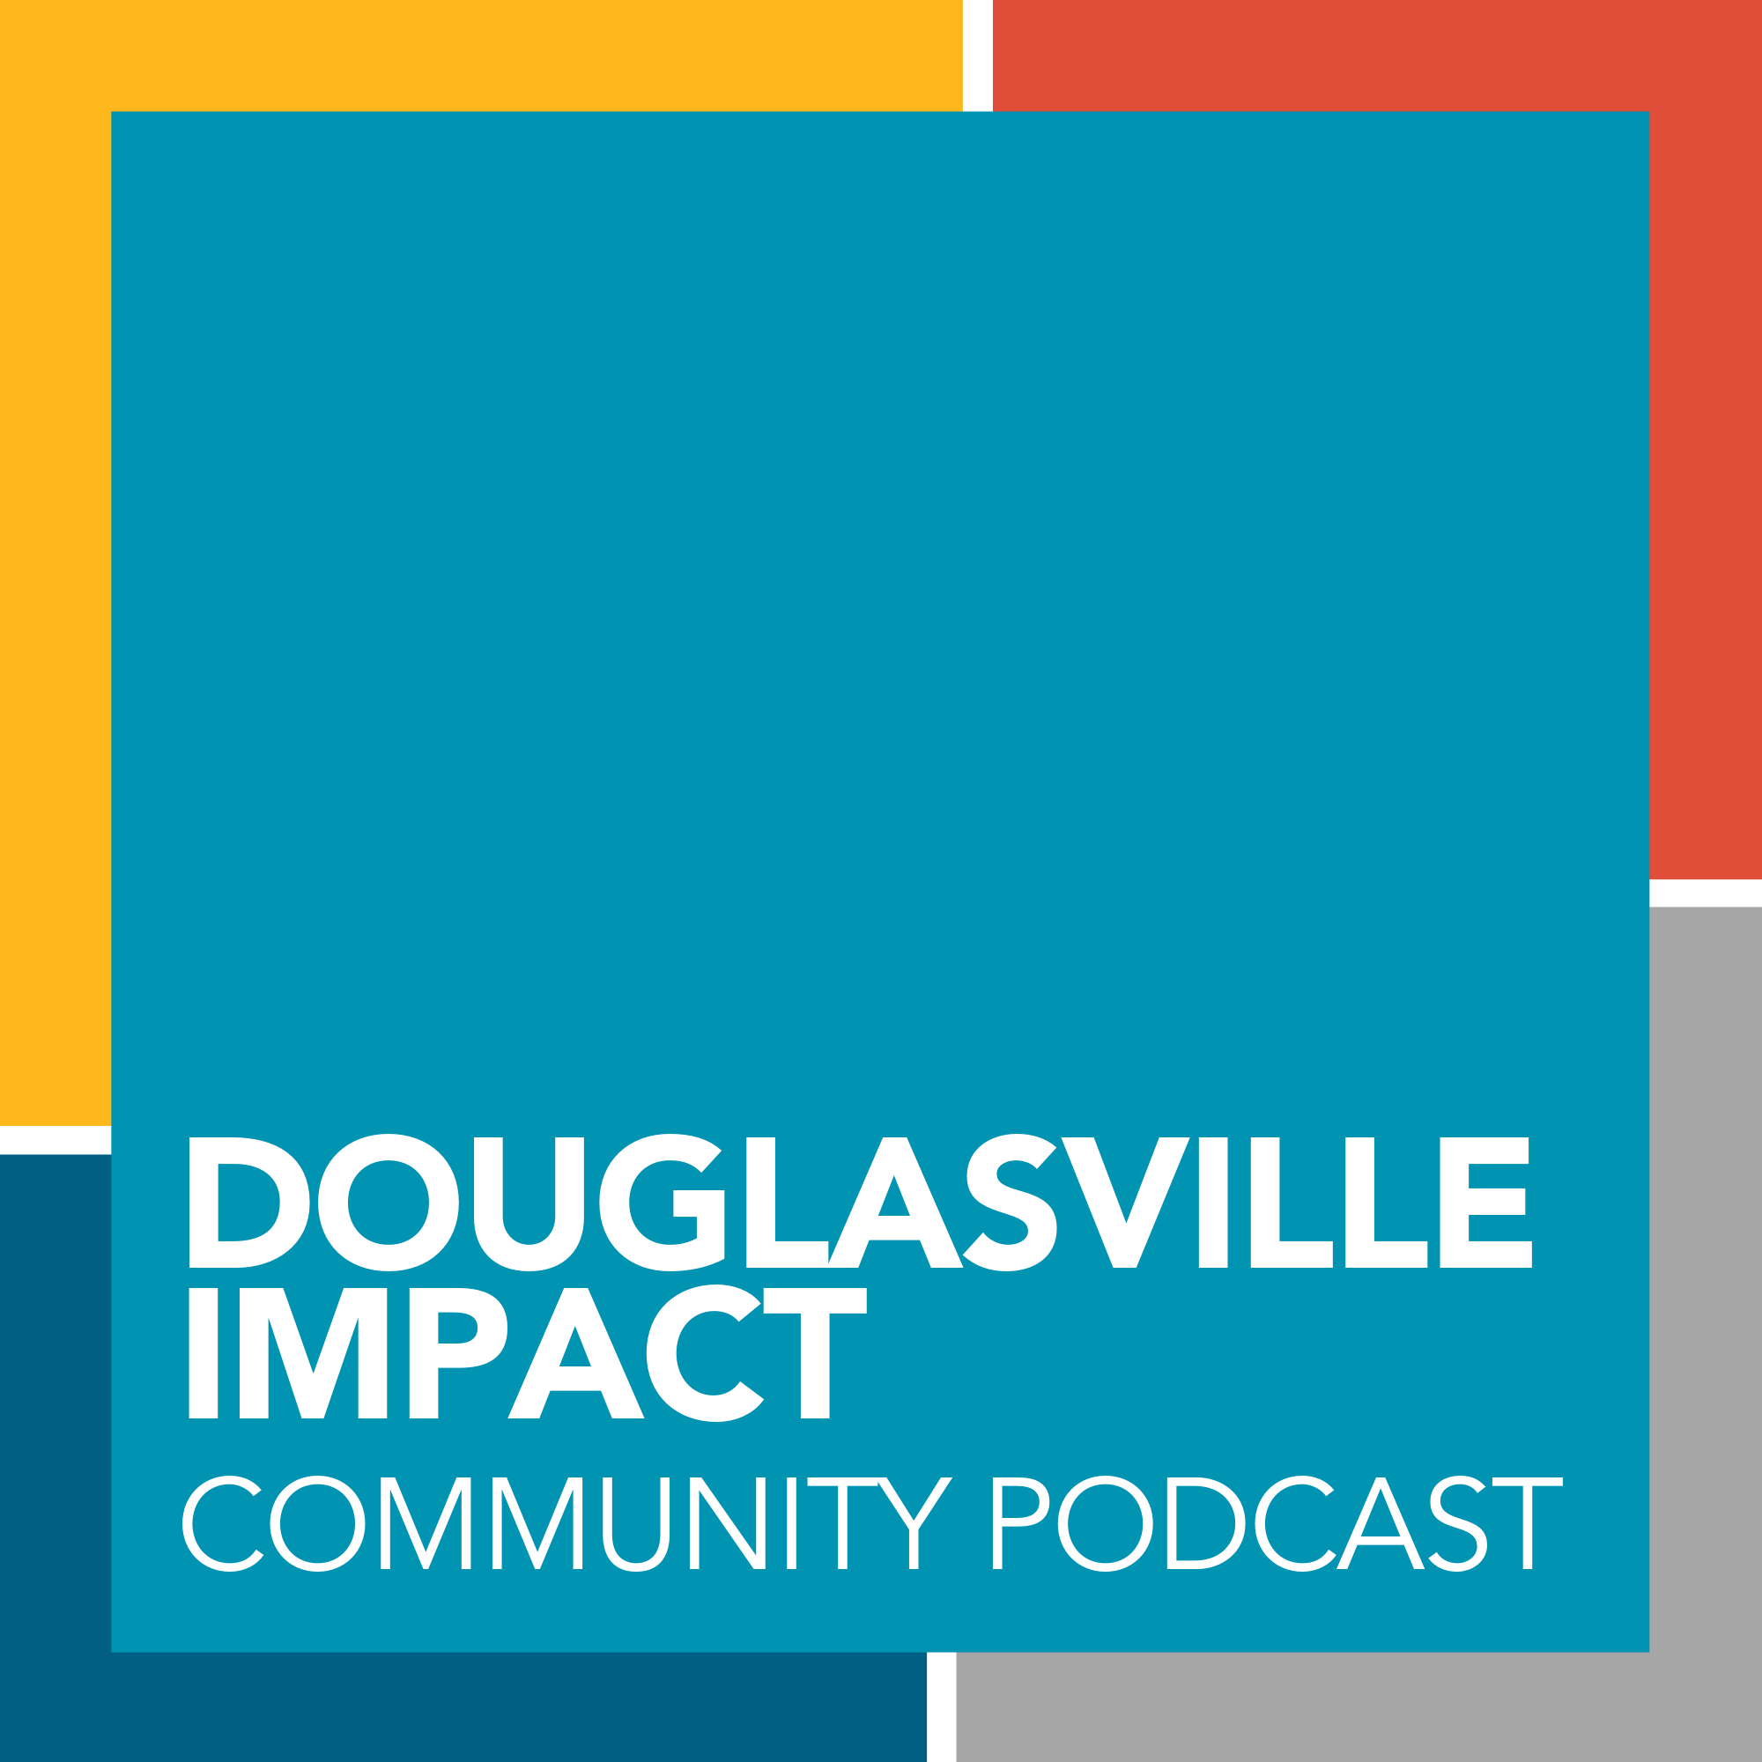
Recorded about every 2 weeks-Hosted on Podbean
Video Version on our Channel
Notes:
We do an episode about every two weeks. This is important in that all the research I did prior to starting the show was that consistency was important for gaining and holding your audience.
We host it on Podbean-we’ll talk more about them in a second.
We post a video version of the show on our TV Station, CITI TV, Channel 22 on Comcast, and on our YouTube channel.
We can be found on most of the major podcast distributors.

Slide 5
Why do a Podcast?
Excellent question…
Notes:
Why do a Podcast?
For us, it is just another part of our overall plan of Information distribution. That’s why we are all here right? Our job is information dissemination.

Slide 6
Part of our over all attempt to just get the word out to our citizens. We also have a news letter, website, social media, and local advertising.
Notes:
We have a TV channel. A news letter. A Website. Social Media. And Stickers that go on our garbage cans. But, what do all of our citizens still say?
They didn’t know about something.
And now we’ve added the podcast.
Because it’s just another tool to help us get the word out.

Slide 7
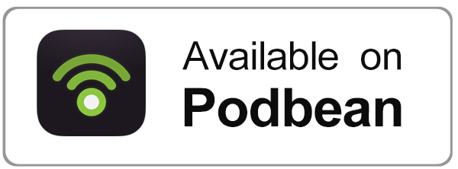
We host Douglasville Impact on Podbean.
Notes:
So let’s talk a little about Podbean.

Slide 8
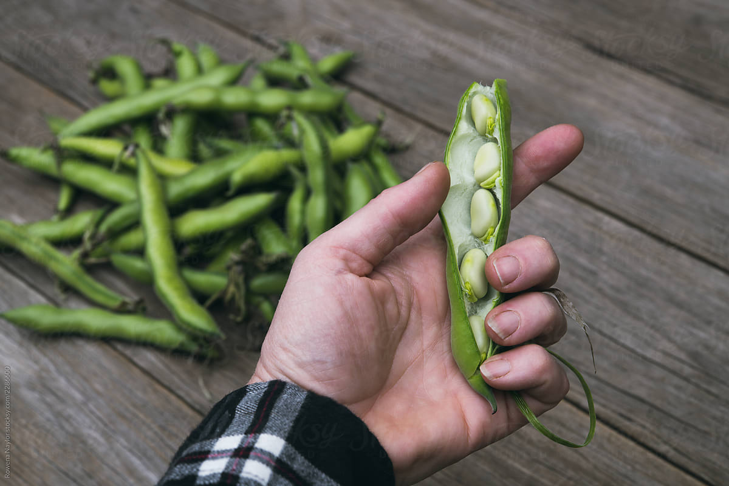
So, what’s a Podbean?
This is a Bean Pod…
Notes:
So, you may be wondering….what is a podbean?

Slide 9
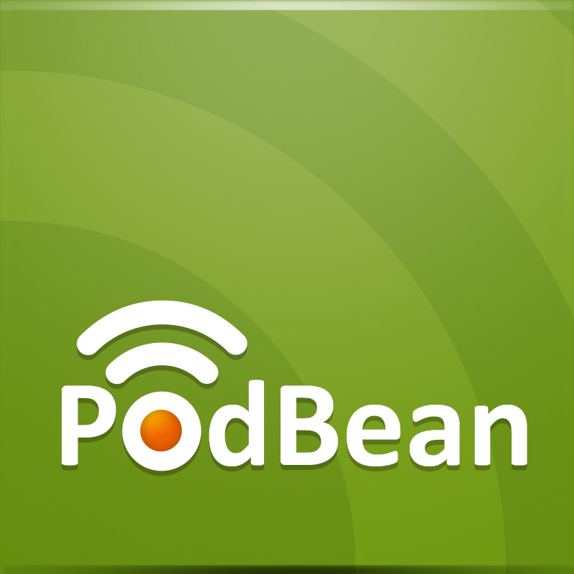
is a hosting site for Podcasts.
Hosts our Podcast files
Distributes those files to…
Notes:
Podbean is a hosting site. You have a host for your website, Podbean is essentially the same thing for our podcast. We upload our completed program to them, and it gets distributed out to the major players in the business: Part of the process for setting up your podbean account is the establishment of an RSS feed that is used to get your program out to the public. Podbean offers a few other services as well. They will create a post on our social media when new content is loaded. It looks pretty good too. They will help you monotize your show if that is something you’d be interested in doing.
But our main benefit from them is that they quickly an efficiently, get us out on the major distributors.
We can be found on
iTunes
Google Play Music
Spotify
And now…iHeart Radio. As I said before, the video version is also available on YouTube and CITI TV.
Let’s try a little experiment.
Breakout your phones, and do a quick search for the words Douglasville Impact. Where do you find it?

Slide 10
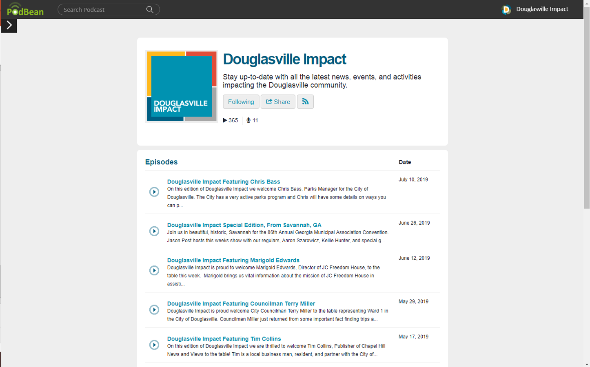
Notes:
This is what the show looks like on Podbean.
Yes, you can listen to it there.

Slide 11
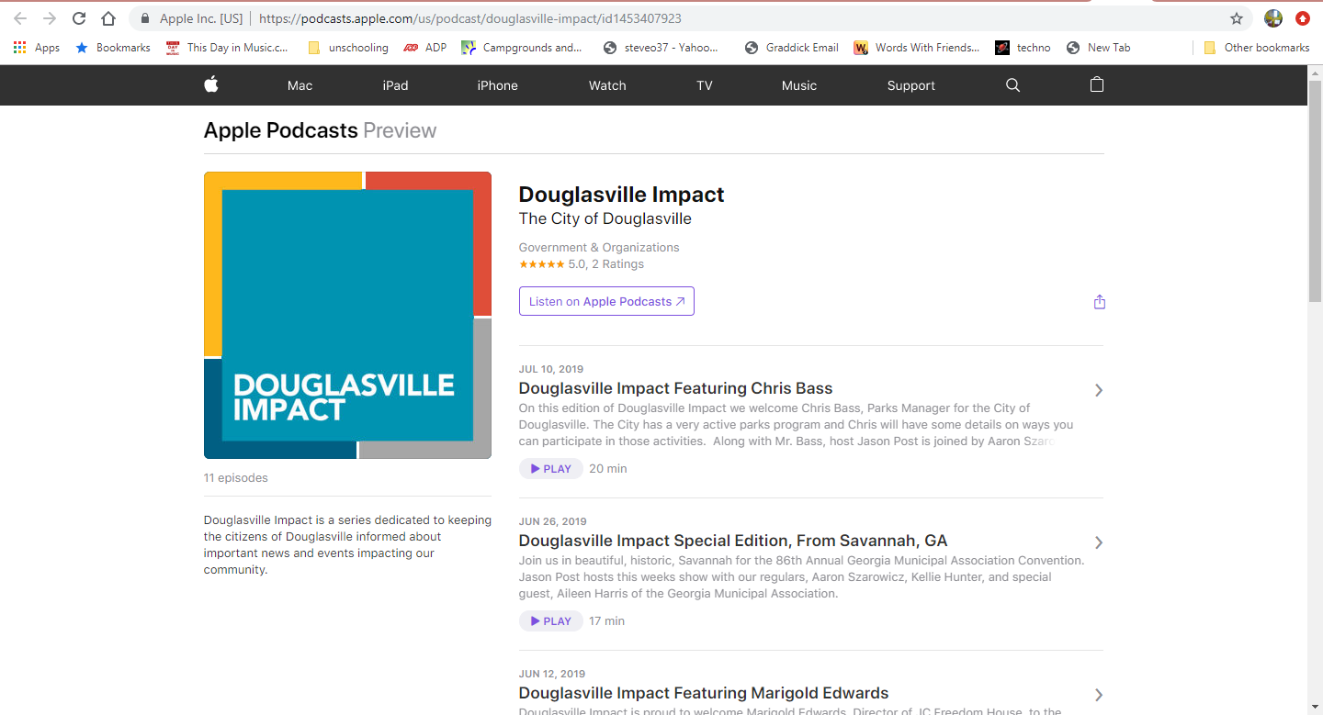
Notes:
This is what our iTunes page looks like.

Slide 12
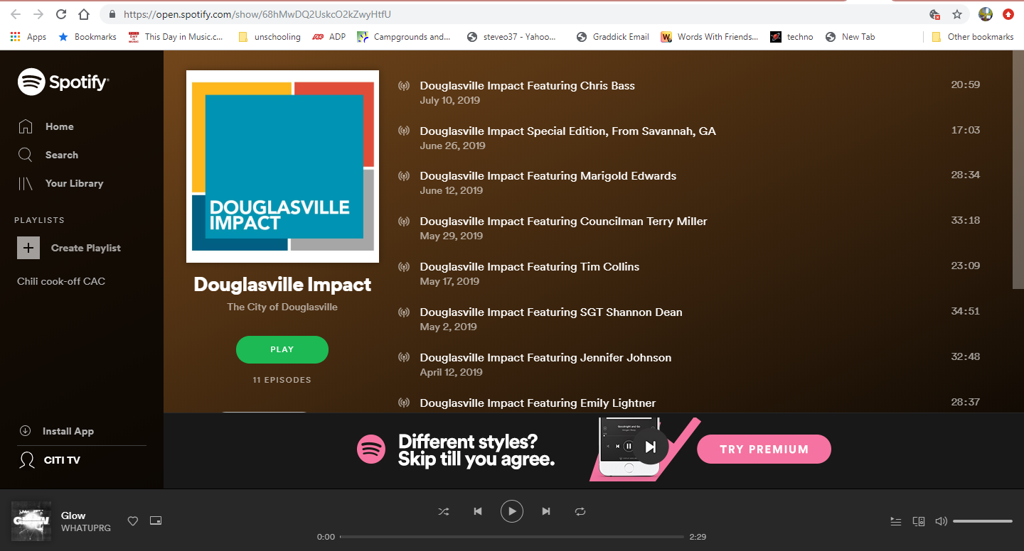
Notes:
Hear we are on Spotify.

Slide 13
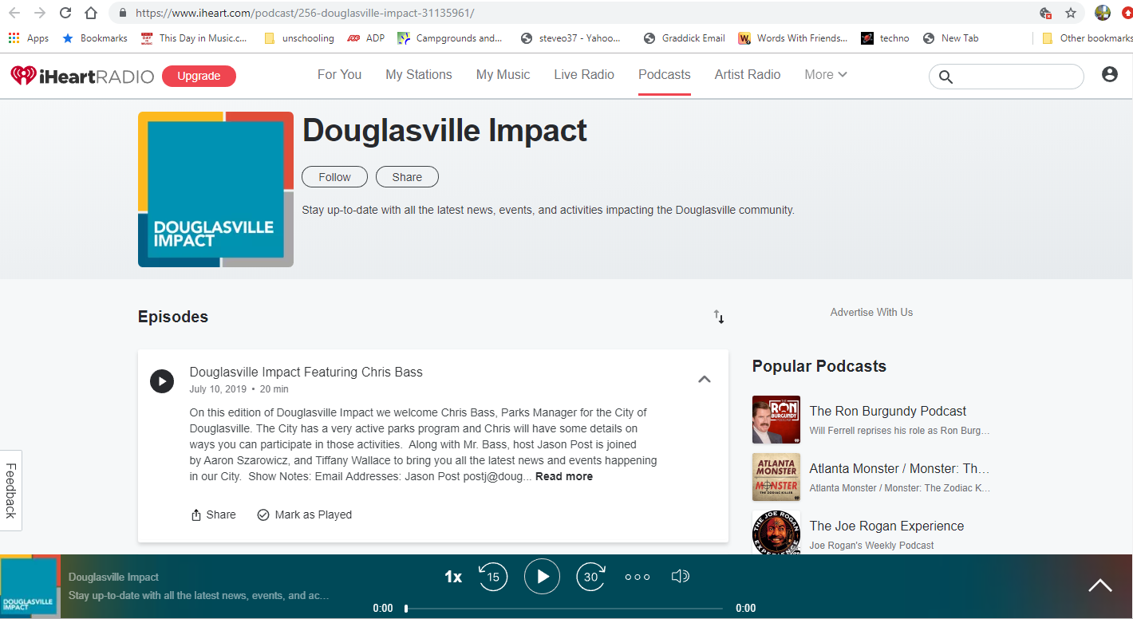
Notes:
And here we are on iHeart radio.
This is a little interesting. We never tried to get on iHeart Radio, but they have somehow picked us up and now we can be heard there.
Im fine with this of course. And it turns out the iHeart Radio is now the 2nd most popular place to listen to podcasts.

Slide 14
How do we do ours?
Notes:
Let me just say, you don’t have to do your podcast like we do ours.
There are many different ways of recording a podcast. They all will work.
I’m going to show you a couple of suggestions in a moment of inexpensive ways you can do a podcast. For us, this show was a replacement for a TV program and a new addtition to our communication strategy.
Frankly, I need the content on my TV station. But keep in mind, podcasting is primarily and audio format. If you can use it as a video piece, then that ‘s just gravy really.

Slide 15
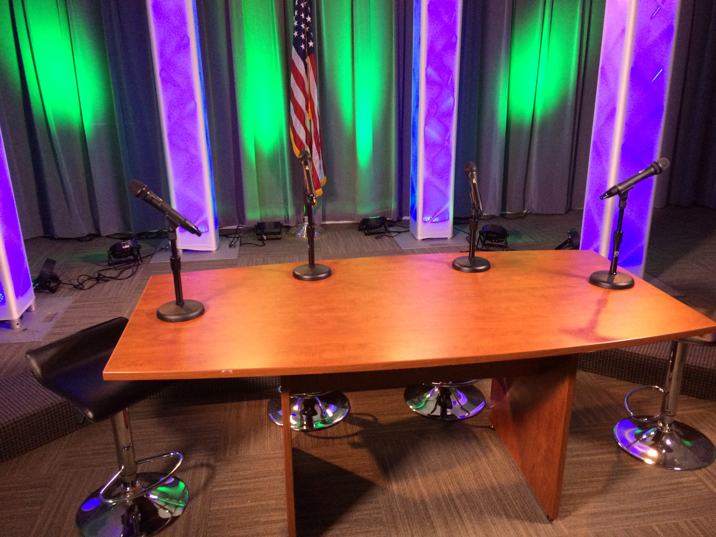
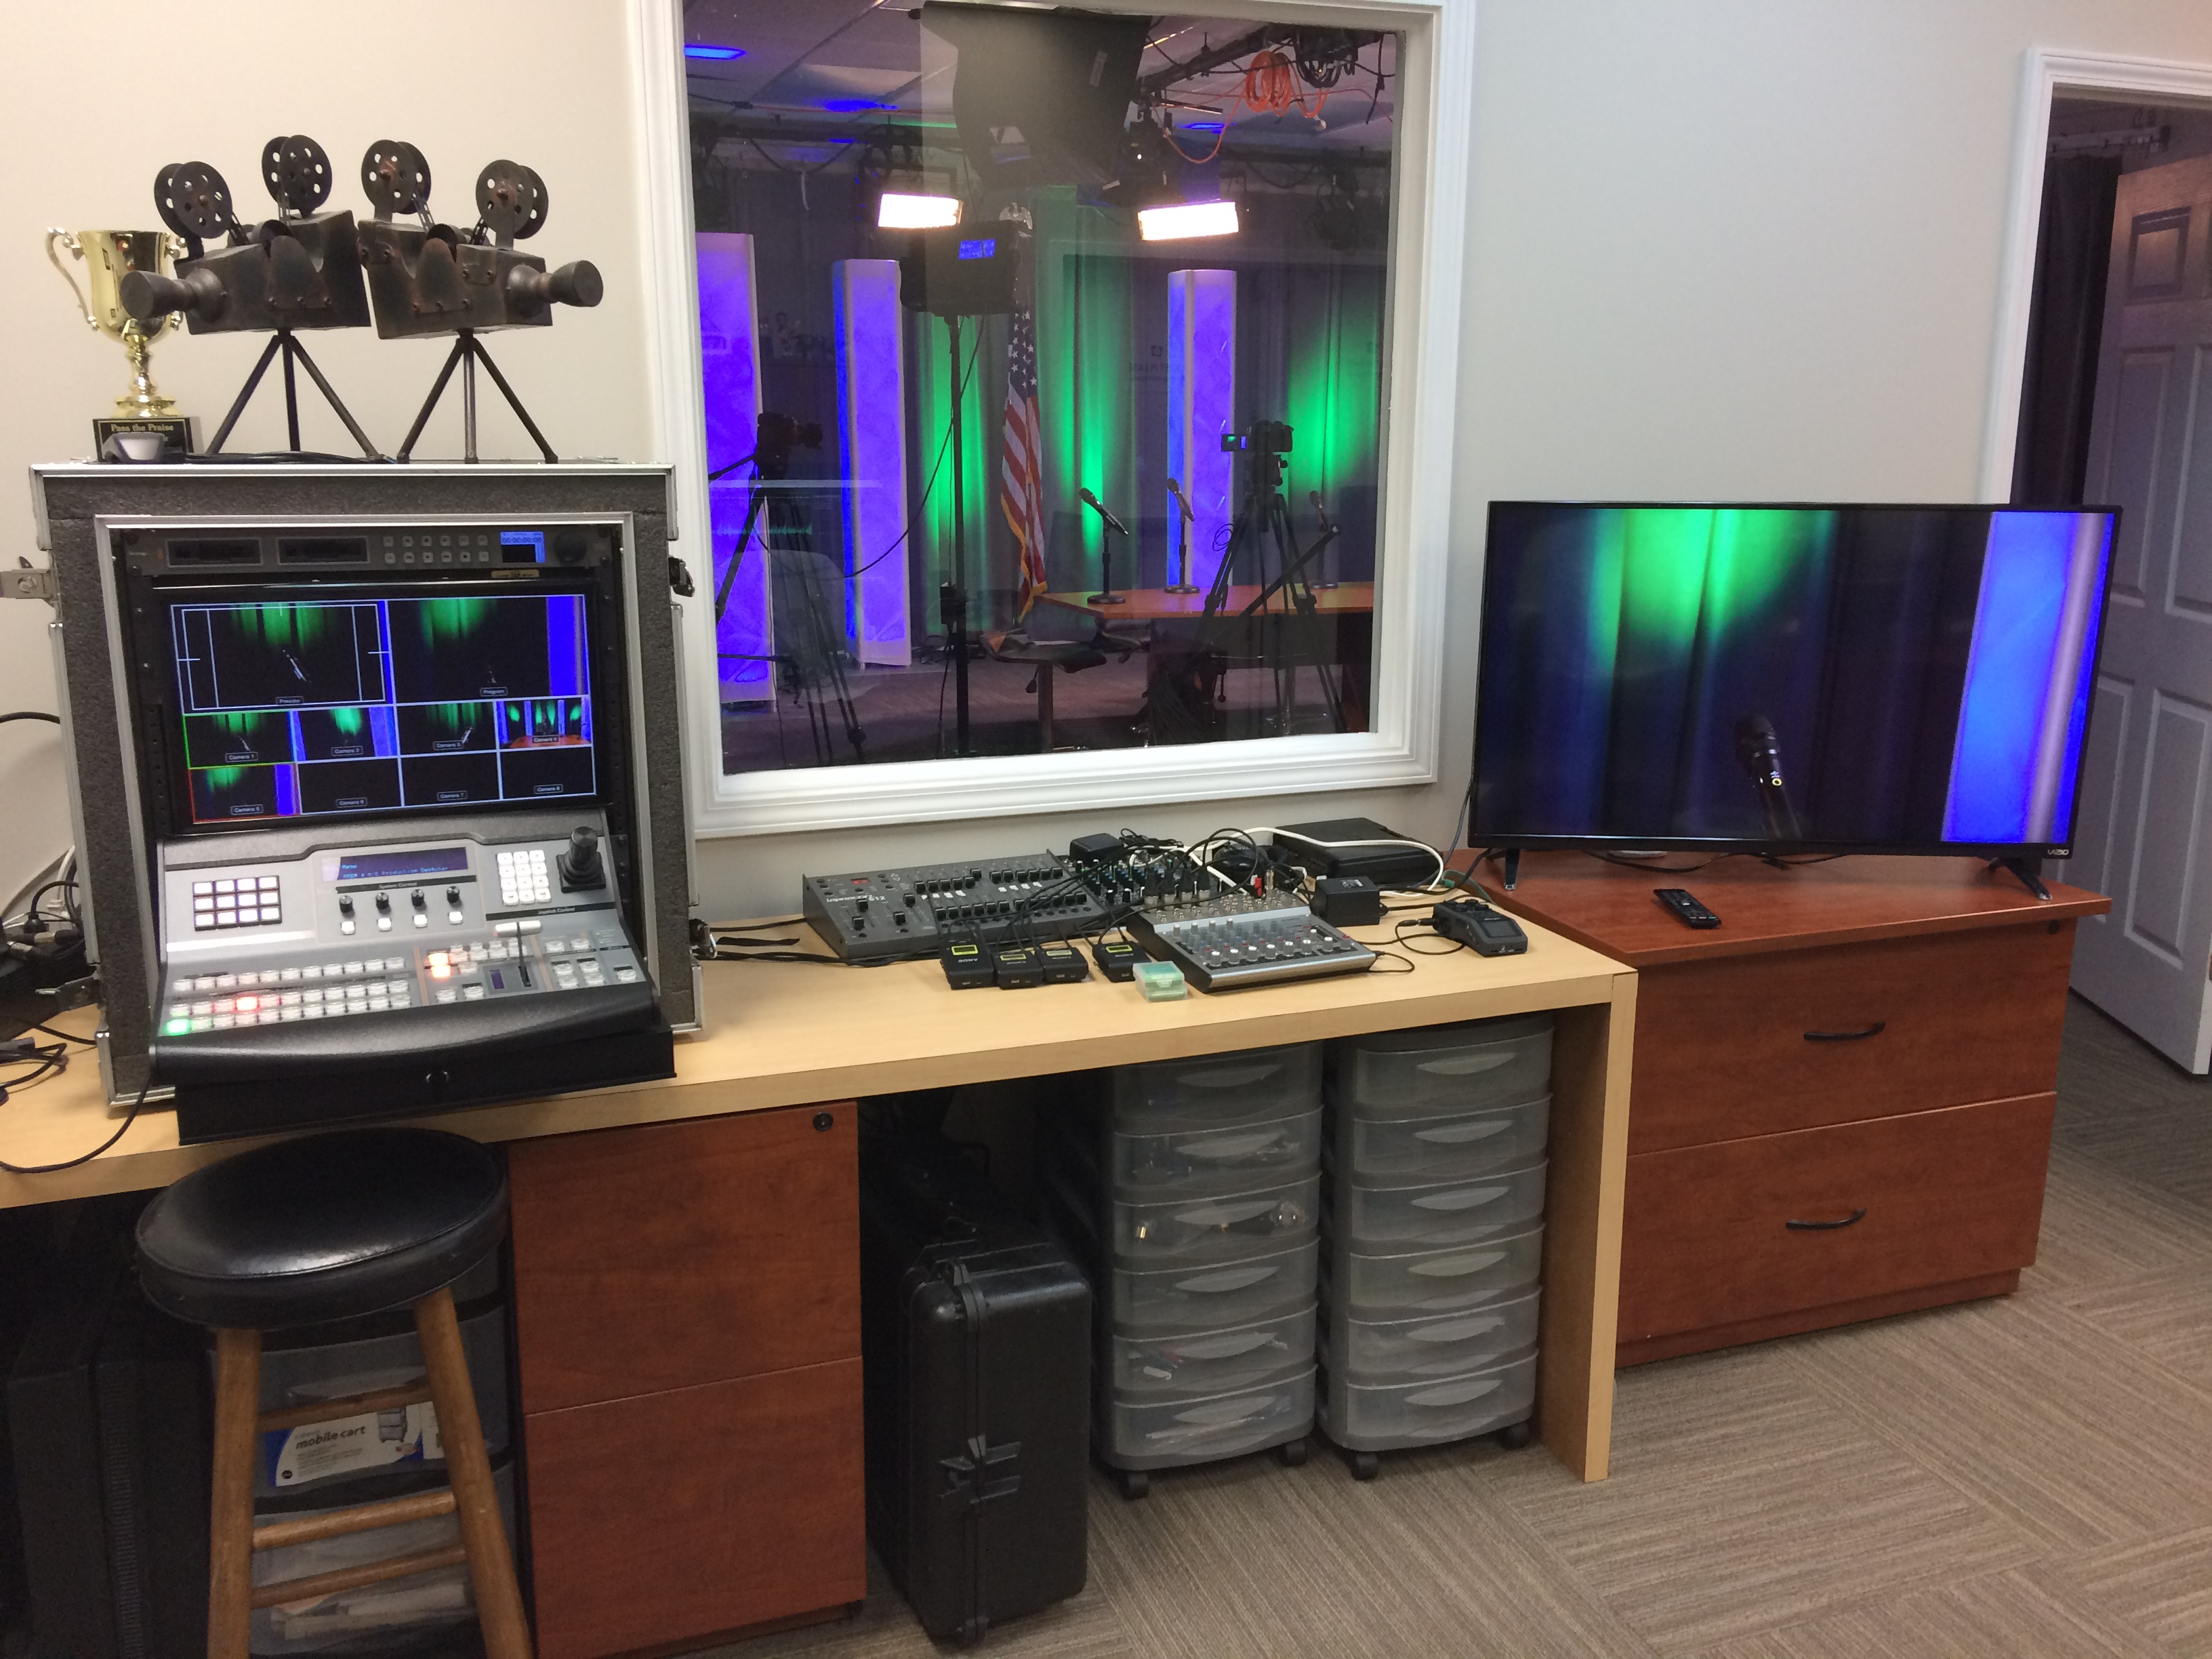
In Our Studio At City Hall
Notes:
Here is where we shoot the show.
On your left is our control area. On your right is the set.

Slide 16
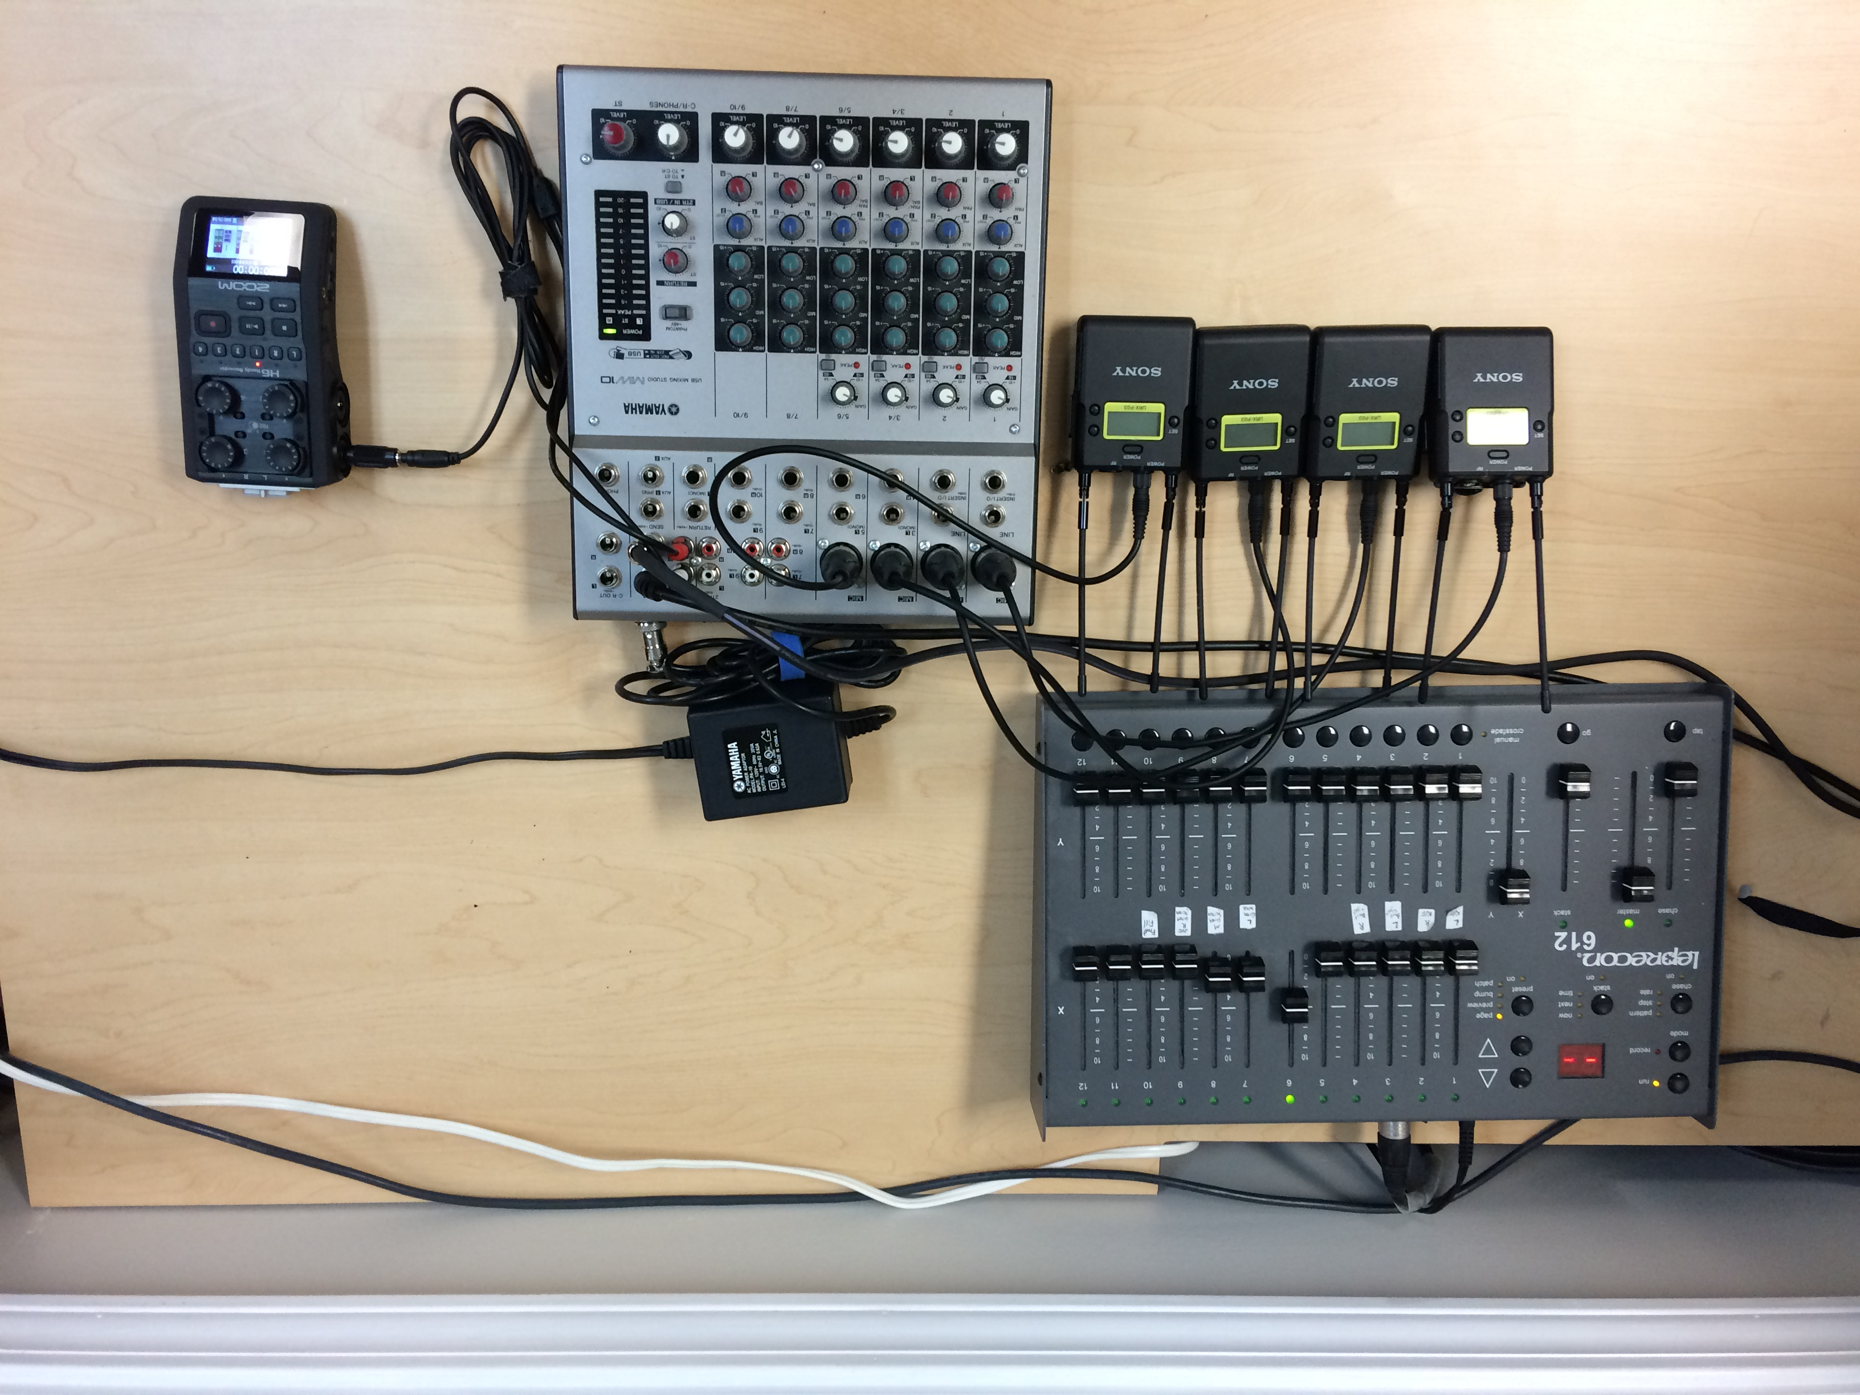
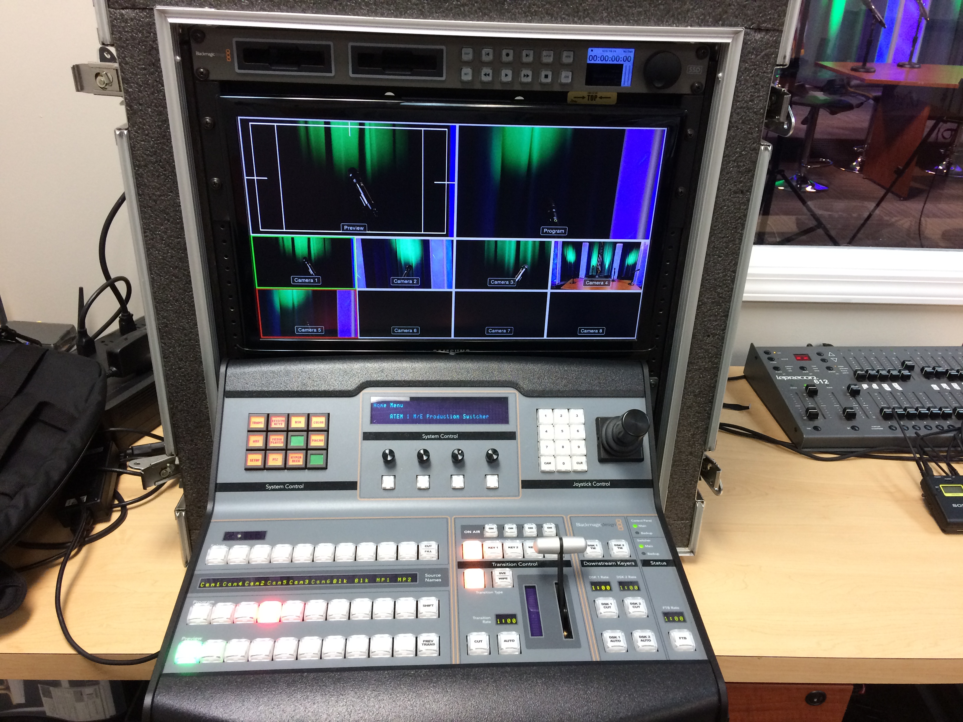
In Our Studio At City Hall
Notes:
Here are so close ups of the gear in the control room.
The switcher and some details about it.
The mixing board and Zoom H6 is essentially the heart of doing our Podcast.
I will show you some other low cost options in a few minutes.

Slide 17
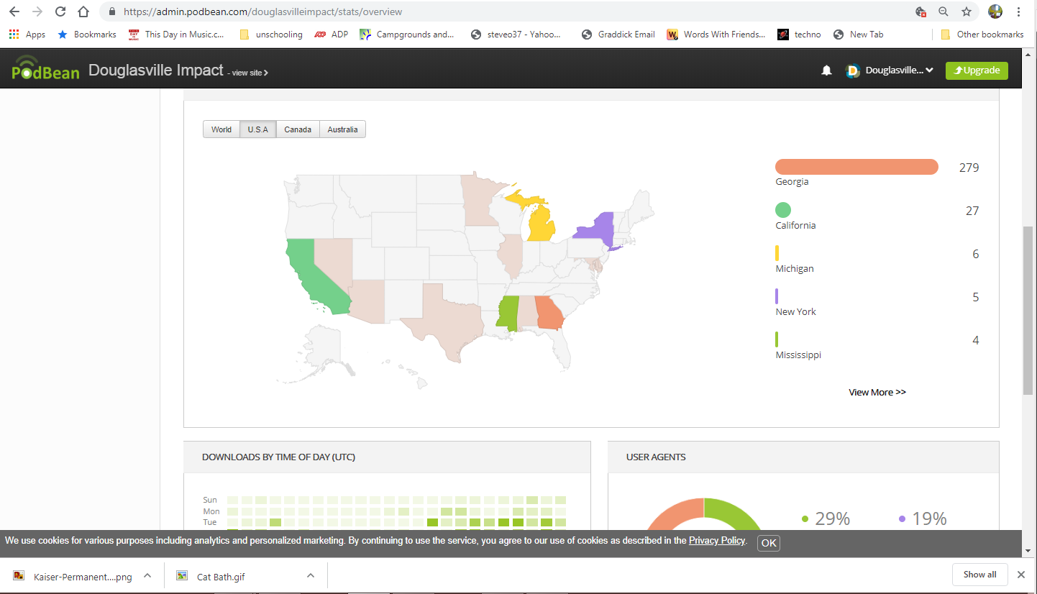
Who’s Listening?
Notes:
In the US:
We have had downloads from:
GA
California
Michigan
New York
Mississippi
Alabama
Arizona
Delaware
And Illinois
At least these are the places we know of….analytics are a little sketchy at this point.

Slide 18
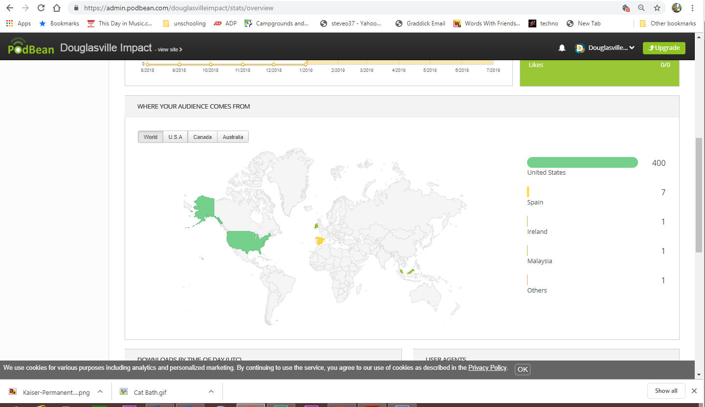
Who’s Listening?
Notes:
World wide:
The United States
Spain
Ireland and
Malaysia

Slide 19
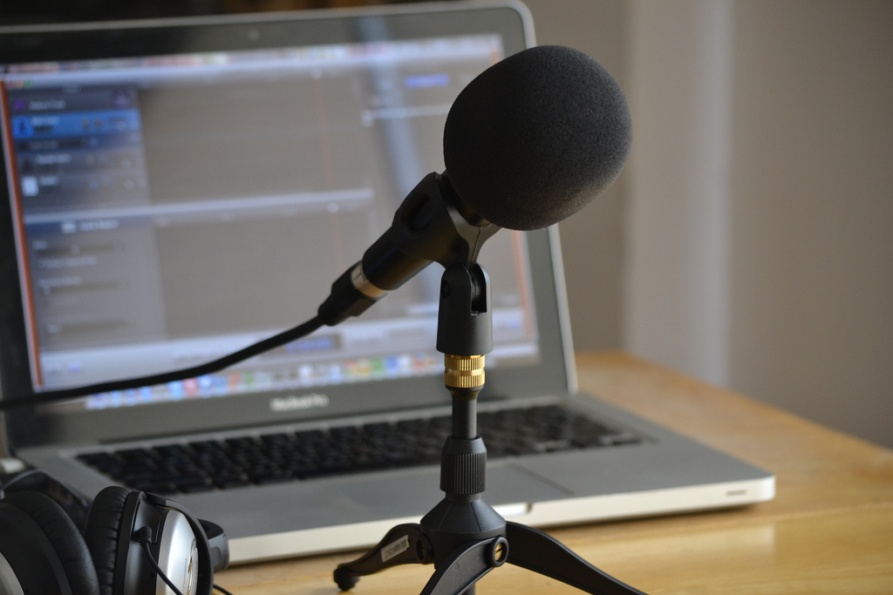
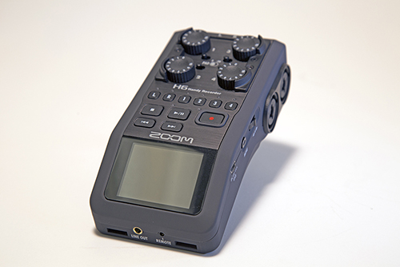
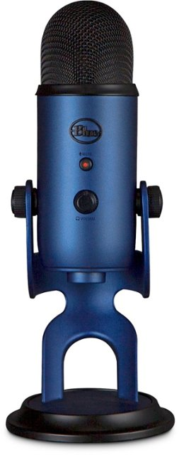
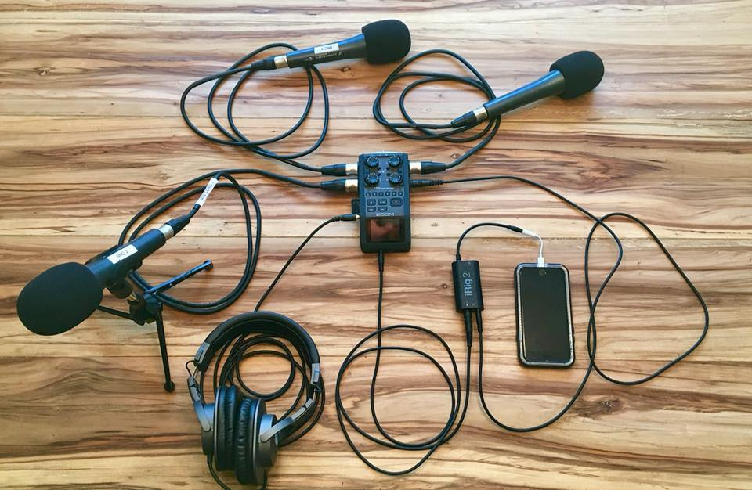
Other ways of doing a Podcast.
Notes:
So, if you don’t have a studio, are your out of luck? Not at all!
Here are some examples of gear you can use to get started.

Slide 20
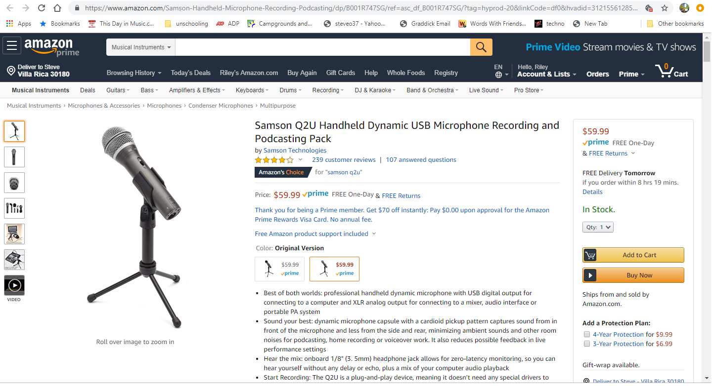
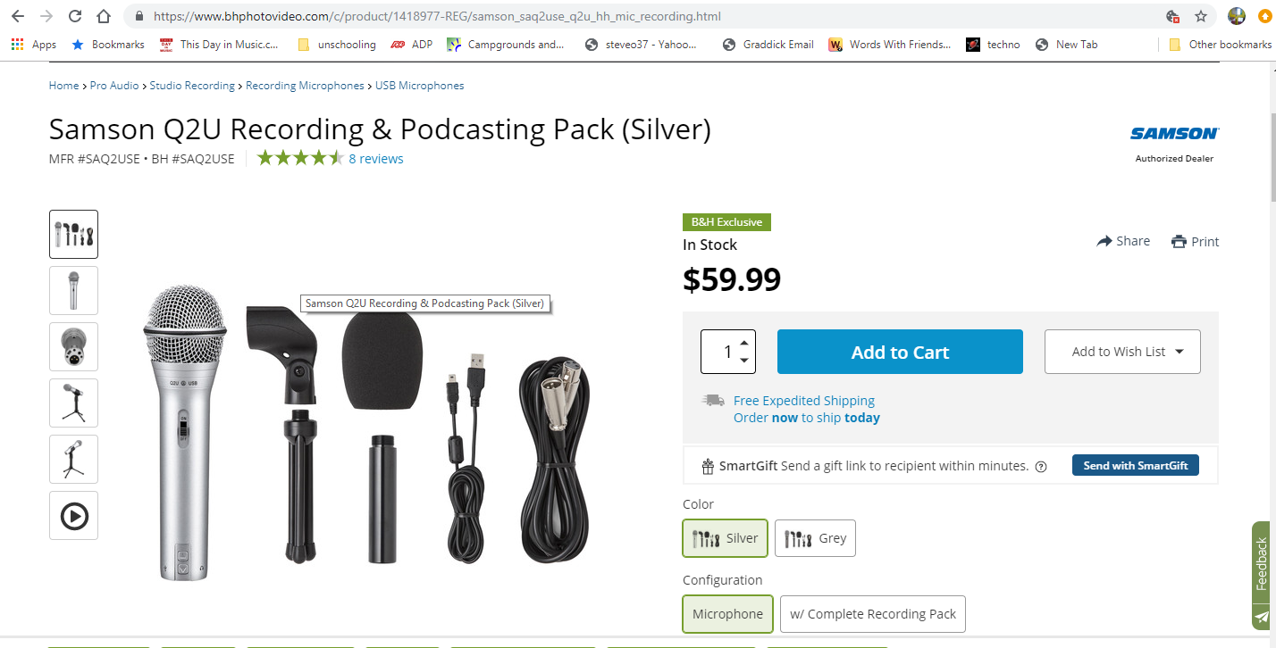
Other ways of doing a Podcast.
Samson Q2U Podcasting Pack
Notes:
I have not personally used this microphone but it comes highly recommended for the price. It comes complete with the mic, stand and cables. It will do USB and XLR output at the same time. It’s about 60 bucks everywhere I looked for it.

Slide 21
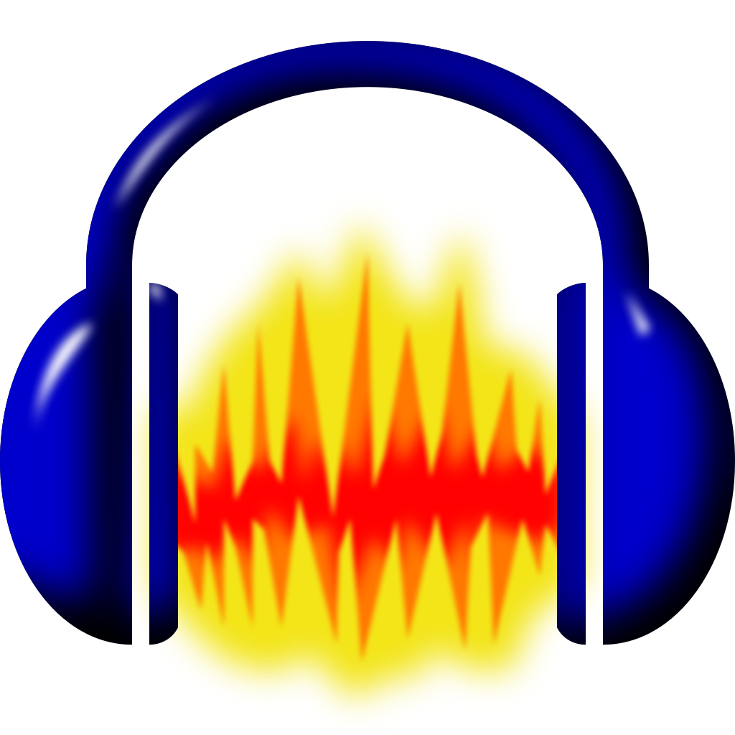
Other ways of doing a Podcast.
Garage Band
Audacity
Free Recording Software
Notes:
If you need something to record to, there is plenty of free software out there.
I think pretty much all Apple products come with Garage Band now a days, and Audacity has been around for a long time. One note about using Audacity, it is “destructive”, in other words, any changes made to the file are permanent and can not be undone. It’s really not a big deal if you are only doing a podcast on it though.

Slide 22
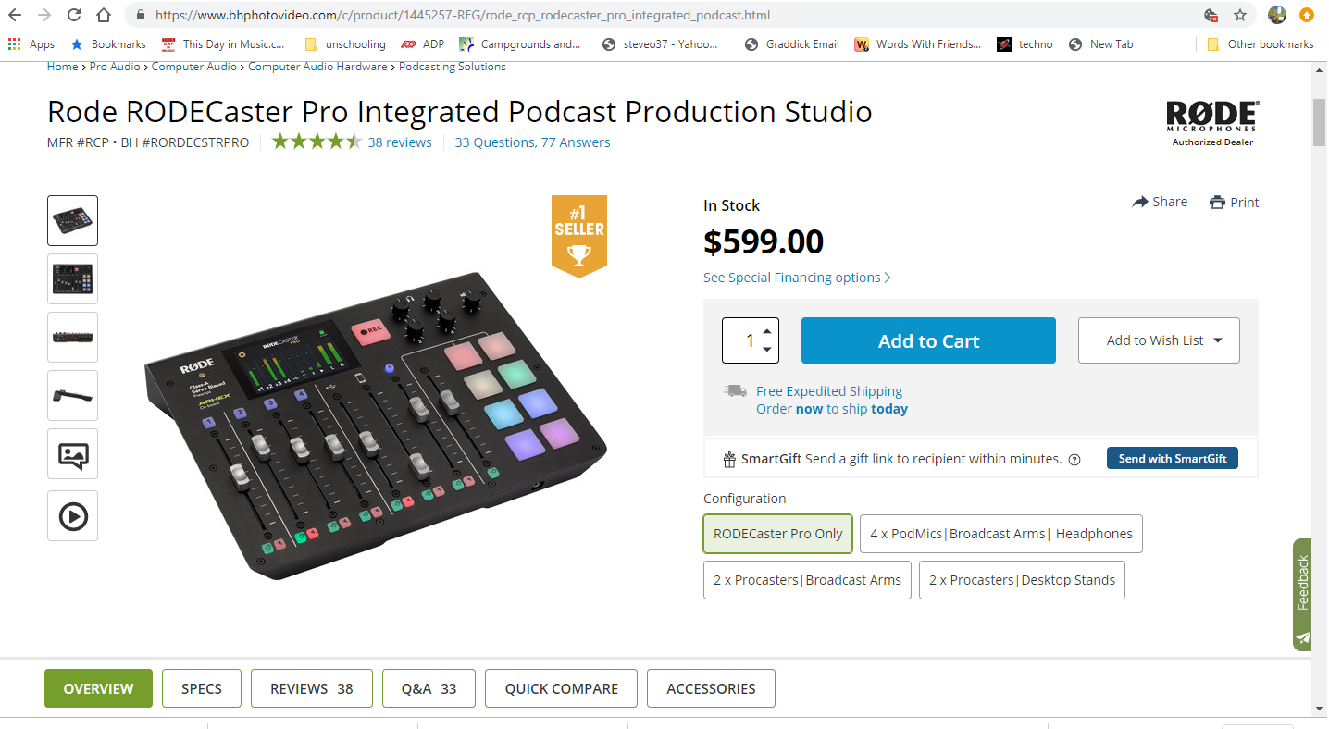
Other ways of doing a Podcast.
Rode RODECaster Podcast Studio
Notes:
So, if you don’t have a studio, are your out of luck? Not at all!
Here are some examples of gear you can use to get started.

Slide 23
Questions?
Notes:
So, if you don’t have a studio, are your out of luck? Not at all!
Here are some examples of gear you can use to get started.

