Slide 1
Georgia Open Records/Open Meetings and Social Media
Rusi Patel
General Counsel

Slide 2
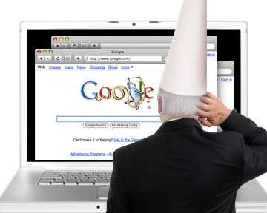
Two Life Lessons
The Law is always behind the times when it comes to technology
People do dumb things when it comes to technology

Slide 3
Legal Issues
First Amendment Law
Open Meetings and Open Records Law
Electioneering
Copyright
Accessibility
Bad Behavior
The Intersection of Public and Private pages

Slide 4
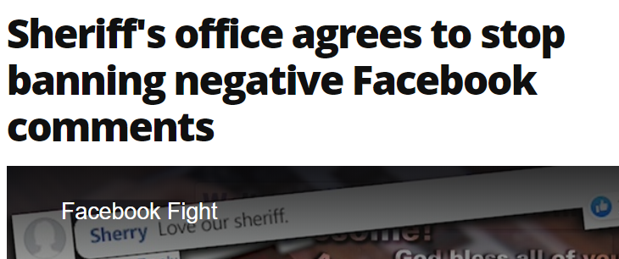
First Amendment
Can we block people or delete their comments?
Be Careful because you will likely get sued

Slide 5
First Amendment
Is the social media site maintained by the government itself?
If so, how is information posted to the site?
Are public comments allowed on the site?
If so, then a limited public forum has likely been created!

Slide 6
First Amendment
There is very limited case on how the First Amendment interacts with social media, but the case law is growing
Early cases indicate blocking people is seen as viewpoint based and basically a no-no
Early cases also indicate a mixed bag when it comes to deleting comments

Slide 7
First Amendment
What about hiding public comments from view?
What about banning comments which pose threats, profanity, or offensive and inappropriate comments?
What can we do?

Slide 8
First Amendment
What are some possible results of a lawsuit?
Government could be found to have unlawfully retaliated

Slide 9
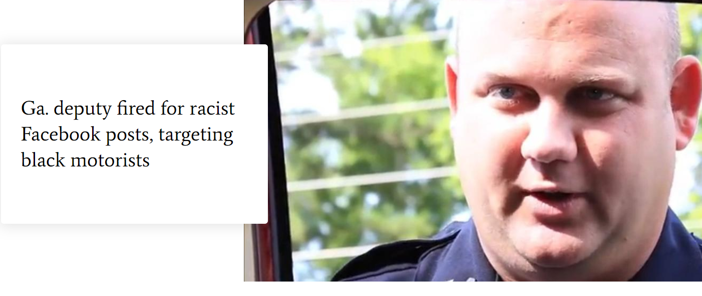
First Amendment
Can employees lose their jobs for things they post on personal social media pages?
How is the social media site created and maintained?
Does the posting color or impact the person’s ability to do their job?

Slide 10
First Amendment
New technology and old law!
Pickering v. Board of Education, the U.S. Supreme Court established the balancing test weighing the government employer’s interest in promoting the efficiency of performing the public services with the First Amendment rights of the employee as a citizen

Slide 11
First Amendment
New technology and old law!
Public employees must show that the speech involved a matter of public concern rather than one of personal interest
If an employee is making statements related to their official duties then they are not speaking as a private citizen and their statements are not protected from potential discipline.

Slide 12
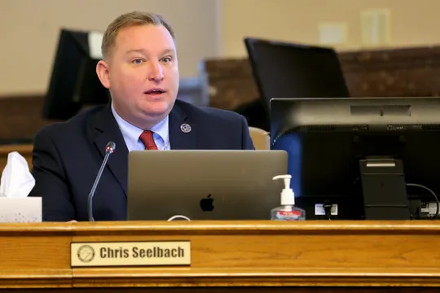
Open Meetings
Otherwise known as “Dumb things to do from the Dais”
Remember Government Business must be held in the open!
DON’T TEXT OR TWEET FROM THE DAIS

Slide 13
Open Meetings
“I wasn’t texting about city business!!!”
Does it matter?
How does the public know you are telling the truth?
How are they going to find out?
What if it was your personal phone?

Slide 14
Open Records
Are social media posts subject to open records laws?
What if I posted it from my personal phone/computer?
Who cares? How can they get materials off of my personal device anyway?

Slide 15
Local Government Records Retention Schedules
How long must records be stored?
What kinds of records are social media posts?
Does it matter who makes the post?
Should we regulate who can make posts?
How can some of this be accomplished?

Slide 16
Local Government Records Retention Schedules
Typically, social media posts are classified as “Correspondence”
Administrative Correspondence must be kept permanently
General Correspondence must be kept for five years
Transitory Correspondence must be kept for the useful life

Slide 17
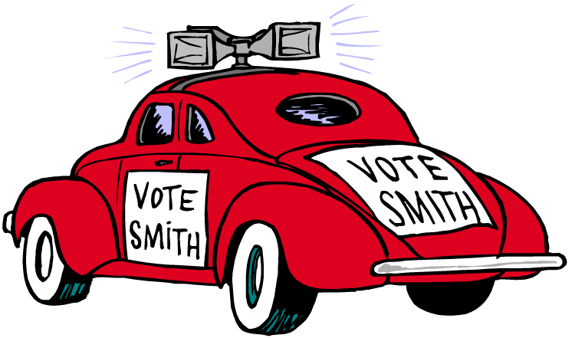
Electioneering
Cannot use government resources for private gain, including your own campaign!
Posting campaign events from a government social media page
Using government issued phones/computers to post campaign events

Slide 18
Copyright
Are government operated social media pages required to comply with copyright law?
Is there sovereign immunity if we mess up?
What if it does not say copyright?

Slide 19
Copyright
Pitfalls
Unauthorized use of photos, videos, text without permission
Sharing content without linking to the source
Assuming something is “Fair Use”
What is fair use?

Slide 20
Accessibility
Americans with Disability Act
This applies to websites!
The U.S. DOJ has sought comment on how the ADA might interact with social media

Slide 21
Bad Behavior
We have all seen things on social media from public officials that should never have been posted, what are some legal issues which could arise as a result?
Discrimination
Sexual Harassment
Defamation/libel/slander

Slide 22
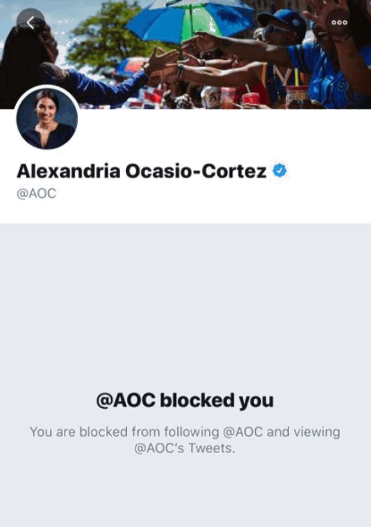
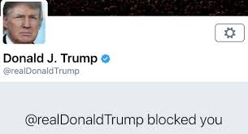
The Intersection of Public and Private Pages
When does a personal social media page become a public social media page?
Litigation involving President Trump may be the guide
2nd Circuit held that his Twitter page had become a public forum and he was acting in a governmental capacity when he blocked people

Slide 23
The Intersection of Public and Private Pages
Lessons:
Just because you created the social media page as a private citizen does not mean it will remain as a private page
Keep your private and professional lives separate

Slide 24
Questions?
Rusi Patel
General Counsel
Georgia Municipal Association
(678) 686-6210 (Direct)
rpatel@gmanet.com

