Slide 1
The Power of Storytelling
Or How to Move a Budget Book
from Boring to Brilliant
15 August 2019
Georgia Government Communicators Conference

Slide 2
Name that tune
Think about your organization &/or your department.
What is your theme song for the year?
Notes:
I’ll explain why later.

Slide 3
Budgets don’t have to be boring
Focus on words, not the numbers
Use photos and graphics
Engage staff and the community
Have fun

Slide 4
Storybook budget
The Budget Narrative
Words – Not everyone is a “numbers” person
Performance Metrics – Data helps illustrate the complete picture
Photos – A picture tells a thousand words
Moved the Numbers to the middle of the book
Additional “Wordy” components in the back
Notes:
FY07-08 added the budget narrative to document – it was departmentally focused
2010 Strategic Plan was adopted late 2010
FY11-12 changed narrative focus to strategic plan principles.
Like other books, some are only interested in what happens at the beginning and the end
Rounded out the book with more words and pictures in the appendices. Includes budget guide, NCS results, benchmarking report and financial policies…

Slide 5
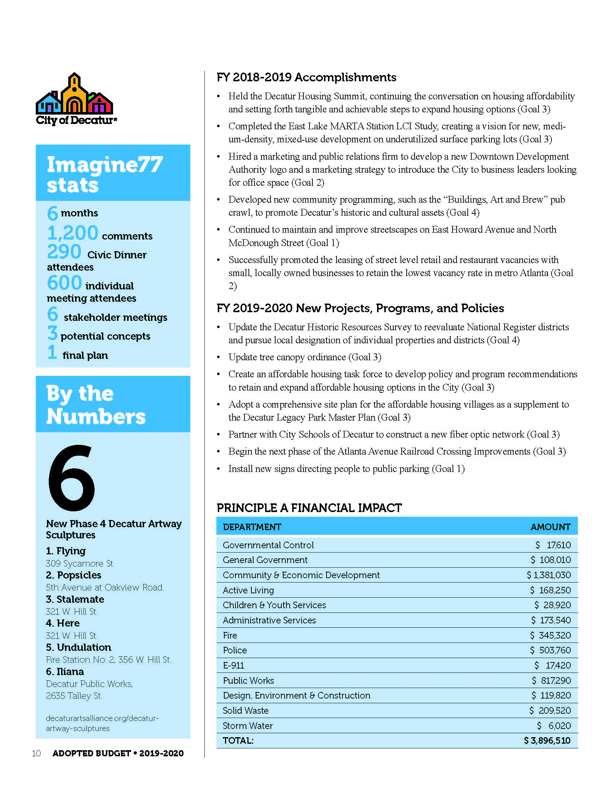
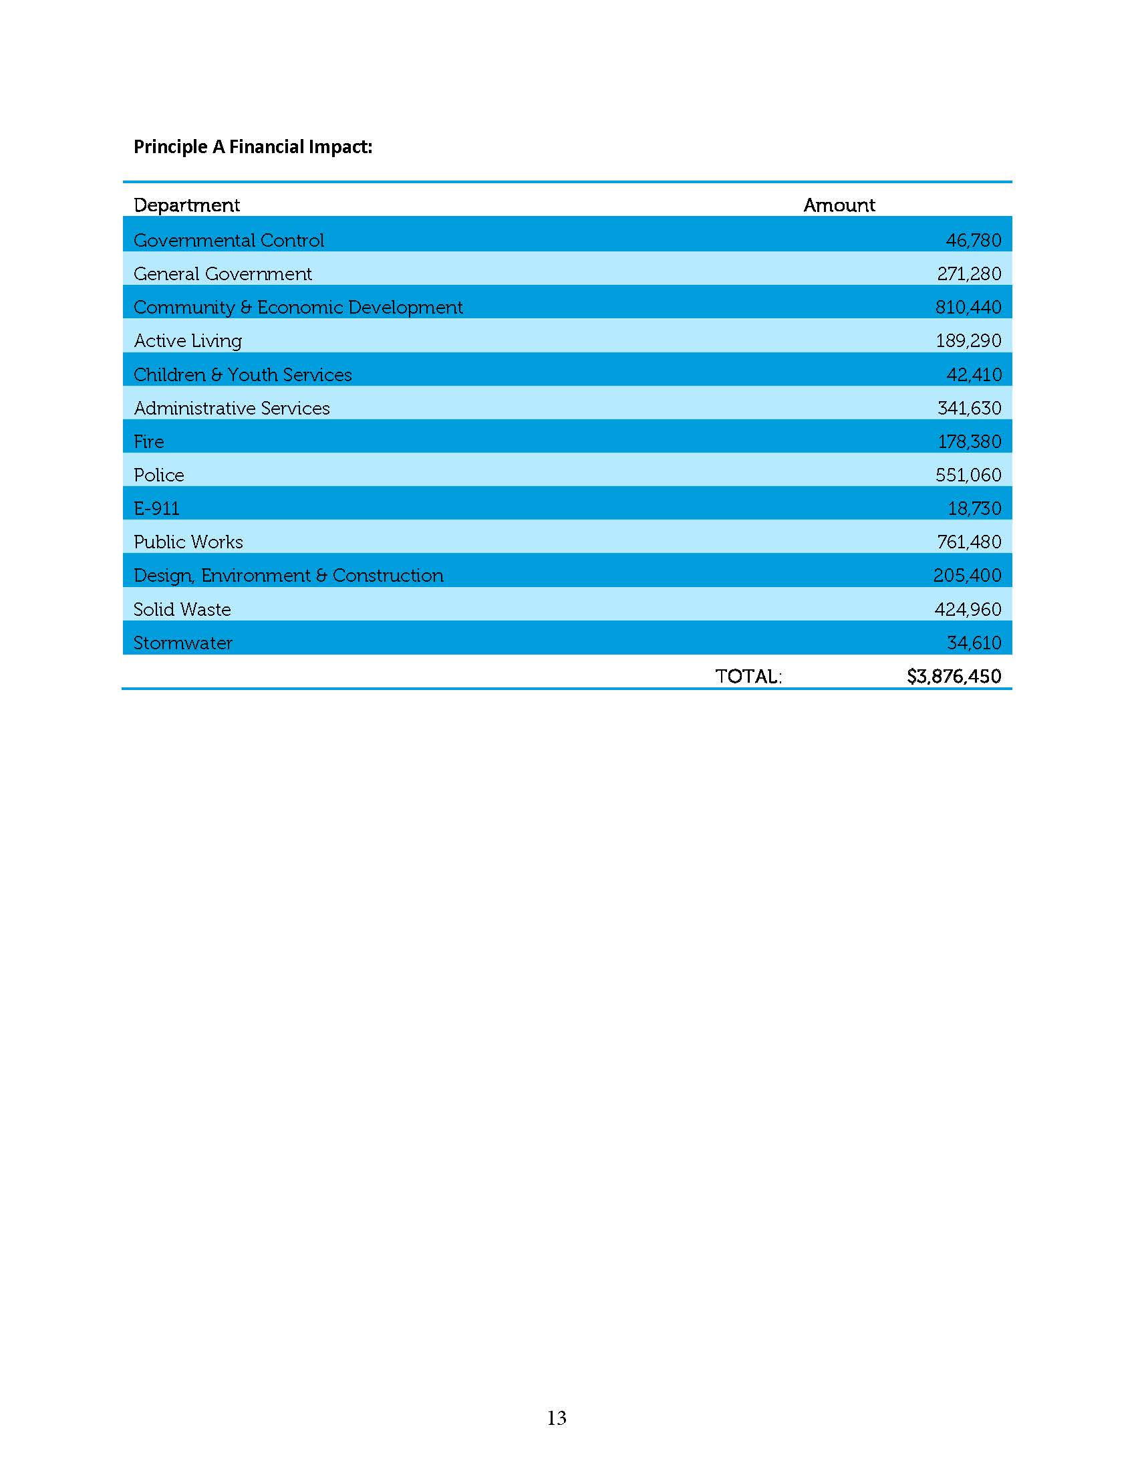
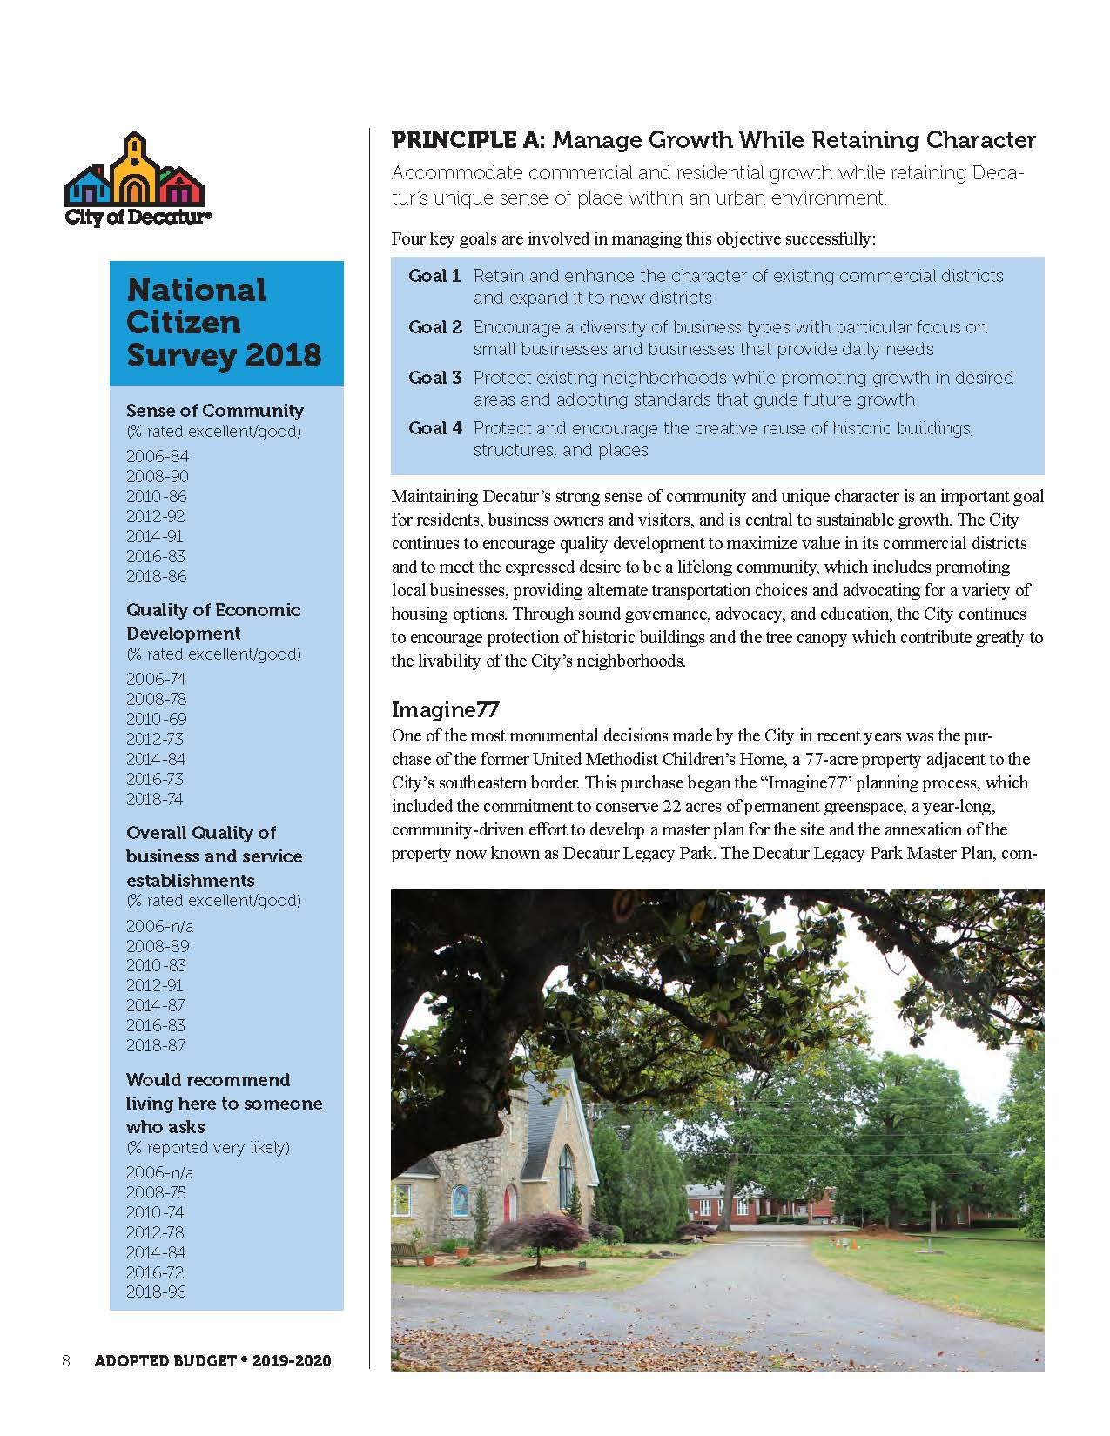
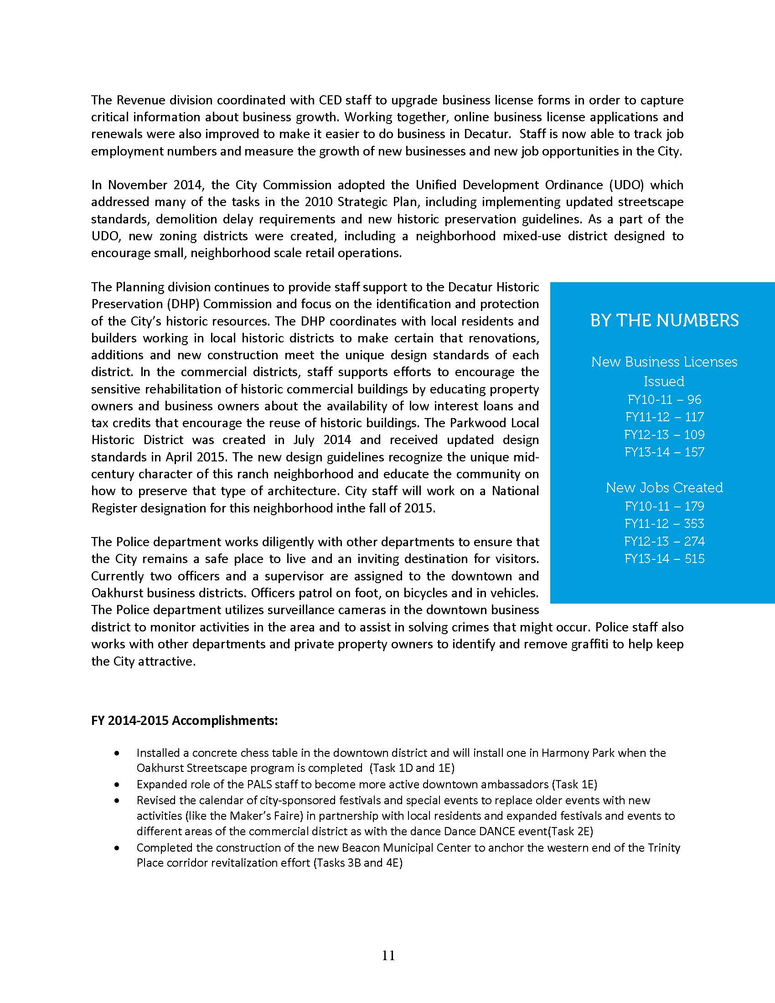
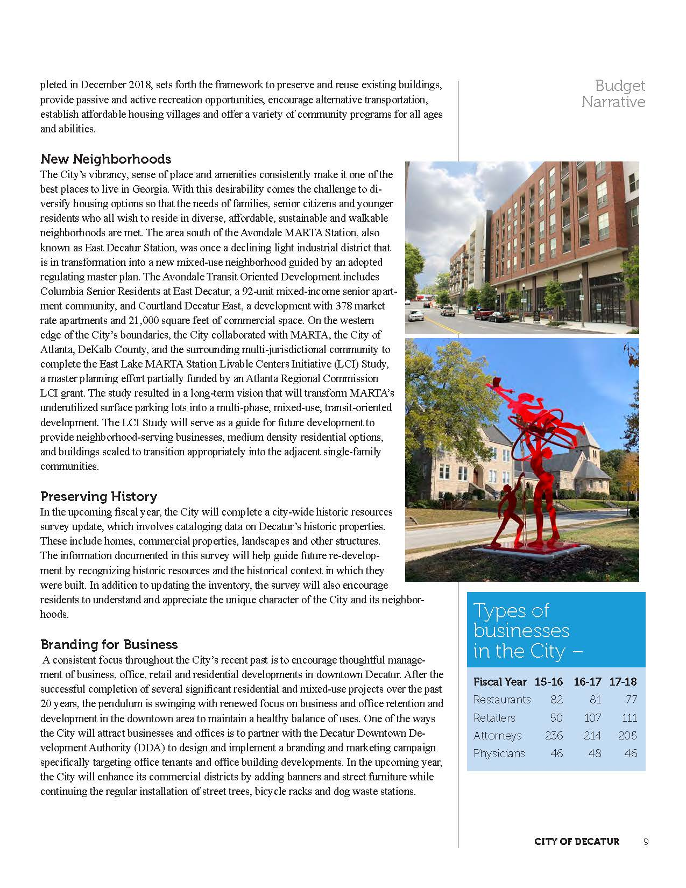
Notes:
Multi year approach – quantitative and qualitative
Started with the what and why; followed by the how much; and finally noting the how well we were doing

Slide 6
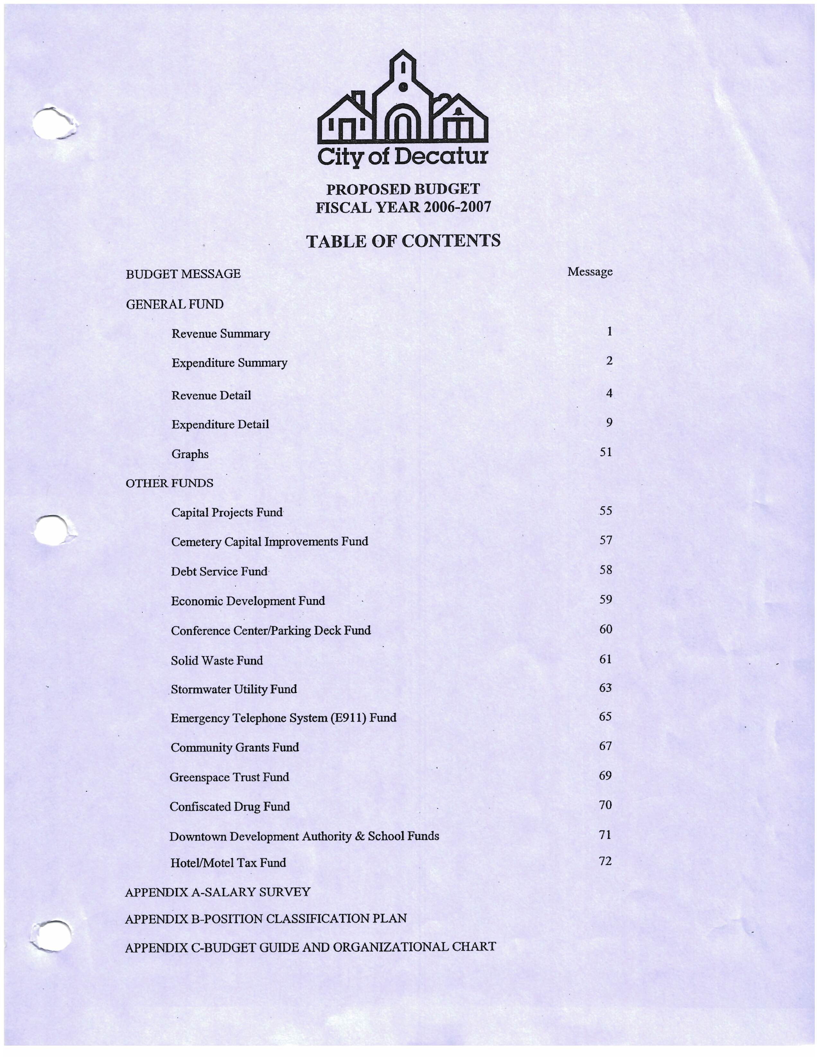
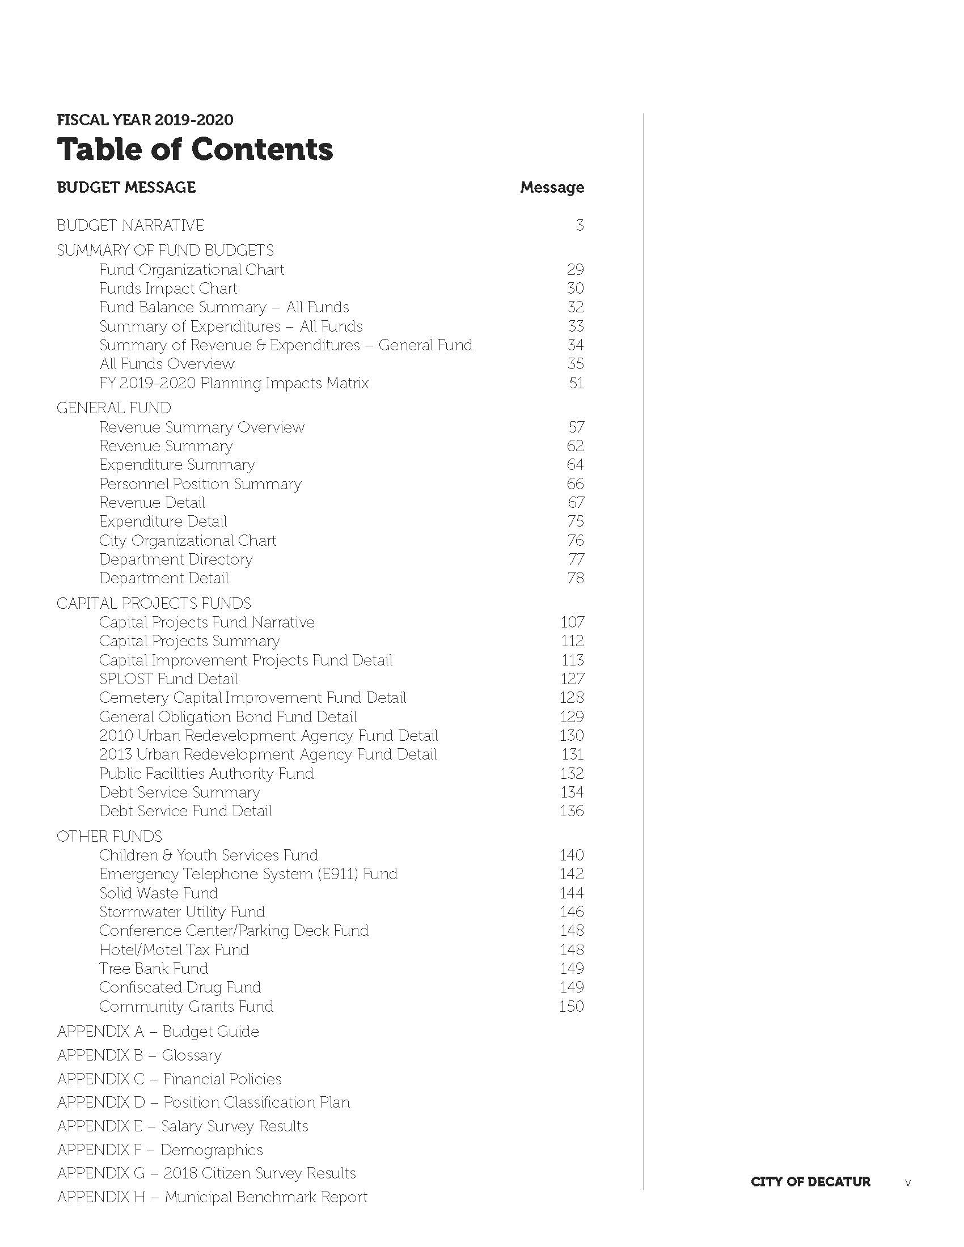

Slide 7
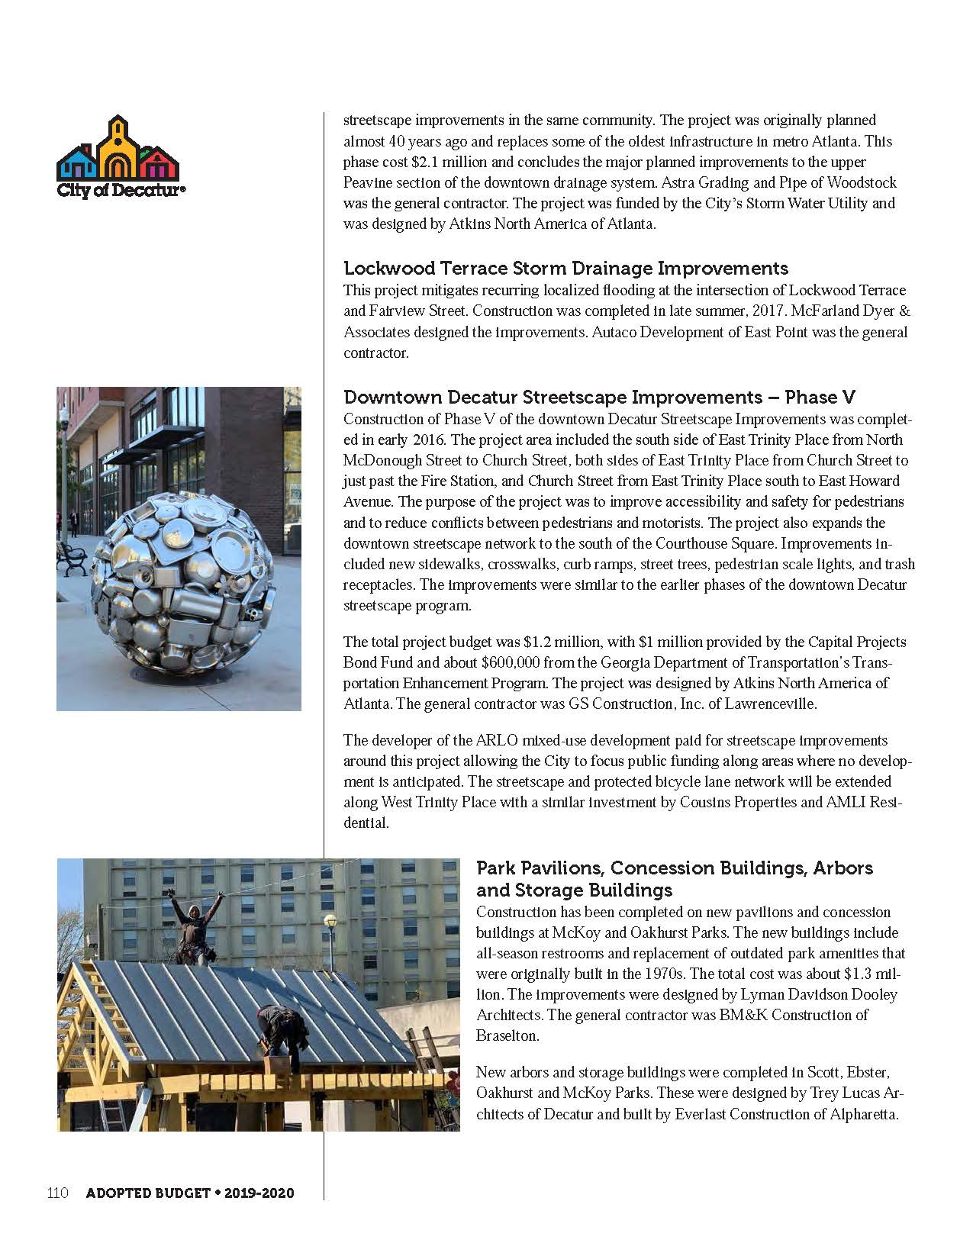
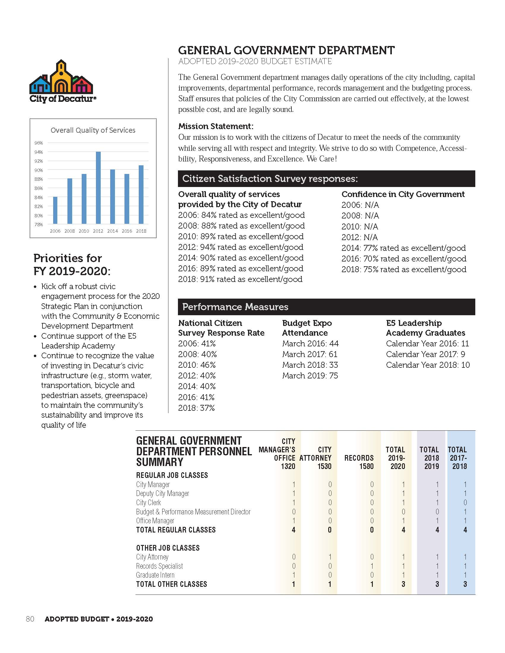

Slide 8
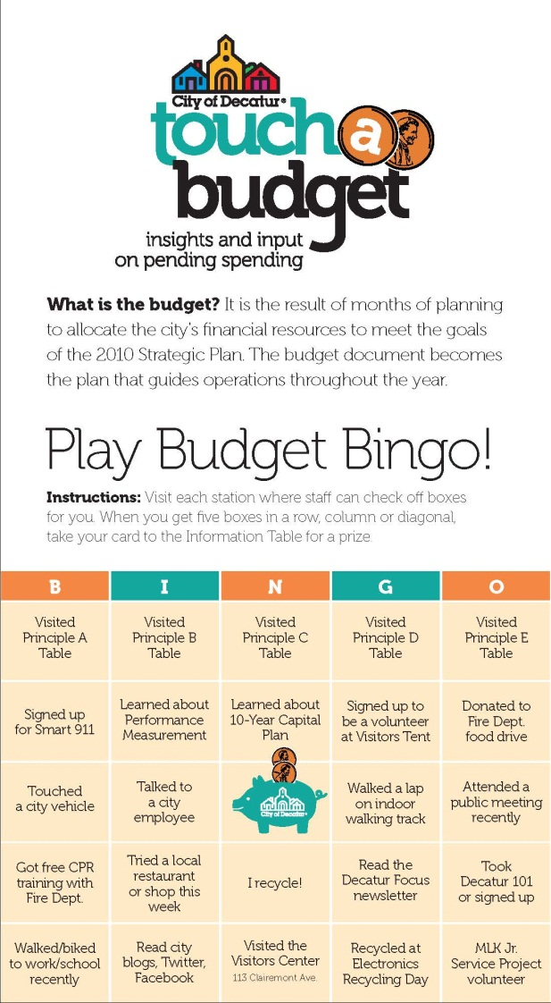
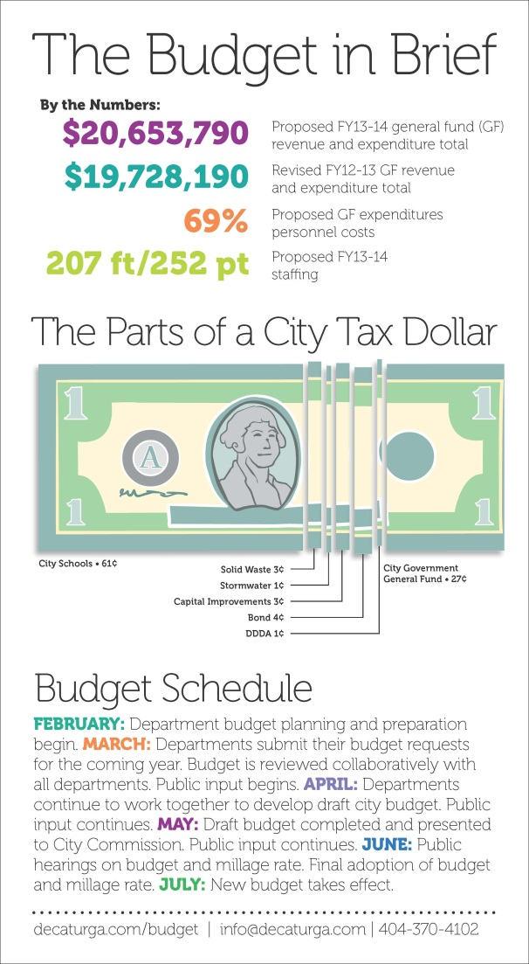
Touch a budget – the budget expo
Combination of Touch-a-Truck event and a science fair
Use of a “game” to assist in circulation
Notes:
Staff bring the items recommended for funding in the upcoming fiscal year so that community members can touch and talk and see for themselves. Allows staff to make connections with each other as well as residents. Recommend snacks and music, prizes and good weather.
Bingo, Tic-tac-toe, Cards against Humanity
Other things we’ve tried – beer and budget and budget focus groups

Slide 9
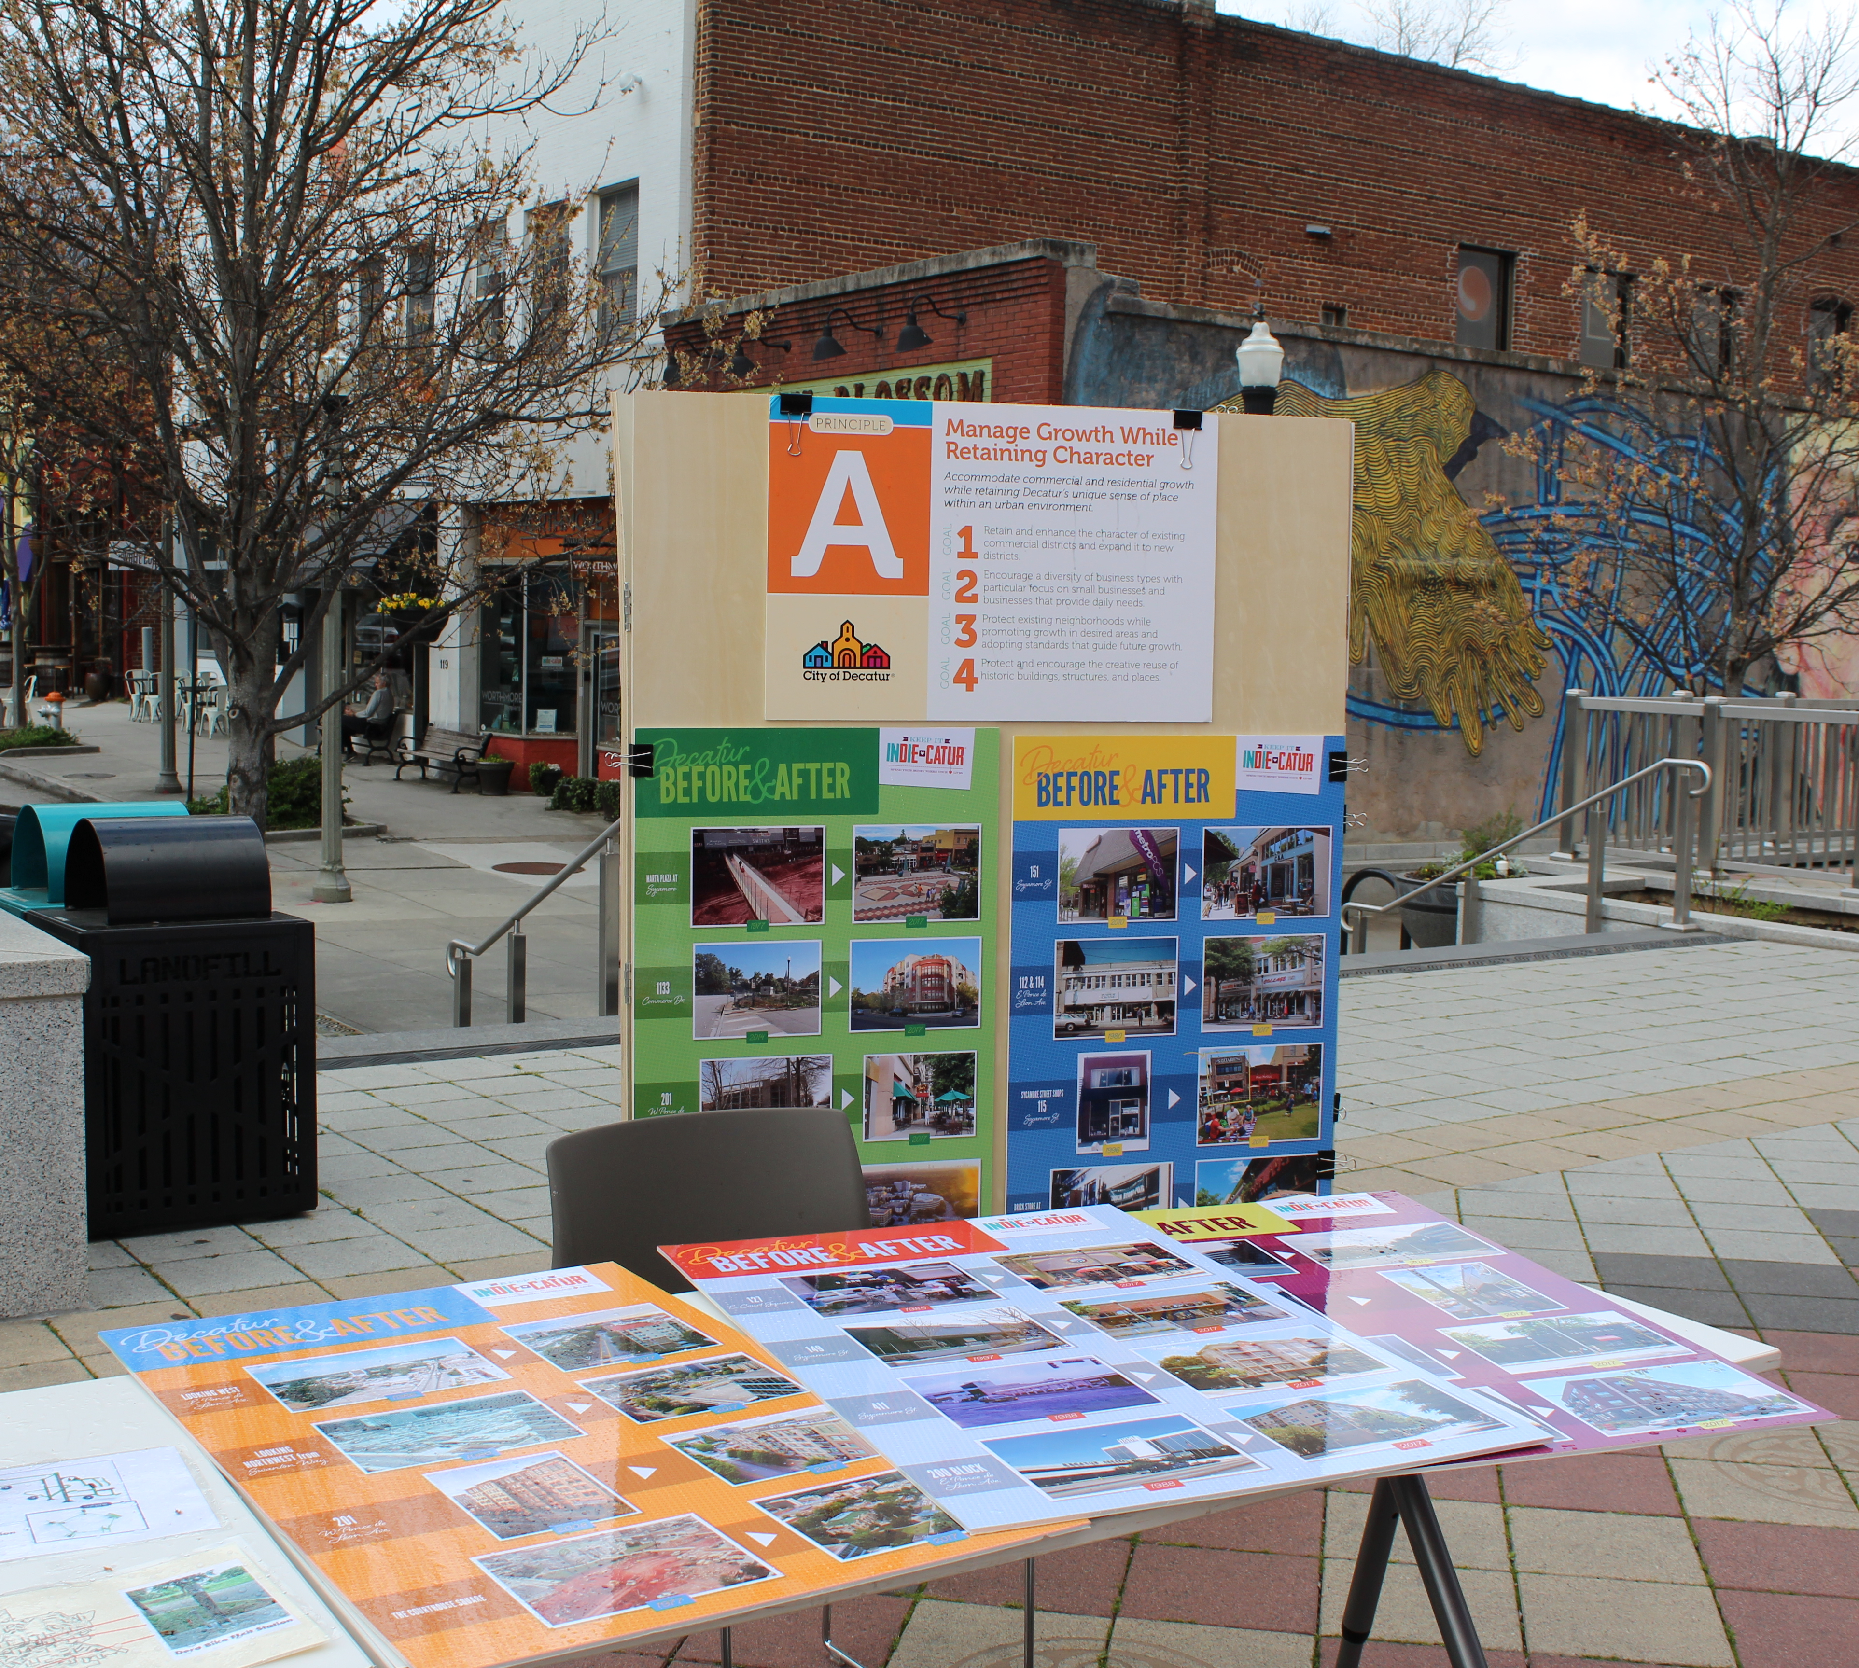
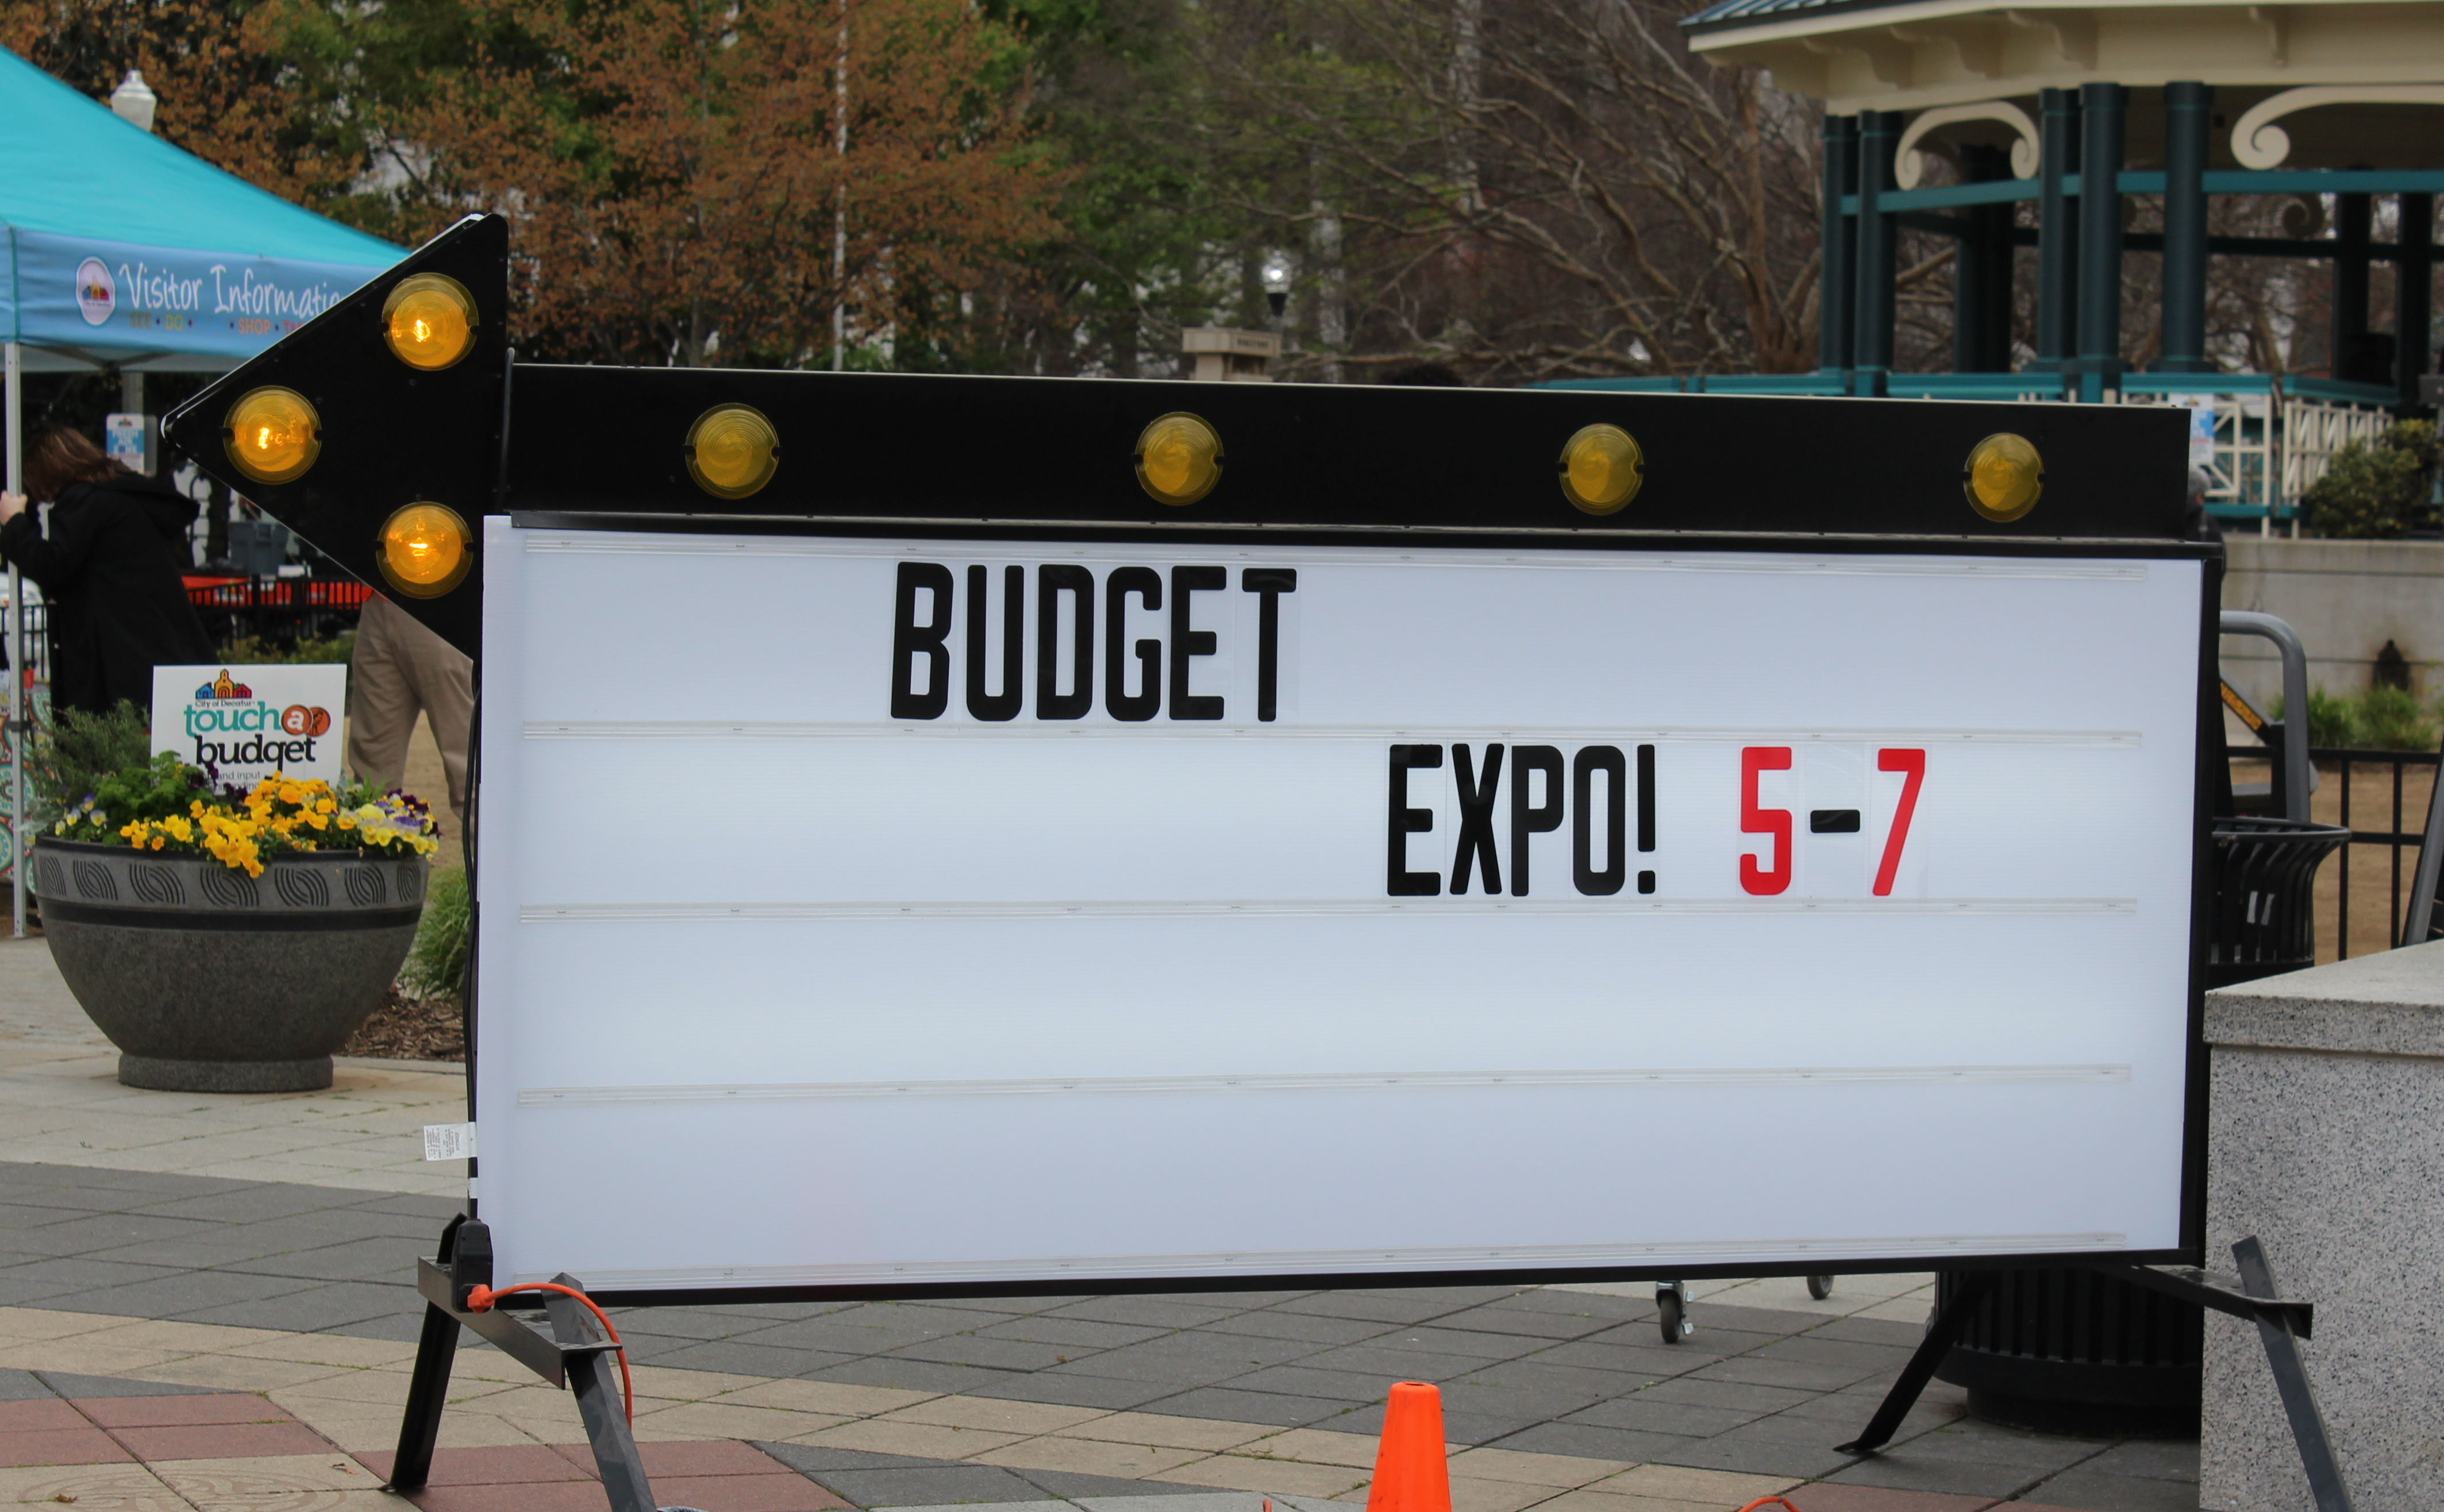
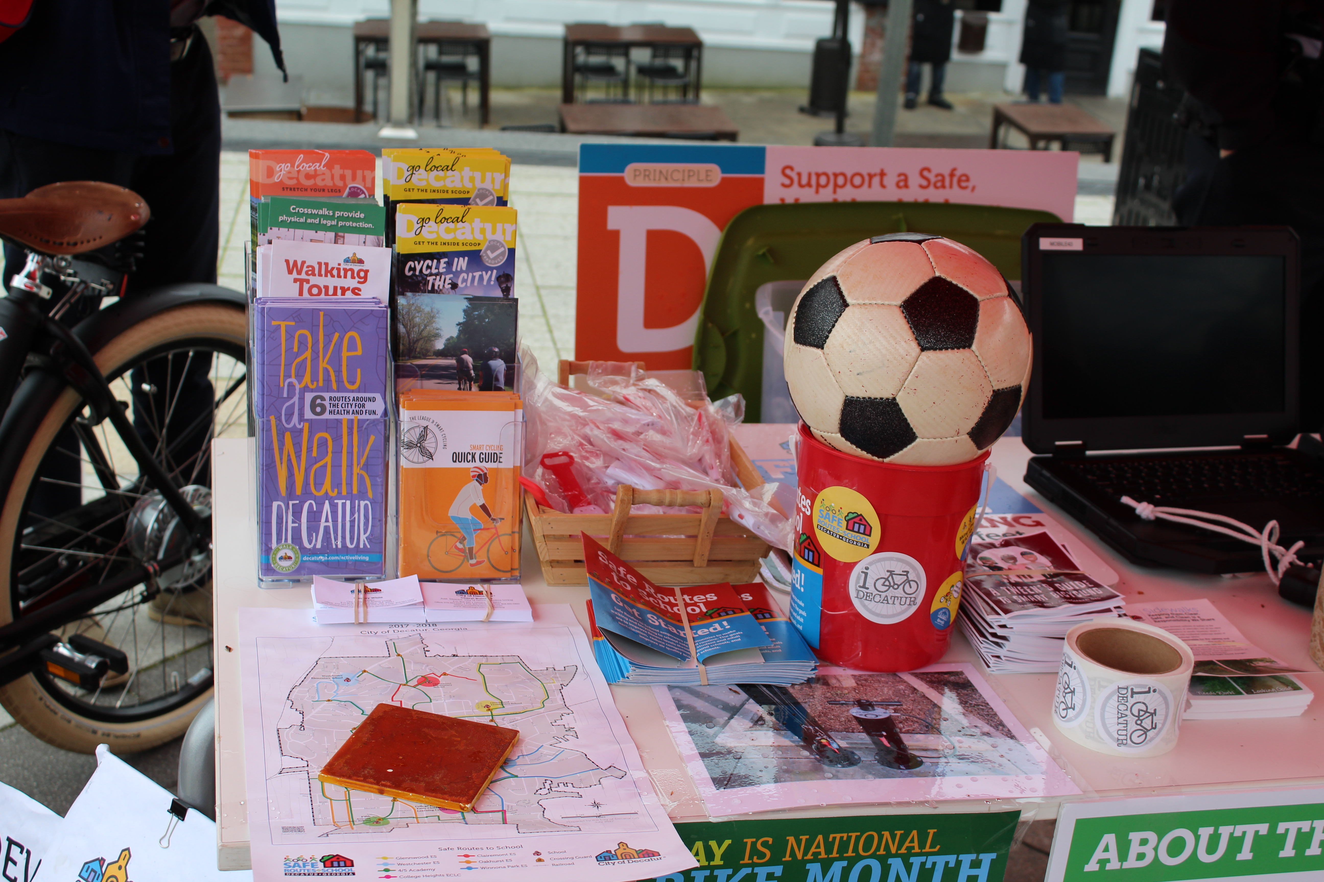
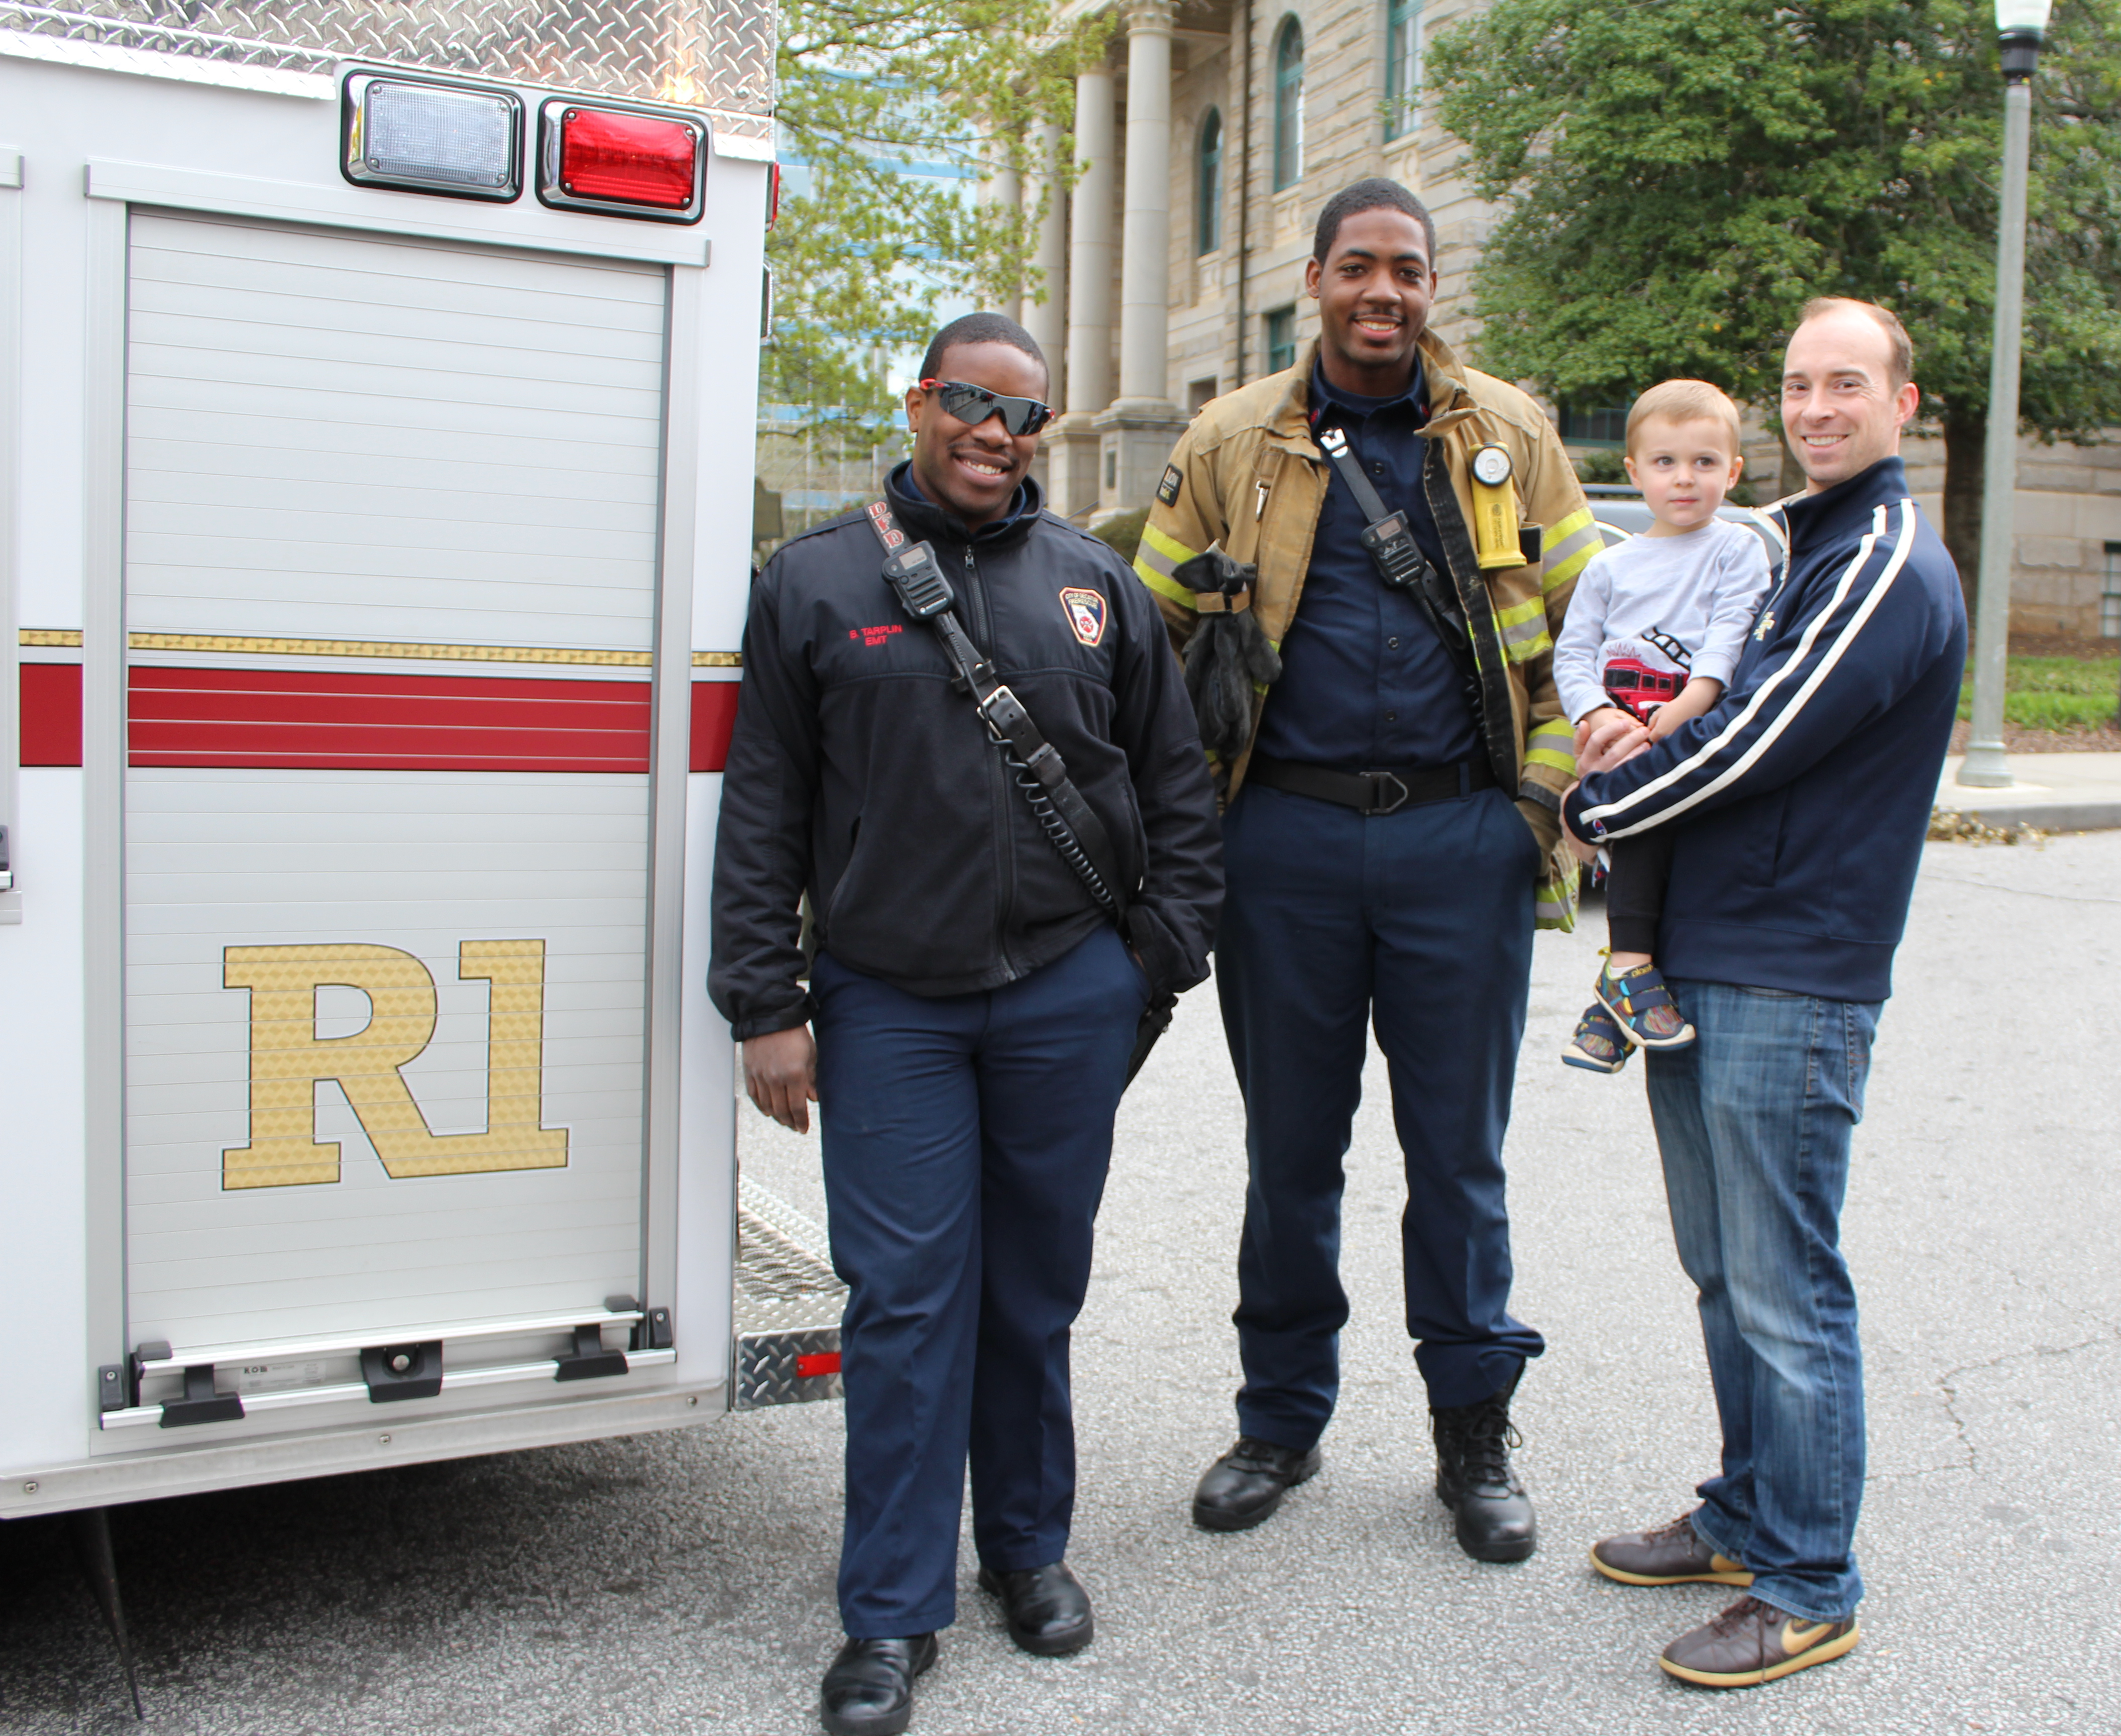
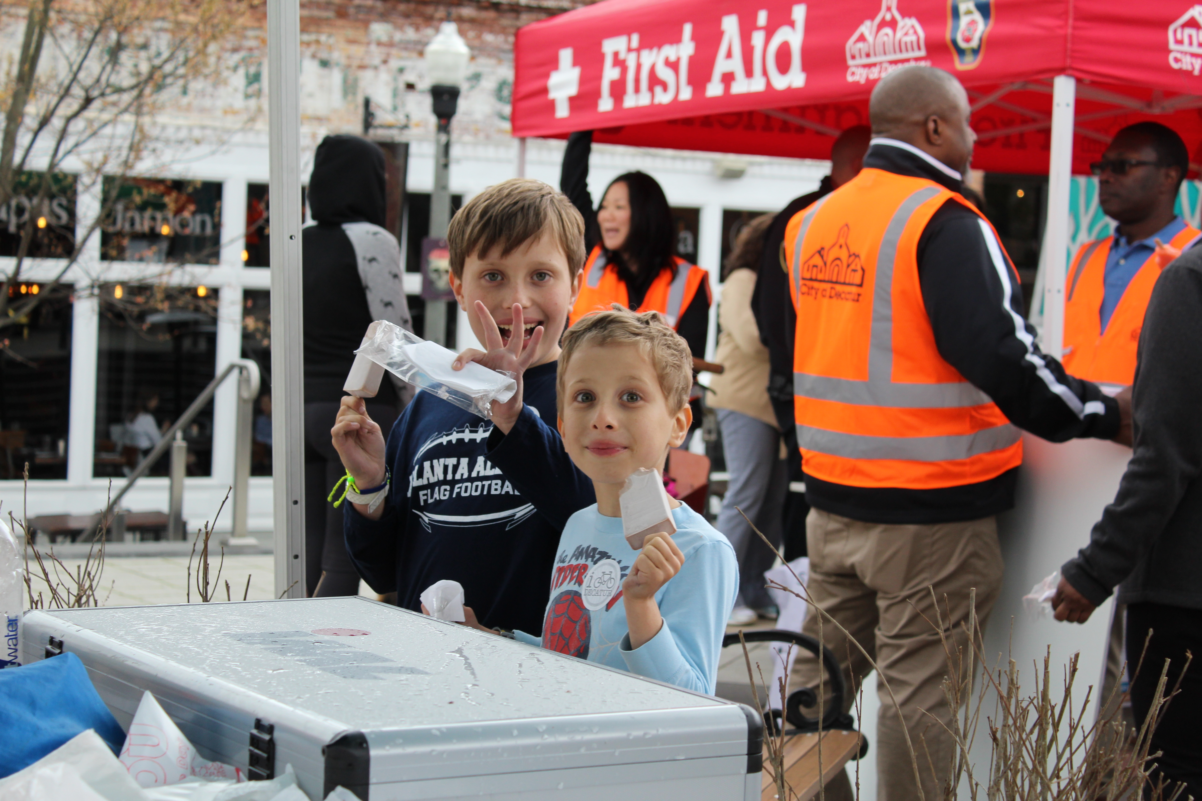

Slide 10
Have fun
Play Games
Budget Expo Bingo
Penny Exercise
Work in Teams
Budget Narrative Team
Performance Management Team
Budget Theme Song CD
Departments made the “A Side” selection
City Manager’s Office made the “B Side” selection
Notes:
Penny Exercise – Overall budget translated into $1, given 100 pennies to distribute among a few funds and departments. Allows us to understand others priorities and allows users to understand how decisions are made.
Teams draft the five sections of the narrative – enjoy food together while working. Some groups have made t-shirts.
CD produced for 4 years.
Examples of A side = Sister Sledge “We Are Family” (CED); Louis Prima “Pennies from Heaven” (ASD); Talking Heads “Burning Down the House” (Fire); Jackson Five “I’ll Be There” (Police)
Examples of B side = Jefferson Starship “We Built This City” (CED); Men with Hats “Safety Dance” (Fire); Queen ”Bicycle Ride” (AL); The Clash “I Fought The Law (Police)

Slide 11
Thank you
Meredith Roark, City Clerk/Budget Director
Meredith.Roark@decaturga.com or 404.370-4102

