Slide 1
Disclaimer
This presentation is a general overview for the Designated Benefits Contact at Participating Employers.
The employee benefits offered through the Life & Health Fund are described in the applicable Benefits Booklets and Schedules of Benefits posted at www.gacities.com/LHForms, and in the Participating Employer’s Declaration Statement (together, the “Plan Documents”). In the event of a conflict between this presentation and the Plan Documents, the terms of the Plan Documents control.

Slide 2
Getting ready for
Open Enrollment
September 30 2019 to November 1, 2019
Notes:
Welcome and Thank you all for attending. I am Denise Joyce, Director of Life and Health Services. All of us in the Life & Health department at GMA are planning and working diligently to make this Open Enrollment as streamlined as possible.
The purpose of this webinar is to empower you with the information you need as Life & Health contact to:
meet your responsibilities as the contact
gain a better understanding what you are offering through the Life & Health program.
but most importantly to help your employees with the steps they need to take so that they and their families go into 2020 feeling assured about the benefits you have opted to provide them.
At this end of this webinar, there will be some time to submit some questions. But Let’s get started…

Slide 3
What We Will Address
The Basics – Maintaining Employee Eligibility Record with GMA
HIPAA Privacy & Security
What’s New 2020
Important Dates
Open Enrollment (OE) for the Life & Health Contact
Open Enrollment for your Employees
Participating Employer Portal (PEP)
Summary and Q & A
Notes:
We will jump right in with the information we will be covering to help prepare you for this open enrollment period. If some of the information to be covered seems redundant to you because this is your 10th open enrollment with GMA, please be patient as there are many newcomers to the role of Life & Health contact.
And many of this topics could warrant their own webinar but for the purposes of this webinar we want to share what is most necessary to assist you over the next couple of months and into 2020.
List off the topics: Ad Lib

Slide 4
The Basics -
Maintaining Employee Eligibility Record with GMA

Slide 5
Benefits of Maintaining Employee Eligibility
Good information & data makes for a smooth and positive enrollment
  Anthem/Aetna/Delta Dental eligibility feeds
  Monthly Billing invoices
  GMA processing - more return emails & requests
Timely enrollments, timely terminations protect city from liability and reduce costs for everyone
Cost Containment – adverse selection & impact on claim experience, disputes/litigation, city paying out of pocket for medical claims
Notes:
As we begin in our first topic - The basics.
We at GMA the Life & Health program can not stress enough:
how important timely and accurate submissions of completed benefit forms and the supporting documentation create a positive experience for you and your employees as they interact with their insurance and benefits. The not so good forms and supporting documents that do get submitted can take on a life of their own because this first important step impacts… [BULLETS}
Timely enrollments & terminations protect your program from liability and reduce costs for everyone.
We want the folks that should be covered be covered. As eligible employees they should be using their plans to stay healthy and actively at work.
When an employee is not enrolled timely or does not makes changes timely or is not removed timely.
It can be more than a tale of an unhappy employee
It could result in claims not being paid when they should be or even worse claims being paid when they shouldn’t be.
This means next year’s pricing could be directly impacted or possibly the city be responsible for claims directly.
In addition, there could be legal violations or disputes that could occur and fall back to your city or entity.
There are a lot important aspects to what appears to be just a form…

Slide 6
Eligibility & Enrollment Guidelines
As a Participating Employer (PE) you must offer coverage to all eligible employees – by giving them enrollment materials in time for them to enroll by the deadline. Plan cannot pay benefits for an ineligible person – a person must be either eligible or on COBRA.
Follow the Employer Instructions for providing documents to eligible employees.
Follow the Employer Instructions for sending completed forms and supporting documents to GMA.
Submit termination and drop forms to GMA IMMEDIATELY.
Why is this so important?
  There is the risk of Legal violations, potential ACA penalties if PE fails to provide forms and notices when required to do so
  There is the risk that the Participating Employer will be “on the hook” for medical claims or paying COBRA premiums
  Neither the GMEBS, the Trust Fund, the Trustees, nor the Program Administrator will be liable for the Participating Employer’s failure to properly and timely offer coverage or properly and timely terminate coverage.
Recommendations:
  Collect a waiver if eligible employee does not enroll in Health Plan and keep on file
  Check bill each month to make sure it matches eligibility.
Notes:
So let’s touch briefly on some core guidelines and where these stem from when interacting with Life & Health:
When your government entity entered into the Life & Health program, a Participation Agreement and Declaration document were executed with these understandings.
These documents guide and assist us in administering your coverage along with your help.
[BULLETS]

Slide 7
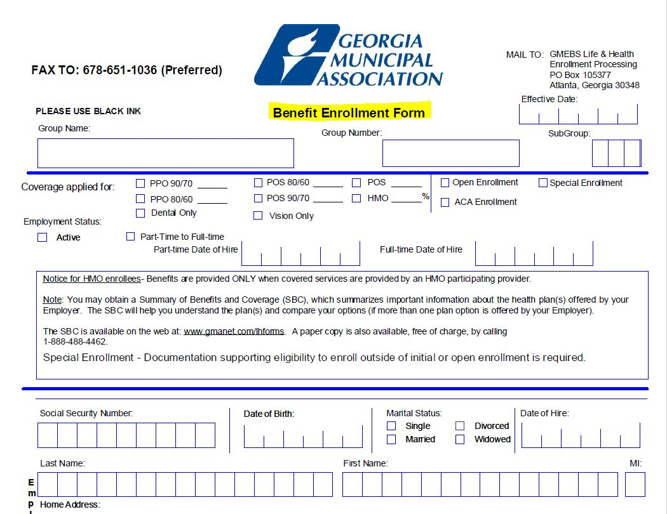
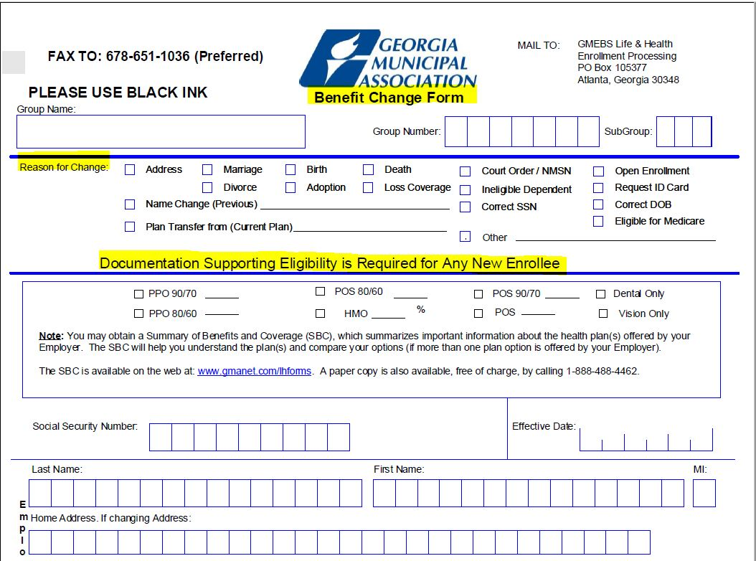
Basics of Eligibility – New or Add/Change
What is required for a new hire or anyone adding dependents and/or coverage?
  New hire or changing part-time to full-time
    Benefit Enrollment form
    SAVE affidavit
    Copy of Driver’s License
    Dependent documents if coverage other employee only
      Spouse: marriage certificate
      Child: birth certificate
  Mid-Year Change due to Special Enrollment event (e.g., marriage)
    Benefit Change form
    Adding spouse/child
      Spouse or stepchild: marriage certificate
      Child: birth certificate
    Proof of Special Enrollment event (e.g., marriage certificate within 30 days of marriage)
Notes:
Next up – New coverage or changing coverage – this applies throughout the year and during Open Enrollment.
[BULLET] – new / change
The new hire tends to be the most common “addition” for your employees
However, sometimes an event happens, that is considered a Special Enrollment event (such marriage). In this case, a Benefit Change form is needed. And this change needs to addressed within 30 days of the event occurring. In addition to the Benefit Change form, supporting documentation must be included as well (ex. Copy of marriage certificate).
Remember for Open enrollment, if an employee is adding coverage for a spouse or children we will still need copies of the marriage certificate and/or birth certificates. Open Enrollment does not remove this requirement.
Need to add snips of forms on this slide…

Slide 8
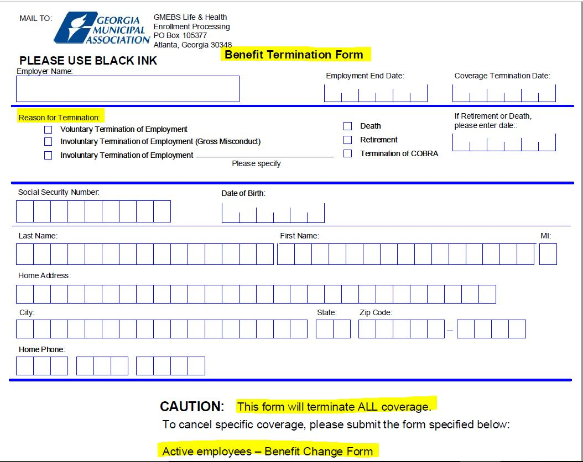
Basics of Eligibility – Coverage Ends
What is required when coverage ends (employment or eligible status ends, dependents to be removed or employee opts to end coverage, etc.) ?
  If the employee is no longer employed, the Benefit Termination form should be completed.
  If the employee remains employed but coverage is changed due to the loss of eligibility of themselves or dependents (e.g. divorce) or opts to end coverage, the Benefit Change form is required.
  Under either of these circumstances, the following should occur:
    Forms must be completed and any applicable supporting documents should submitted within 30 days of loss of eligibility or notice.
    COBRA - Either situation is likely subject to COBRA law and potential liability for lack of compliance can apply*.
*The PE may be required to pay for COBRA coverage or may be required to reimburse the Plan for any claims paid for any ineligible person due to PE’s failure to timely terminate.
Notes:
We have touched on what happens when someone becomes eligible or needs to make a change. What happens when they are no longer eligible or no longer in need of the coverage.
[BULLETS]

Slide 9
Important – Retro Rule of 60 days
As part of the Declaration Page and Participation Agreement, GMA may authorize a 60-day retroactive period in some situations.
Once 60 days has passed, additions will need to be made at Open Enrollment.
Retroactive terminations* will never result in credit of more than 60 days of premium.
Example:
  Employee submitted new hire enrollment form on time, but Designated Contact submitted it to GMA late
* Retroactive terminations create COBRA exposure for the employer and adverse selection. Employer may be required to pay COBRA premiums for any period of enrollment during which individual was not eligible.
Notes:
For those of you who have been in the Life and Health program for while, you may have already heard the term “Retro Rule”. As we have shared so far this throughout this webinar, timeliness and good forms and documentation are needed. However, what happens, when unusual circumstances occur.
[BULLET]
We hope that this re-cap of eligibility practices will help you and your employees a great deal.
Let’s move on to another important part of the Life and Health program…

Slide 10
HIPAA Privacy & Security

Slide 11
HIPAA & Information Privacy & Security
The GMEBS Health Plans offered by GMA must comply with HIPAA.
As Program Administrator for the Plans, GMA assumes most of the burden of the stringent and complex legal responsibilities under HIPAA.
This allows PEs to be “Hands Off” in relation to PHI (Protected Health Information) and act on behalf of employees, not the Plan.
Because of this, YOU (Life and Health contact) are SPECIAL!
GMA L&H Staff may share ONLY Enrollment & Billing Information & ONLY with Designated Benefits Contacts
Other disclosures require individual’s written Authorization or oral consent (if individual is present by phone)

Slide 12
Helpers – Authorization Required
(or oral consent of individual while present)
  Spouse
  Partner
  Adult child
  Parent of adult
  Parent of minor (for certain medical issues)
  Friend
  Co-worker
  Broker
  Benefits Contact (for any information other than enrollment/billing)
Authorization forms can be found under the Miscellaneous section – www.gacities.com/LHForms
Notes:
The Authorizaton form can be found on the GMA website for any one who is not a who is not a designated contac but is needing to contact Life & Health on behalf of an employee.
Examples include….
[BULLETS]

Slide 13
HIPAA & Information Privacy & Security
  YOU must secure confidential information!
  From Participation Agreement:
  Enrollment and Billing Information
  The Participating Employer shall designate . . . the position of a contact or contacts for receipt of billing information and other information necessary for proper enrollment of eligible employees.
  The Participating Employer is solely responsible for ensuring that any designated contact properly secures this information and uses it only for permissible purposes.
  The Participating Employer agrees to promptly notify the Program Administrator if a designated contact is no longer authorized to receive this sensitive information.
GMA is committed to protecting the Personal & Private Health Information of your employees!
Notes:
As a result of the sensitive nature of individual data…
Shown here from the Participation agreement is the understanding regarding Enrollment and Billing information… [BULLETS}

Slide 14
Information Privacy & Security
Life & Health contact
  Adding a secondary contact
  Changing the contact
When calling identify yourself as the Life & Health contact so we can confirm
ACA Report that is sent to you requires confirmation of role
Always send forms and documents and information about individuals securely
  Reply to a Secure Email from GMA – Subject Line should read Re: SECURE: _______
  Fax to L&H #
  U.S. Mail, ATTN GMA Life & Health
  *NEW* Upload to the new GMA PEP (Participating Employer Portal)
Notes:
Helpful & Important things to remember regarding Information Privacy & Security…
You are the Life and Health contact. Only the Primary Contact add Secondary contacts or change Secondary contacts
Please identify yourself as a Life & Health contact. Life and Health may need to confirm your role prior to discussing Enrollment & Billing Information to you.
Each year before the ACA reporting is distributed, we will confirm your role again as it is required since sensitive data is being sent to only the Primary Life & Health contact.
In regard to sending Enrollment and Billing information to us:
Anytime you reply to a SECURE: email sent from GMA it will be returned secure
Fax to 678-XXX-xxxx
A New Option will be the ability to uploading securely to PEP
So by now you may be wondering what does 2020 and Open Enrollment have in store for you and your employees…

Slide 15
What’s New - 2020

Slide 16
New 2020
Renewal Rate letters were distributed for 2020 in August and go into effect 1/1/2020. Any increases in premium rates will be for medical coverages only.
NO plan design changes for Medical plans. Current deductibles, co-pays, co-insurance, etc. will remain unchanged.
NEW Medical Plan option available: POS 80/60 $3000 deductible
Dental premiums will remain unchanged.
NO plan design changes for the Dental plans. Current deductibles, co-insurance, etc. will remain unchanged.

Slide 17
New 2020
Vision Plan is now available
  GMA implemented the Anthem Blue View Vision plan in April 2019
  Competitively priced option with $180 frame or contact allowance
  If interested, a newly executed Declaration Page is required to add this option for 1/1/2020.
Reminder - Our network and carriers currently and for 2020 are:
  Anthem, Inc (formerly Blue Cross Blue Shield of Georgia) – Medical & Vision
  Aetna – Prescription Benefit Manager
  Delta Dental - Dental

Slide 18

New 2020
Anthem Items:
Anthem’s new app – Sydney
Live Health Online – No fee for GMEBS members
Northeast Georgia Health System – Negotiations for October 1st
Aetna Items:
Aetna & CVS – PBM services merged to provide better services and discounts
  Mail Order through Aetna or at a CVS pharmacy near you. Employees & the plan can reduce costs.
Quarterly Notice of Changes
  Customized letters regarding formulary changes, prior authorization requirements, etc.
  This may include any annual overall changes to the current formulary
Reminder - Medical/Dental/Vision only (Open Enrollment does not apply for Life or STD)

Slide 19

New 2020
Paper Reduction and Open Enrollment Materials
Updated website and availability of all plan documents
Participant Employer Portal (PEP)
GMA will not be mailing documents to your active and enrolled employees for Open Enrollment 2019. Employers will need to distribute per the Employer Instructions the required Open Enrollment materials to both eligible and enrolled employees and eligible but not enrolled employees.
GMA will continue to mail Open Enrollment materials to COBRA participants and any Retirees.

Slide 20
Important Dates

Slide 21
Important Dates
Aug. thru Sept. 30 | Confirm 2020 premium rates or make change your plans
Sept. 16 – 18 | Open Enrollment Webinars
Sept. 23 | www.gacities.com/LHForms - 2020 plan summaries, document and forms will be available.
Sept. 20 – 30 | Submit Affirmation of Distribution to Life & Health Distribute Open Enrollment materials
Sept. 30 – Nov. 1 | Open Enrollment Period
Nov. 1 | All forms signed by employees and submitted to employer Benefits Contact no later than November 1
Nov. 4 | Deadline for Benefits Contact to submit all forms and return supporting documents to L&H
Sept. 30 – Nov. 4 | GMA will accept change forms/new enrollments/supporting documents beginning Sept. 30
Please do not wait until Nov. 4th to send what has been returned.
Notes:
NEED clean text to read

Slide 22
Important Dates
After you have submitted your forms and supporting documentation:
Enrollment processing & Quality Assurance Sept. 30 – Nov. 22
  During this period, please watch your email for updates or questions from the Life & Health team to ensure timely processing
Eligibility File Feeds will be sent to Anthem/Aetna/Delta Dental week of Nov. 25 for Jan. 1 for any new plans, adds or changes and to produce updated Member ID cards. Member ID cards are to be sent if consistent with the change made.
Any forms and supporting documents received after Nov. 4 will be processed in the order received. Eligibility in the network systems and receipt of member ID cards may be delayed and/or may not available on Jan. 1.
If there is any other situation that would delay the timely update of your data and issuance of member ID cards, you will be notified.

Slide 23
Open Enrollment for the
Life & Health Contact

Slide 24
Life & Health Contact Responsibilities
Confirm acceptance of the 2020 premium rate/s and no changes to be made.
If changing or adding medical plans OR adding or changing the other options options (dental/vision), please advise Life & Health so that a new, updated Declaration Page can be sent and executed.
No updates or notification to Anthem/Aetna/Delta Dental can be made without an executed Declaration Page per our contractual agreement with them.

Slide 25
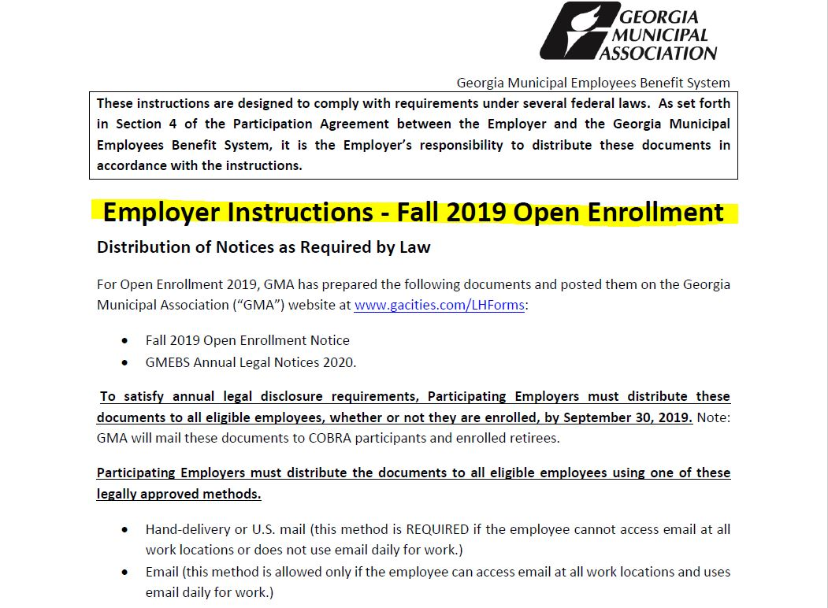
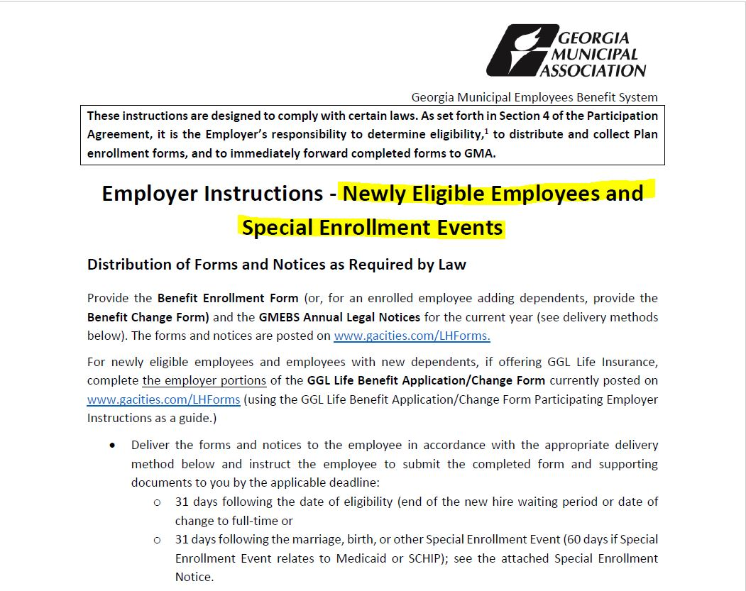
Life & Health Contact Responsibilities
Upon receipt of the secure Open Enrollment email from Life & Health:
Read and review the Employer Instructions and all attachments contained in the email
  If any questions regarding the instructions or attachments, please do not hesitate to contact Life & Health for clarification.
In the Open Enrollment email, there is a link for you to affirm your understanding.
  Click on the “Affirmation of Distribution of Enrollment materials” to read and affirm.
Distribute OE materials in accordance with Employer Instructions by September 30th.

Slide 26
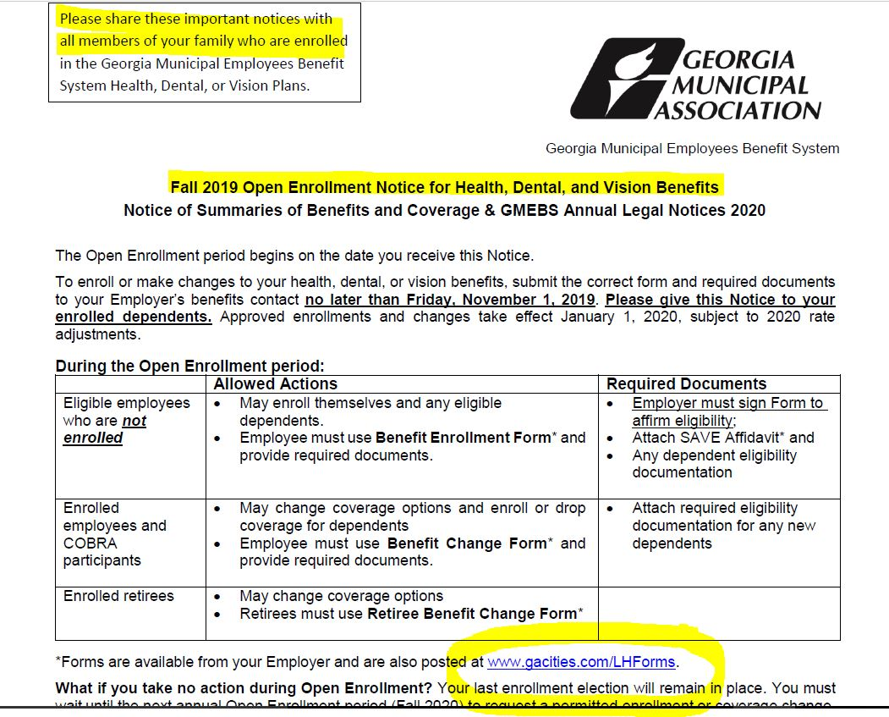
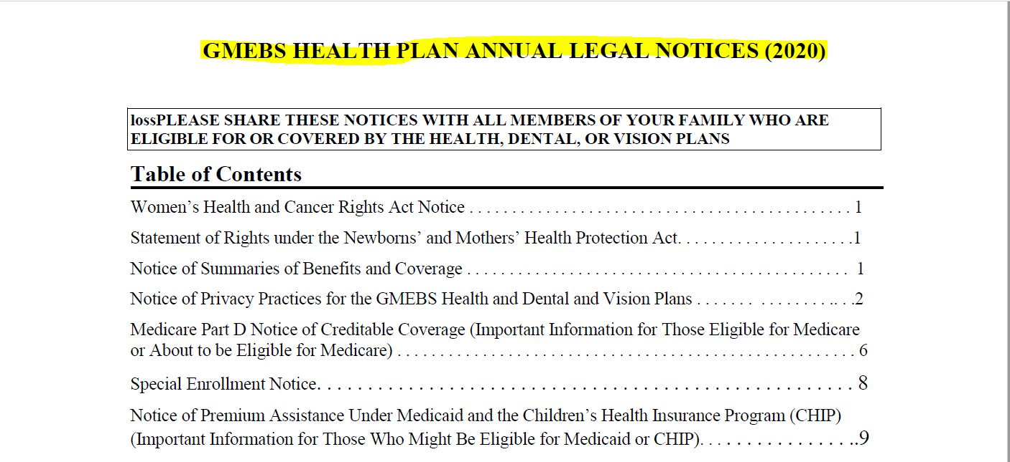
Managing Open Enrollment
What do I communicate to our eligible employees?
  Follow the Employer Instructions document to ensure you communicate all information required to comply with the law and PE obligations in the Participation Agreement
    Employer Instructions contain required messages about access to Legal Notices, Enrollment Actions, and Summaries of Benefits and Coverage
  Any of your own internal notices regarding plan or option changes you may be making, payroll deductions, return of documentation, etc.

Slide 27
Managing Open Enrollment
What else is important for Open Enrollment?
  Consider holding an Open Enrollment meeting if you don’t have one planned already to promote your benefits as well as tackle the administrative task related to enrollment or change forms.
  If you are not utilizing the wellness program assistance through LGRMS, it is a great time to consider planning with them for 2020 programs.
  Gather forms & supporting documents and batch them to GMA as file upload into the PEP system (fastest) or to the fax number or mail address on the form.
  Please do not send forms without supporting documents. The enrollment form (new or change) will not be processed & will be sent back to you to request the missing information. It will not be submitted until complete.

Slide 28
Managing Open Enrollment
  “Healthy” practices:
  Encourage the return of employee forms and documents at least one week before you want to send your paperwork to GMA.
  Have a list of ALL eligible employees & request a confirmation from everyone whether they are or are not enrolling or making changes to their current coverage.
  After November 1st, OE is closed and employee must wait for next OE or special enrollment event.
  Send several communications and/or post notices about Open Enrollment, where the materials can be found or requested, how to get them as well as the deadlines.

Slide 29
Open Enrollment for your
Eligible Employees

Slide 30
What Your Employee Needs to Do
Receive and review the Open Enrollment Notice and Annual Legal Notices and share them with spouse/dependents
Receive and review any additional employer related updates and handouts provided about their coverage or new plans or options being offered and share them with spouse/dependents
Complete enrollment or change forms by the deadline and submit to you, the Designated Benefits Contact

Slide 31
What Your Employee Needs to Do
Attend an Open Enrollment meeting if you are hosting one
Ask questions, ask questions, ask questions!
Return the following to you:
  Benefit Change form (if currently enrolled)
  Benefit Enrollment form (if enrolling for the 1st time)
  Supporting documents (if enrolling themselves or any dependents for the 1st time)
  No later than Nov. 1

Slide 32
Participating
Employer
Portal (PEP)

Slide 33
Participating Employer Portal (PEP) Overview
Phase 1 → Uploading forms securely for Open Enrollment.
Document library also available.
Phase 2 → 2020 training on using the system
  No more faxing, sending secure emails or mailing required
  Enrollments/changes/terms can be keyed directly into the eligibility system
  Access billing invoices
  Document library expanded
Notes:
Participating Employer Portal (PEP)
In July 2019, GMA upgraded to a new eligibility database platform.
The New Platform will allow you and your designated benefit contacts to add, update and terminate eligibility by keying and uploading documents into the system eliminating the need to fax, securely email or mail.
Training and transition to the PEP will begin in January 2020.
However, for Open Enrollment 2019, you will have the option securely upload forms and documentation into PEP.

Slide 34
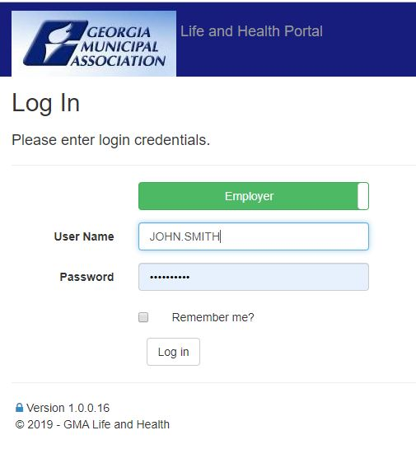
Introduction of PEP

Slide 35
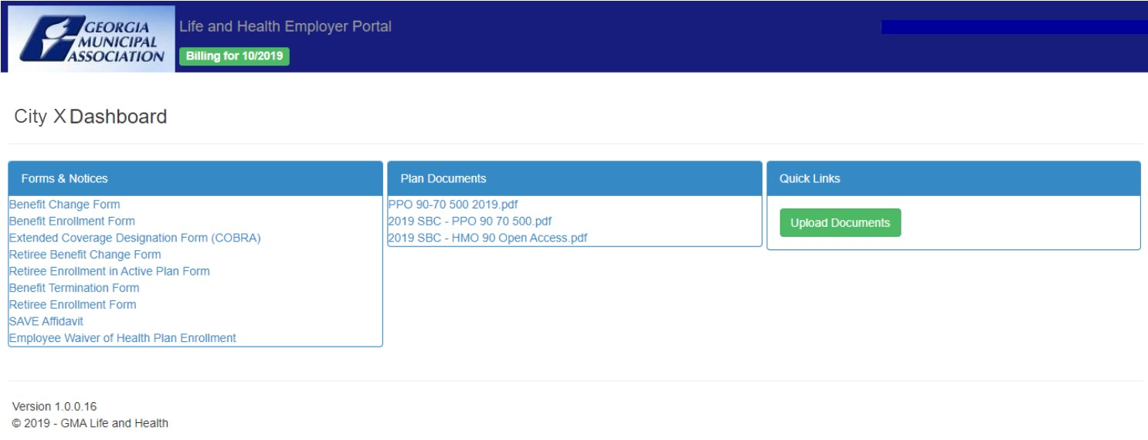
Introduction of PEP

Slide 36
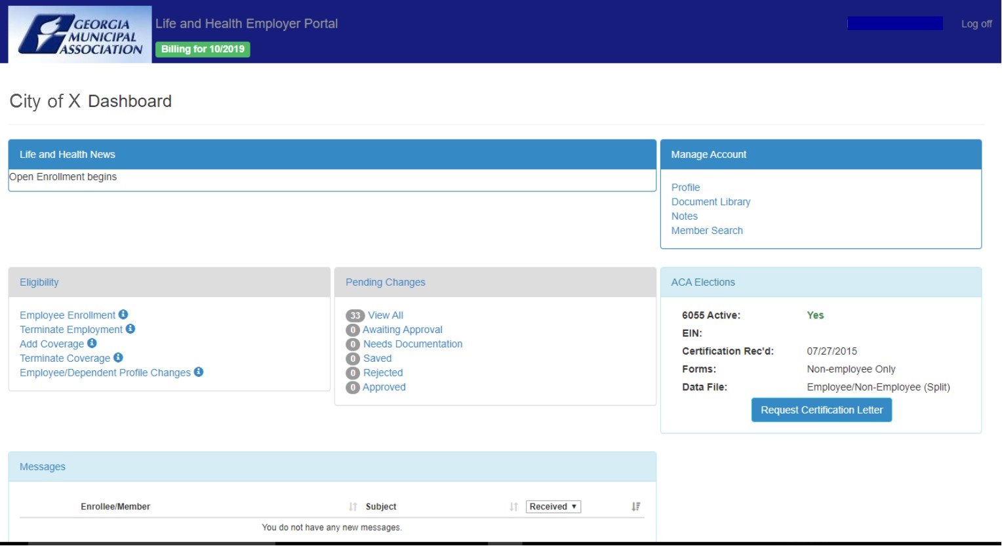
Introduction of PEP

Slide 37
PEP for Open Enrollment 2019
You will have the option securely upload forms and documentation into PEP for processing by Life & Health department
There is access through the document library YOUR plan benefit booklets, benefit plan & comparison summaries, all required legal documents as well as Enrollment, Change, Termination and GMA forms.
Full access to the features of PEP are not available at this time. Training for this rollout is important.
Access is available by using the same GMA login and password used on the GMA website (www.gacities.com).

Slide 38
Recap/Summary
Timely and accurate eligibility information submitted leads to a confident Designated Benefits Contact and a happy employee
HIPAA Compliance & protection of private information is VERY important to GMA and drives how and what we communicate to protect you & your employees
No plan design changes for either medical or dental
NEW Vision plan option
Confirm your intentions for 2020 (plan changes/options/no changes)

Slide 39
Recap/Summary
Be sure to read and review Employer Instructions and documents attached to the Open Enrollment email.
Affirm through the link included in the Open Enrollment email - Affirmation of Distribution of Enrollment Materials
Distribute OE materials to all active & eligible employees per Employer Instructions document
  GMA will send Open Enrollment materials to current retirees & COBRA
Submit forms and supporting docs to GMA no later than Nov. 4

Slide 40
Recap/Summary
Webinar will be sent to you and placed within portal under document library
Access to PEP for uploads and document library will become available on Monday, September 23rd
Complete Open Enrollment forms and any supporting documents means good data and happy employees in 2020!
Open Enrollment: Sept. 30 – Nov. 1
  The dates provided are important to make Jan. 1st a truly happy New Year!

Slide 41
Questions ??

