Slide 1
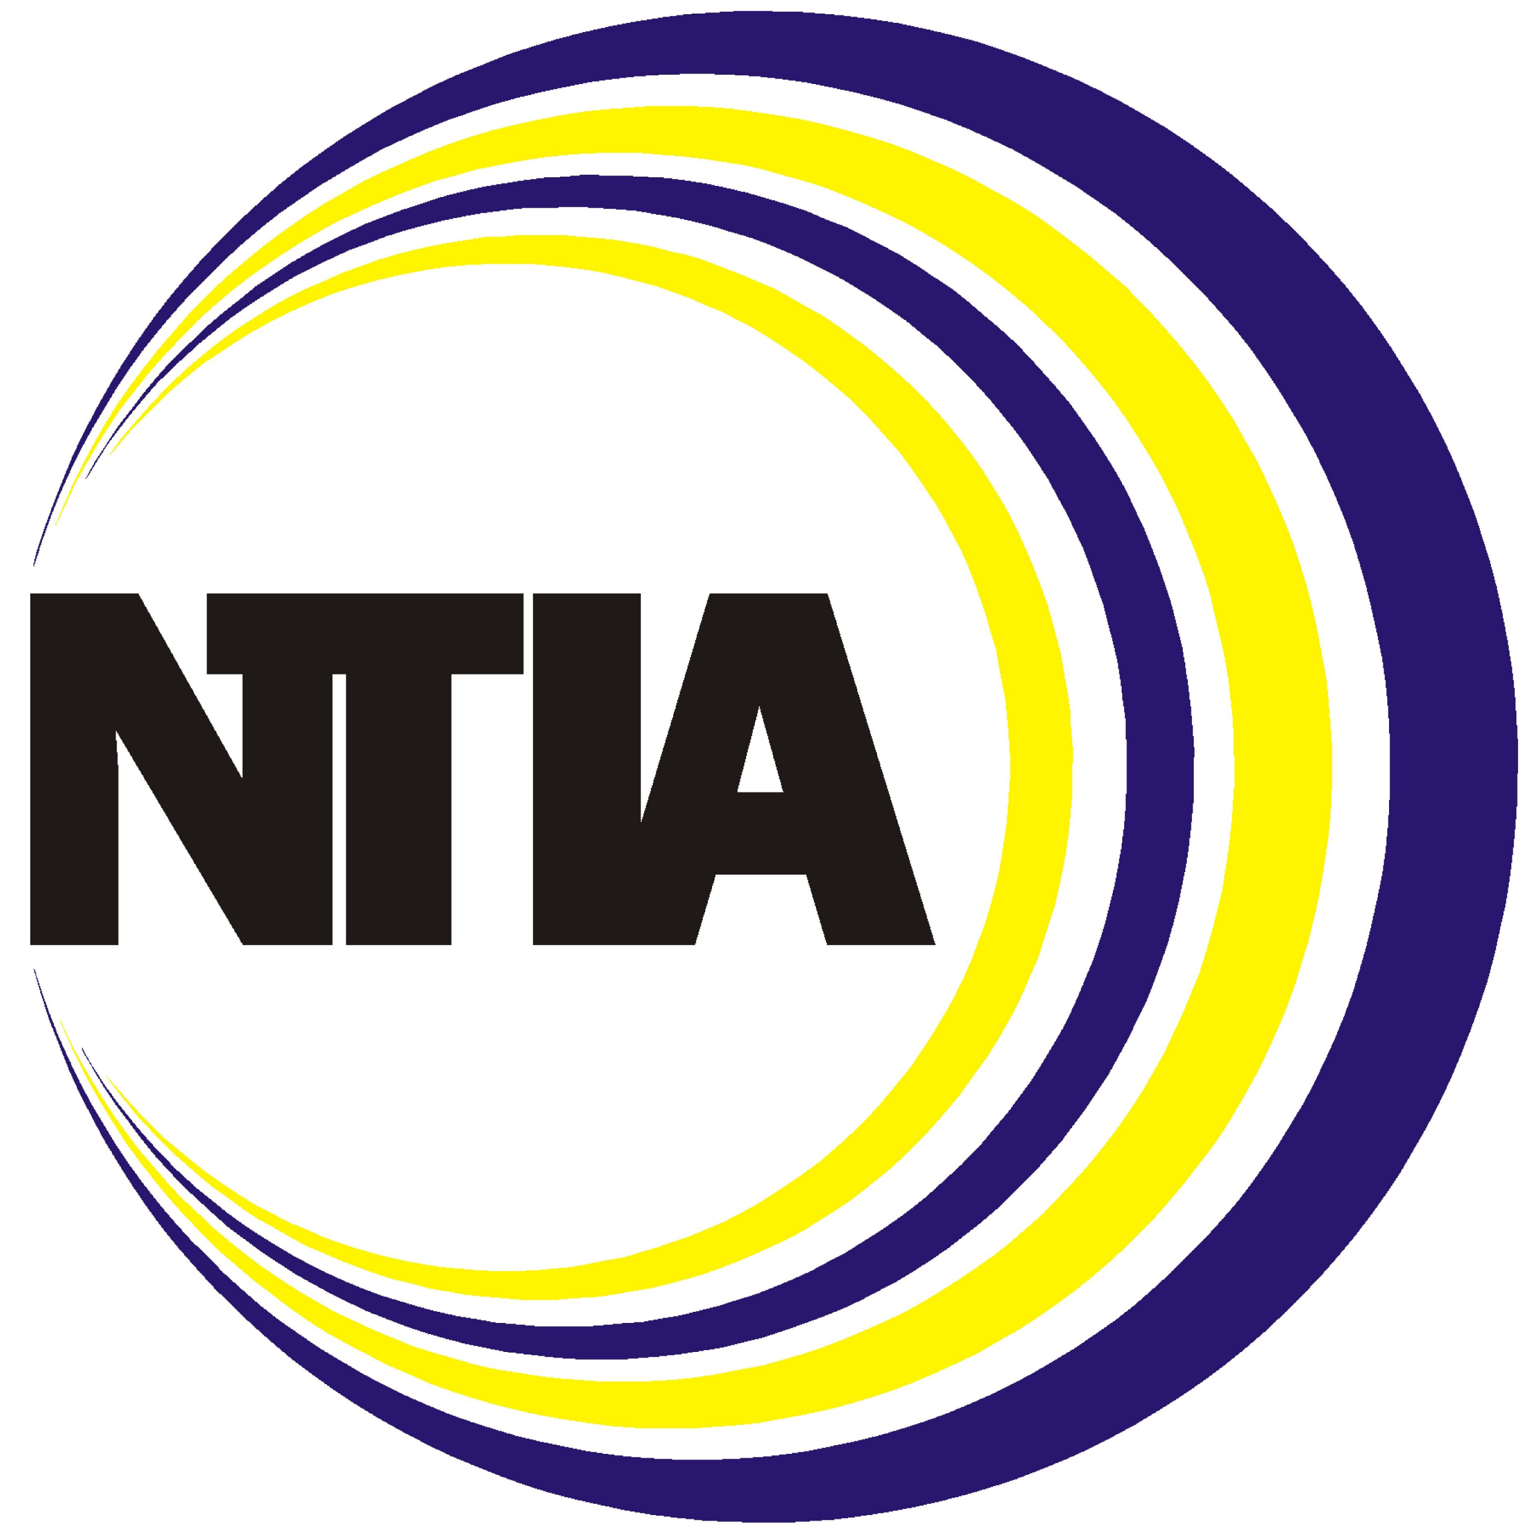
Permitting to Accelerate Broadband Deployment
Amanda Pereira, Environmental Program Officer
National Telecommunications and Information Administration
Office of Internet Connectivity and Growth
apereira@ntia.gov

Slide 2
Timeline of Documentation
Getting a head start on the required permitting documentation is critical to a successful application, as many of the documents take significant time to complete and process.
Application
Post-Application
Fees/
Appraisals
Traffic Control Plan
Period of Construction
Confirmed Owner Consent*
Pay Cost-Recovery Fees
Environmental/
Cultural Study
Legal Description
Approve Application
Begin
application
Submit all documentation
270-day
deadline
Engineering/Design
Information of Contractor Performing Work
Fix Application Errors and Missing Information
Bonding/Insurance
Application
Performing an environmental/cultural study per NEPA and state/local regulations, gathering application materials, and assessing the appropriate fees and appraisals will be the most time-consuming activities and documentation of the permitting process. It is important to begin these activities as early as possible in the permitting process, as they provide the foundation for the rest of your application. Engaging early, scheduling pre-meetings, and coordinating with all relevant permitting agencies is critical to accurately and timely submission of all documentation.
*Note that owner consent must be accurate to the date of application submission.
Note that federal permitting agencies have a 270-day deadline to approve permitting applications. The 270 days starts directly after a complete and comprehensive application is submitted. Incomplete applications will be returned, and the 270-day deadline will not trigger until the application is complete.
Notes:
New Content: Slide is net-new content. Content was taken from Permitting 101.

Slide 3
What Types of Permits Will a Deployment Require?
IFA programs emphasize building high-speed internet infrastructure for unserved and underserved communities, which require all kinds of permits at the federal, state, and local level. Each permit is unique in its application process, so applicants must pay keen attention to the various permits they will need to juggle. It is imperative that all applicants fully understand permitting requirements and procedures to ensure a streamlined process.
 | Easements to Access Government or Private Assets Applicants and subgrantees will need permission – such as a right-of-way or other easement – from a range of owners/authorities when their deployment crosses: government or privately owned land, bridges, overpasses, railroads, buried deployment (running cables underground), aerial deployment (attaching cables to utility poles and tower builds), etc. The federal government alone owns about 28% of U.S. land, and this land is managed by many different federal agencies.
 | Environmental and Historic Preservation (EHP) Considerations Federally-funded broadband projects must perform a National Environmental Policy Act (NEPA) analysis and meet state, local, and/or Tribal government environmental and historic preservation permitting requirements as well. A NEPA/EHP toolkit will be provided to assist with environmental permits.
Notes:
The Federal government owns a little more than 5% of land in Georgia, which equals a little less than 2M acres.

Slide 4
Who is Engaged in Federal Permitting?
Multiple federal agencies own land and require permits, plus each agency may have their own specific permitting process and required documents for securing an easement.
 | Department of Energy |  | Department of Interior
 | Department of Transportation |  | Department of Commerce
 | U.S. Military |  | U.S. Army Corps of Engineers
 | Department of Defense |  | General Services Administration
 | Department of Agriculture |  | Any other relevant federal agency
Notes:
Previously Cleared: Taken from Tribal BB Summit Permitting Presentation

Slide 5
Potential Permits Required
A simple one-mile deployment may require many permits if it runs through many different types of land, so pay attention to where and what lands/properties the deployment will be going through.
Aerial deployment will go across federal highways, requiring a permit/ROW from the Federal Highway Authority (DoT).
The deployment will run through Tribal land, requiring a specific set of permits for Tribal access.
Every federally-funded project will require an end-to-end NEPA analysis and state/local agencies will have their own environmental/ historic preservation regulations.
The deployment will run through a city-owned park, requiring a state/local permit/ROW to be obtained.
One mile of aerial deployment
The aerial deployment passes through a private household, requiring a permit/ROW for possibly both the municipal road and for crossing private land.
The highway is built on Bureau of Land Management (BLM) land, requiring a permit/ROW to build on that land.
Notes:
New Content: Slide is net-new content. Content was taken from Permitting 101.

Slide 6
Land Ownership and Checkerboarding
Land in the U.S. is often owned by multiple owners, requiring applicants to seek permits through multiple owners to fully access the land.
What does it mean when land is checkerboarded?
Tribal Land
Checkerboarding refers to when land ownership is intermingled between two or more owners, resulting in a checkerboard pattern across a given area.
This is typically common among railroads, private properties, forest land, and Tribal lands.
To best prepare for checkerboarding, always be confident of the landowners and coordinate early with each agency. Early coordination and pre-meetings will be the best way to tackle this issue early and quickly.
Checkboarded Land
Private Land
One mile of aerial deployment
State/Local Land
Checkboarded Land
BLM Land
Notes:
New Content: Slide is net-new content. Content was taken from Permitting 101.

Slide 7
NEPA/EHP

Slide 8
What is NEPA?
Passed in 1970, the National Environmental Policy Act (NEPA) is considered an “umbrella law” as it provides a framework within which all other environmental, historic, and cultural resources laws can be evaluated.
NEPA, along with the National Historic Preservation Act (NHPA), requires that Federal agencies understand the impact of their proposed actions before taking them.
As there are many different environmental laws and Executive Orders (EOs) that impact Federal activities, the NEPA process provides a way to address compliance requirements with multiple laws and EOs in one process.
NEPA
Resource Conservation and Recovery Act
Superfund Authorization and Recovery Act
Archaeological and Historic Preservation Act
American Indian Religious Freedom Act
Floodplains and Wetlands laws and requirements
Safe Drinking Water Act
Coastal Zone Management
Clean Water Act
Clean Air Act
State and Local land use requirements
Climate Resiliency
Endangered Species Act
Migratory Bird Treaty Act
Bald and Golden Eagle Protection Act
Executive Orders on Environmental Justice
Toxic Substances Control Act
Comprehensive Environmental Response, Compensation, and Liability Act
Farmland Protection Policy Act
Native American Graves Protection and Repatriation Act
Notes:
Slightly New Content: Content taken from NEPA, Historical Preservation, and Climate Resiliency webinar. However, the 2nd and 3rd paragraph are net new content.

Slide 9
What does NEPA do?
Determines whether a Proposed Action and Alternatives have the potential to significantly impact the environment
Requires early consideration of the environmental effects of a Proposed Action
Requires the preparation of environmental documentation when federal funds, permits, lands, and/or rulemaking are involved
Provides interdisciplinary analysis of the effects of a Proposed Action and Alternatives on the human environment
Addresses requirements under other environmental and historic preservation laws, regulations, and Executive Orders without the need for duplicative analysis
Aids in decision making
Requires that environmental effects be considered as decision points along with technical, economic, and other factors
Requires public involvement
Notes:
Previously Cleared: Content taken from NEPA, Historical Preservation, and Climate Resiliency webinar.

Slide 10
Planning For A Successful Process

Slide 11
Best Practices
Eligible Entities and subgrantees can do the following in the project planning process to avoid or minimize impacts to sensitive resources:
Consult the 2013 U.S. Fish and Wildlife Service (USFWS) Revised Voluntary Guidelines for Communication Tower Design, Siting, Construction, Operation, Retrofitting, and Decommissioning for any portion of your project that may require towers.
Reach out to federal land- or resource-managing agencies early, if applicable, to determine if your proposed project that crosses those lands is feasible. These agencies can include the US Forest Service, the Bureau of Land Management, the US Fish and Wildlife Service, the Bureau of Indian Affairs, the National Park Service, and others.
Consult the National Wetlands Inventory’s Wetlands Mapper and the US Army Corp of Engineers (USACE) Nationwide Permit Information to understand the potential presence of wetlands in your project area, and whether USACE permits may apply.
Consult with your State Historic Preservation Office to inform project design.
Engage the services of a qualified consultant to produce any required environmental analysis, such as Environmental Assessments, surveys, and any required studies.
The most common factors that extend the EHP process are impacts to sensitive resources – understanding how to avoid or minimize those impacts is crucial for moving through the process efficiently

Slide 12
How State and Local Governments Can Streamline Permitting
When designing right-of-way access and permitting policies, Eligible Entities and State Broadband Offices (SBOs) should consider streamlining permitting processes.
STREAMLINE PERMITTING & INSPECTION
Consider simplifying the number and complexity of permit applications (the “one-stop shop”), offering expedited permitting for minimally invasive construction practices, and adopting e-permitting.
DEFINING PARAMETERS
Consider the appropriate sizing and location of conduit, small cells, and other broadband infrastructure to ensure safety and durability. Many cities, including Los Angeles and New York, define the parameters for micro-trenching, a lower-impact method that, when done correctly, can reduce construction cost and minimize disruptions.¹
REQUIRING EXCESS CAPACITY
Consider whether to require excess capacity within conduit to ensure that they are “future-proof” (i.e., have capacity to meet future needs).
ENCOURAGE DIG ONCE POLICIES
Dig once policies encourage or require project owners to install multiple conduits or micro-ducts (or both) for future use. This can reduce future costs and minimize disruption to services.
1. Los Angeles Municipal Code, “Sections 62.00, 62.03” 2020 (link); The Rules of the City of New York, “Title 67, Chapter 1” 2015 (https://codelibrary.amlegal.com/codes/newyorkcity/latest/NYCrules/0-0-0-93779)
Notes:
Previously Cleared: Taken from Broadband Policy Introduction, Broadband Academy

Slide 13
THANK YOU

