Slide 1
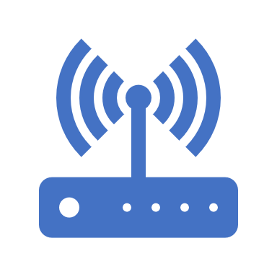
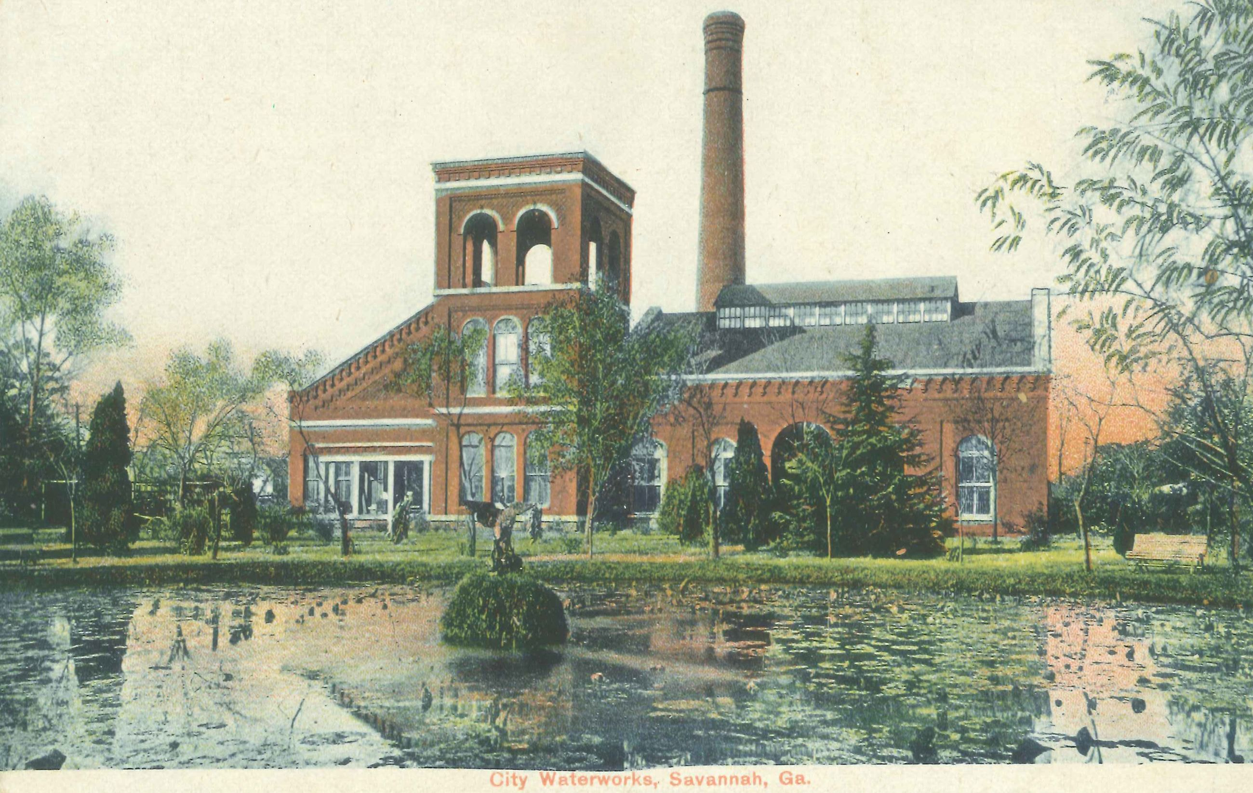
GMA Cities Connect Call
By: J. Laplander, PE Water Resource Planning & Engineering Director &
Mike Bell Files, GA 811 Liaison Manager
City of Savannah and GA 811
October 17, 2023
Notes:
Thank you, Becky, for inviting me to this 4th Annual Broadband Summit where the theme is Partnering for Digital Equity. To start out, we all need to say there will be no Digital Equity w/o adequate infrastructure. The infrastructure I am referring to is not computer servers, network switches, routers, provider services, computers, laptops, and such, but the Backbone of the Broadband – the fiber network and specifically, the installation of the underground network. I will discuss GA municipalities’ challenges when new underground fiber networks are being constructed and installed – specifically the utility locating challenges.
Before installation of the fiber can begin, the utility – power, gas, water, sewer, telecommunications, water, sewer, and storm – underground locates are required by the GA Underground Facilities Protection Act – the Dig Law for all excavations. In my experience with the COS Water Resources Department and as a member of the GA 811 Board of Directors, I have been involved firsthand and seen what can happens when our backbone of the Broadband network is installed. I will be only discussing the underground network installation and will not discuss the other means of installations.

Slide 2
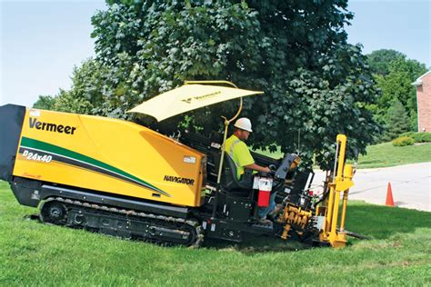
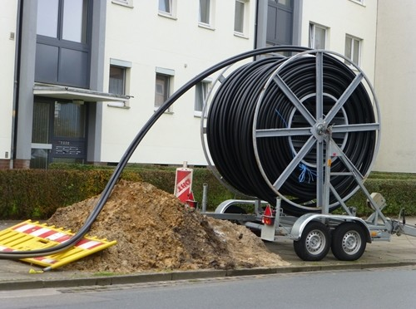
GMA Cities Connect Call
Infrastructure Fiber - Backbone of the Internet
How does the information get to your computer from a web-site?
The infrastructure to get information of the Internet to your computer
includes:
Cables and wires
Servers, Network Switches, and routers,
Pipes, poles, wireless towers, and more
Broadband – high-speed Internet supplied on the following platforms:
Cable Modem - normally same company for television
& internet access,
Digital Subscriber Line (DSL) – phone lines
Fiber – fiber network
Wireless – cellular technology
Satellite – normally used in where no other service is available
Notes:
The typical installation of Broadband’s underground fiber network is normally through the directional drilling process, although some of us have all seen other construction methods such as trenching and typical excavation.

Slide 3
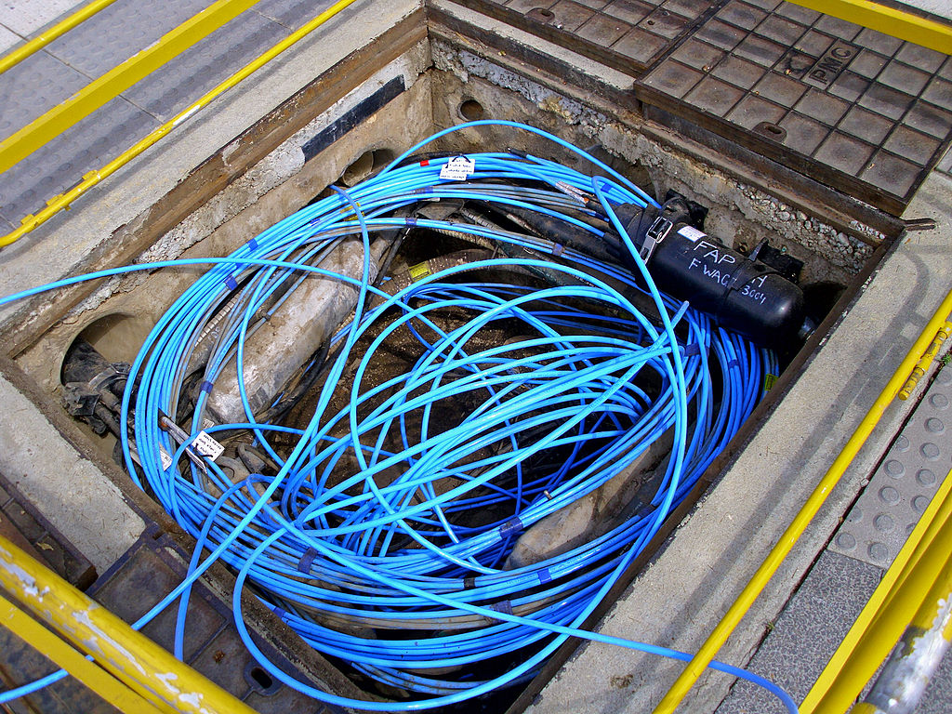
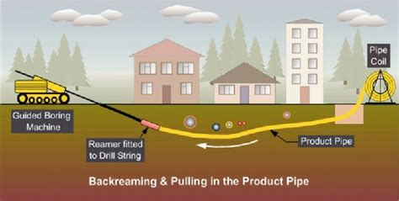
GMA Cities Connect – Fiber Infrastructure
Backbone of the Internet
State & Local Policymakers must ensure communities have the infrastructure needed for Broadband & must understand:
The backbone of the Internet is the optic network that is constructed in part and serviced by Network Service Providers
The requirements and navigating the range of legal and logistical challenges
INCLUDING STATE DIG LAW REQUIREMENTS and the GPSC’s Large Project Rule.
Franchise Agreements, Right-of-Way Encroachment, Traffic Permits, and securing & easements for construction, & underground fiber location
Directional drilling installation of fiber optic cable network, along with construction, connecting, and maintaining the wireless infrastructure facilities.
Fiber Optic Cable

Slide 4
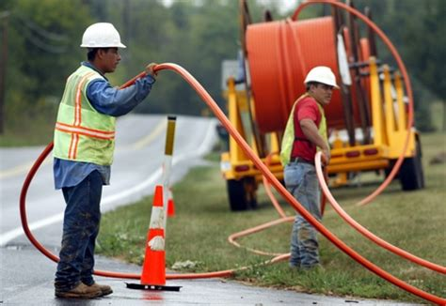
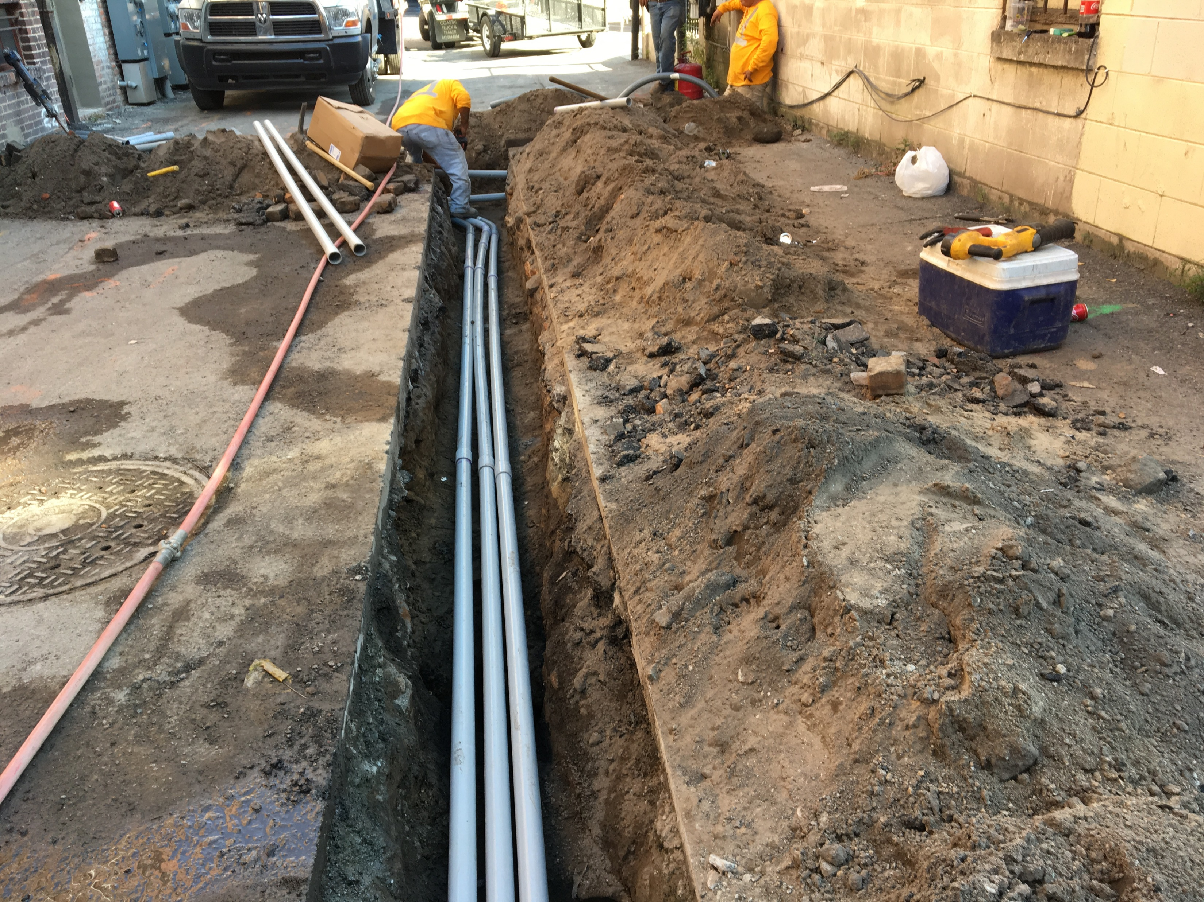
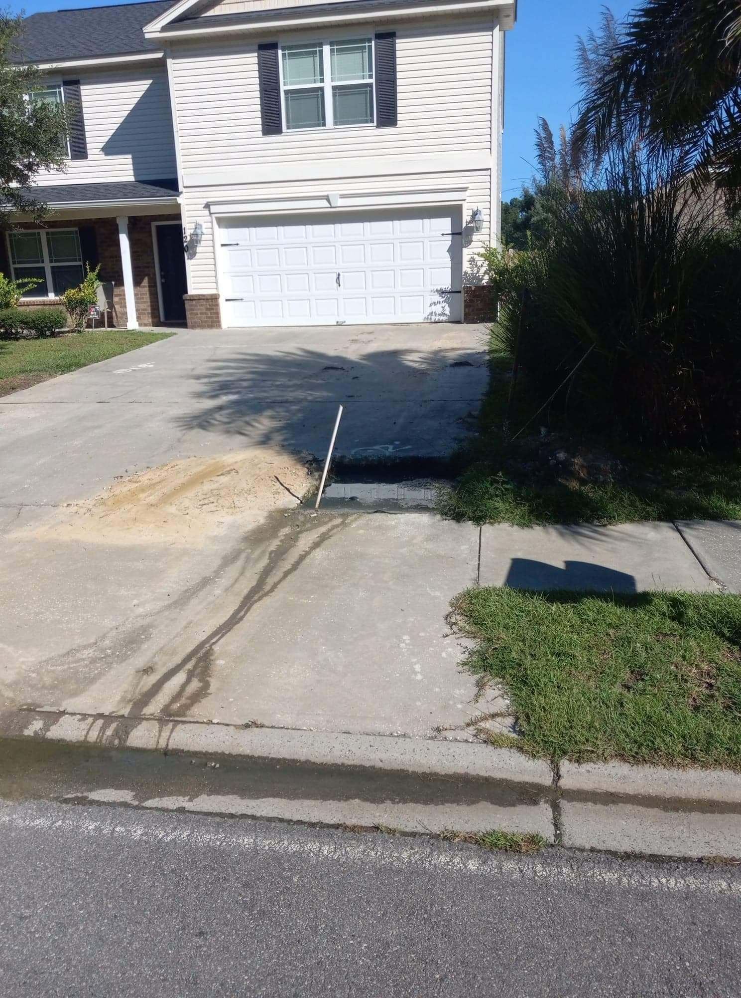
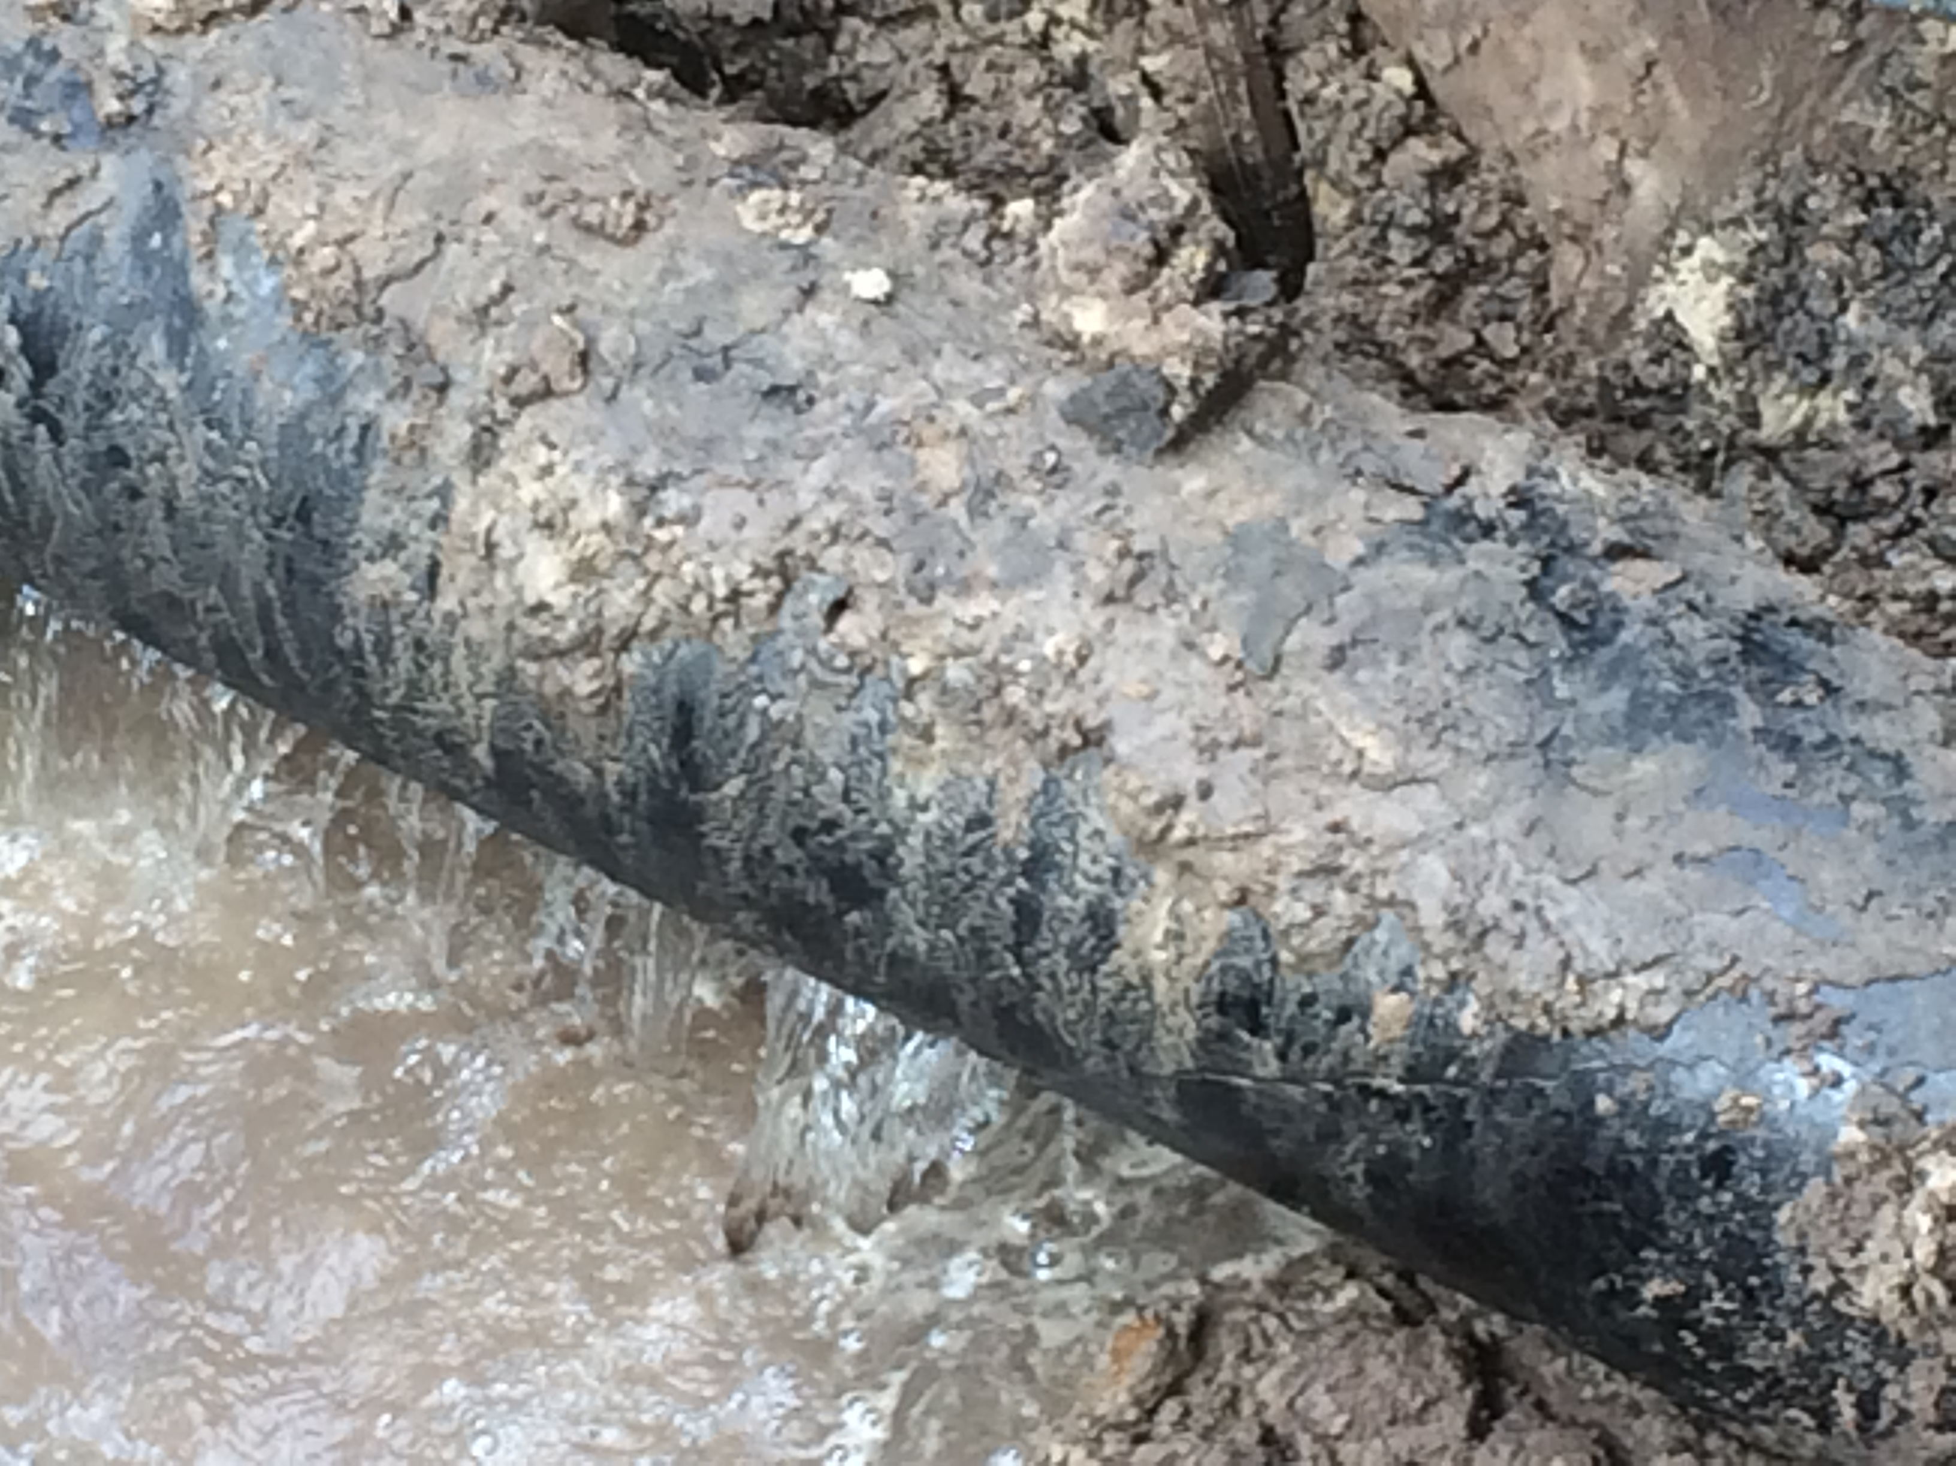
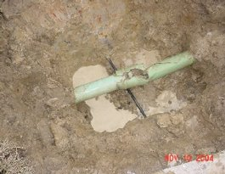
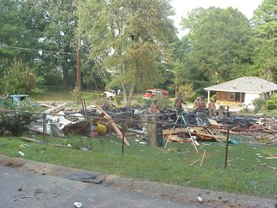
GMA Cities Connect – Fiber Infrastructure
Backbone of the Internet
Directional Drilling Fiber Network Installation/Construction
Typical benefits and challenges of horizontal directional drilling
Benefits | Challenges
Saves excavation, shoring & connection costs | Long lengths of daily utility locates required
Removes trenching related accident possibilities | Cross-Bores and other utility conflicts
Ideal to minimize surface disruptions & eliminate leveling & matching pre-existing ground surface | Maintain bore-hole stability & varying soil conditions
Faster & neater – requires much less time than trenching methods & reduces weather delays
Directional Drill Installation
Drill Damage to City of Savannah water main
Lateral crossbore
Austell Georgia – 1999 explosion
from gas line bore through sewer lateral
Sewer Lateral Damage from directional drill crossbore
Conventional excavation installation
Notes:
The advantages of directional drilling can’t be overstated. It has become the major method of preference for installation of all utilities, including power, gas, water, sewer, telecommunications, and other utilities. It saves in excavation, tie in connections, and restoration costs, along with ability to be done faster, cheaper, neater, and w/o surface disruptions.
The challenges of the Directional drilling process must be addressed and planned for, however. MY QUESTION – HOW WERE THESE CHALLENGES DISCUSSED DURING THE INITIAL STAGES OF BROADBAND PLANNING?
These fiber installation challenges include:
Compliance with the State Dig Law – the Georgia Underground Facilities Protection Act (GUFPA) and specifically the GPSC’s Large Project Rule – that is compliance by both the contractor and the utility owner.
Crossbores
Major planning is a must before the project bore path – the fiber underground location - can be determined. Today’s public ROWs are filled with utilities – water, sanitary sewer, storm, telecommunication, power (aerial and underground), gas, and others.
Compliance with GUFPA 1 - the planning can start very easily with Provider’s engineer calling in a GA 811 Utility Design Locate (no cost to the Service Provider Engineer) to ensure the Engineer and boring contractor will plan and know where to bore the fiber. Such information is needed to assure proper separation with other utilities and to avoid conflicts with existing utilities, structures, abandoned utilities, and unlocatable utilities (i.e, private utilities, those utilities put in when locating was not a requirement, and sewer laterals – many of which in GA are private even in the ROW).
This planning may even require Subsurface Utility Engineering (SUE) and / or land surveys / engineering design to assure the actual location and depths of existing utilities.
It is always a good habit for the Service Provider and Contractor to get to know the existing utility owners and locating technicians.
Crossbores - After determination of the bore path the contractor must avoid all cross-bores. “A cross-bore is an intersection of an existing underground utility or underground structure by a second utility resulting in direct contact between the transactions of the utilities that compromises the integrity of either utility or underground structure.” Such damages can cause water leaks, gas line hits, storm main hits, and bores through sewer laterals causing sewage blockages which then cause backups into homes. These leaks, gas line, and sewer lateral crossbores will further cause major structural destruction, costs, and potential loss of life and compromises to public safety.
Compliance with GUFPA 2 - Before the bore begins all utilities - private, unlocatable, and public utilities - must be located per the GA Dig Law which will normally require a GPSC’s Large Project Ticket for these large and long projects. These Large Project Tickets require that the contractor and the utility locators agree on a utility marking schedule to assure that all utilities are marked and located prior to beginning the bore must be agreed upon by all parties. The daily lengths to be bored by the contractor are at times in lengths which cannot be met by the resources available to municipal governments so both the utility owner(s) and the boring contractor must negotiate in good faith, which means give and take on both sides.
Example - In the City of Savannah, the three locators we have can locate around 1,000 linear feet per day while the contractors are asking for 5,000 linear feet per day of locates. This is similar to other municipalities who have this same challenge. What this means is that the schedule that the boring contractor is planning for to install his fiber, will take 5 times more to have all the utilities located so the boring / directional drilling project can be completed.
Who gives in and how does this get resolved? Additional cost of installation and the acutal installation schedule will be determined by this
The COS has had locating staff work unbudgeted OT at times to meet the schedule in the past – not sustainable!
Another method both the service provider, contractor, and COS agreed to was for the contractor to hire their own locating firm (at their cost), with assistance in training from Savannah locating and operating crews. The service provider has questioned liability however on this method

Slide 5
GMA Cities Connect: Fiber Infrastructure – Backbone of the Internet
Notes:
This chart shows the increase since 2022 in the number of Large Project Tickets that are being processed at GA 811. In the City of Savannah 25% of our large project tickets are large directional drill fiber installation projects and for most of these projects the COS does not have the resources available to have the large project locates done at the schedule proposed by the contractor. Savannah is not the only municipality with this problem and needs to get resolved.

Slide 6
Communication is the key
Georgia 811 Ticket Types
Design Tickets- It is a best practice to request Design locates for purpose of design, pre-bidding and surveying the area for where the new utility can be installed to have the least impact on existing utilities and the crew installing the utility. Utilized prior to excavation.
Large Project ticket- Will be required on any project that exceeds one mile or when excavation exceeds 90 days. They require a Large Project meeting to determine the utility marking schedule which is negotiated between the excavator and the utilities.

Slide 7
Enhanced Communication
Local Utility Coordinating Councils – participate in these meetings, make local council aware of the upcoming projects and stay engaged to assist with any challenges. Consider requiring the contractor installing the new facility to attend these meetings.
For more information on local utility coordinating councils in your area go to www.gucc.com
Large Project Meetings – Ensure the correct personnel are attending for the utilities and consider having a rep from the muni/local governing authority attending to ensure each party is negotiating in good faith. These meetings will determine the dates when locates will be completed and impact the installation of the utility.
Stay engaged throughout the locating and construction phases of these projects to address any challenges.

Slide 8
Education
We recommend all utilities and excavators take the Georgia 811 Competent Person Training. It’s free, takes about 2 hours and available is via online self paced training or in person.
Utilize the Large Project training materials available online and request an in person Large Project training. All training is free, and we will come to you.
Utilities can utilize a tool called ThoughtSpot to monitor data concerning ticket volume, locate responses and damages.
Register for the free educational opportunities at https://www.georgia811.com/index.php/training-education/

Slide 9
Contact us
Mike Bell
Georgia Liaison Manager
mbell@Georgia811.com
770-286-1886
For your regional liaison contact info visit https://www.georgia811.com/index.php/our-liaisons/
Jim Laplander, PE, City of Savannah
Water Resource Planning & Engineering Director
JLaplander@savannahga.gov
912-651-6573

