Slide 1
Lead Service Line Financing
Designed to Meet Your
Compliance Needs
Lisa Golphin
GMA ~ October 10, 2023

Slide 2
Lead Service Line Funding
What is GEFA and Who is Eligible
GEFA’s Mission is to conserve and protect Georgia’s energy, land, and water resources.
Eligible Borrowers:
Counties and municipalities
Local water, sewer, and sanitary districts
State and local authorities, boards, and political subdivisions created by the General Assembly.

Slide 3
Lead Service Line Funding
Why you Should Consider GEFA
For your Compliance Needs?
Bipartisan Infrastructure Law (BIL)
$66.8 Million Dollars Allocated for FY22
$28.7 Million Dollars Allocated for FY23
Dedicated funding to assist communities with Lead Service
Line (LSL) Inventory and LSL Replacement Projects
49% Principal Forgivable Loans to eligible
Disadvantaged Communities

Slide 4
Lead Service Line Funding
Potential Funding Sources:
Grants – Grant Funding for Lead Service Line Inventory Projects Only
Grants Awarded: Approx. 204 Communities
https://gefa.georgia.gov/water-resources/intended-use-plans
Loans – Affordable Low-Interest Funding for both Lead
Service Line Inventory and Replacement
Projects with Principal Forgiveness eligibility.

Slide 5
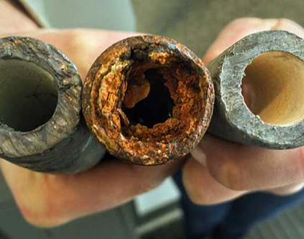
Lead Service Line Funding
What Projects are Eligible?
Lead Service Line Inventories
Field investigations, potholing
statistical or predictive modeling,
tax maps & parcel information,
interviews, engineering plans.
Existing and Completed Inventories
Lead Service Line Replacement
Removal and replacement of lead or galvanized service lines, goosenecks, pigtails, connecters, and curbstops downstream of lead service lines.

Slide 6
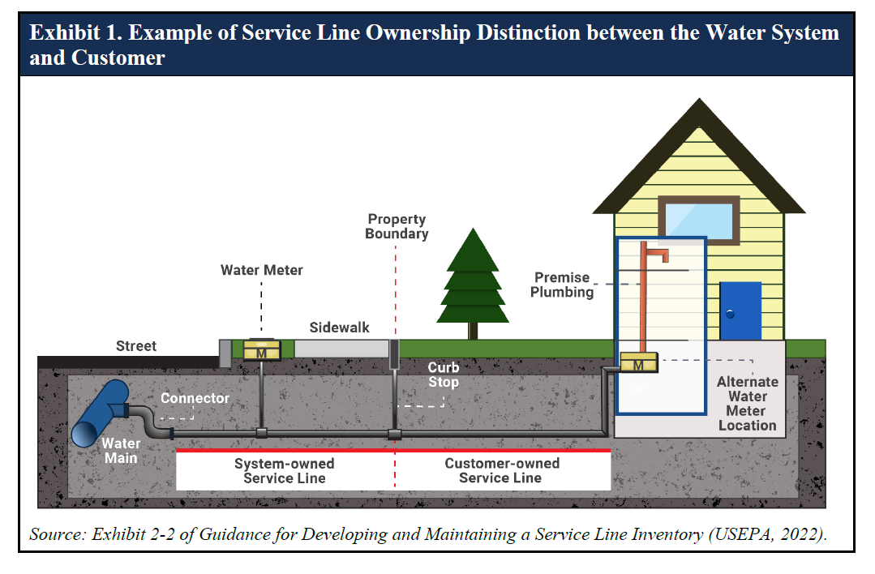
Lead Service Line Program
Funding Requirements – LSL Replacement Projects
Replace entire service line – System & Customer-Owned
Notes:
However, requirements under the DWSRF Lead Service Line Replacement funding requires all PWS to replace the entire section of service line from the street to the home. This means that you will be required to replace both the system-owned section of service line and the customer-owned service line. As shown on the diagram onscreen.

Slide 7
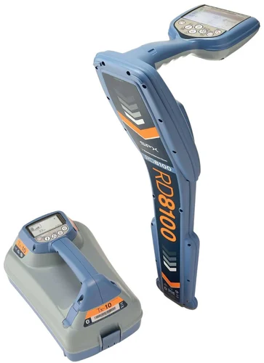
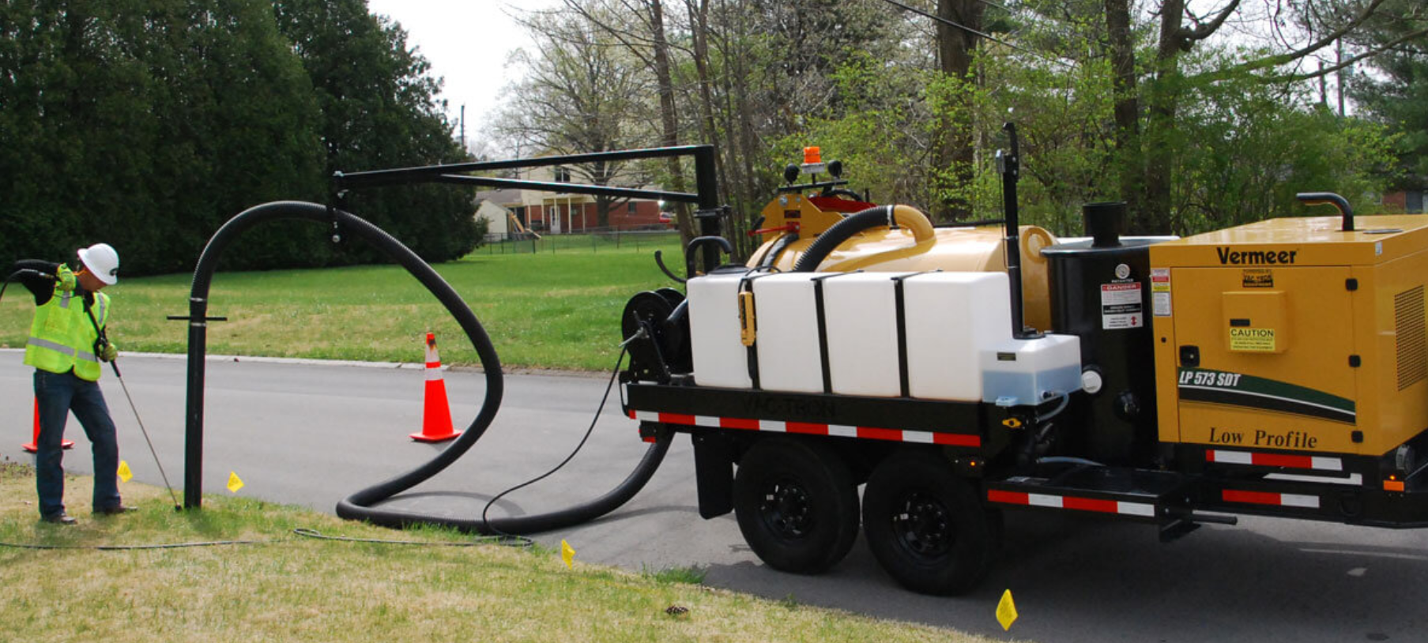
Lead Service Line Program
LSL Eligible Equipment - Examples:
Lead Pipe Detectors,
Vacuum Excavators
Notes:
Some eligible equipment that EPA has deemed eligible for reimbursement within lead service line inventory projects include:
Lead Pipe Detectors as shown on the right of the PowerPoint slide and Vacuum Excavators.

Slide 8
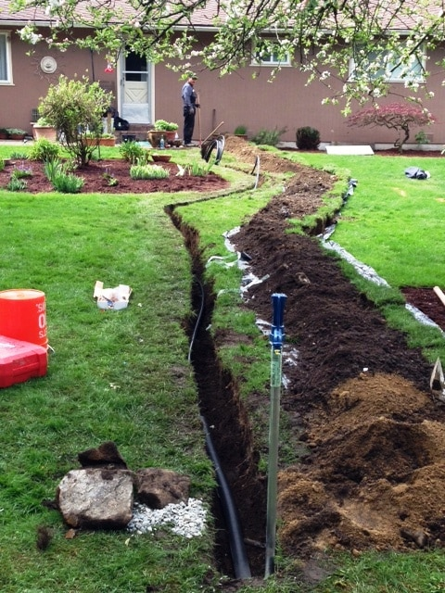
Lead Service Line Funding
What Projects are Eligible?
Site Restoration
Pavement Cuts, Sod Replacement,
Debris Removal
Permit Fees
Non-Routine Sampling and Temporary Filter Devices
Community Engagement and Public Outreach
Billers, Town Hall Meetings, Public Education Workshops, Postcards, Flyers

Slide 9
Lead Service Line Funding
Principal Forgiveness:
Principal forgiveness funds will be allocated to those projects that receive the highest score based upon the pre-application scoring and ranking criteria during the annual solicitation process until all principal forgiveness is exhausted.
Under the SRF Programs, Principal forgiveness is awarded to disadvantaged communities based on GEFA’s Affordability Criteria.

Slide 10
Lead Service Line Funding
Assistance for Disadvantaged Communities
GEFA’s Affordability Criteria:
Median Household Income
% Unemployment
% Not in labor force
% of all people with income below poverty
% with Social Security income
% with Supplemental Security income
% with cash public assistance
% with Food Stamp/SNAP benefits
Population change
Population

Slide 11
Lead Service Line Funding
Lead Service Line Funding Requirements:
Any project funded under this appropriation will be subject to the replacement of the entire lead service line, not just a portion, unless a portion has already been replaced or is concurrently being replaced with another funding source.
Any project receiving funding under this appropriation must adhere to federal requirements, such as the State Environmental Review Process (SERP), Disadvantaged Business Enterprise (DBE), Build America – Buy America (BABA), the Davis-Bacon Wage Act, American Iron and Steel (AIS), and project signage.

Slide 12
Lisa Golphin
GEFA Water Resources Project Manager
Lead Service Line Program
lgolphin@gefa.ga.gov
(470) 606-1393
www.gefa.ga.gov
Lead Service Line Replacement Program | Georgia Environmental Finance Authority
47 Trinity Ave SW
Fifth Floor
Atlanta, GA 30334
gefa.georgia.gov

