Slide 1
SLFRF—What Should We Be Doing Right Now?
Georgia Municipal Association
March 31, 2022

Slide 2
Rely on Primary Source Guidance
Treasury Department Grant Agreement Terms and Conditions
Treasury Department Interim Final Regulations (31 FR 35, 5/17/21)
Treasury Department Final Regulations (31 CFR 35, 1/6/22)
Treasury Department Compliance and Reporting Guidance 3.0 (2/28/22)
Treasury Department Assistance Listing Number 21.027
OMB, Uniform Administrative Requirements, Cost Principles and Audit Requirements [“The Uniform Guidance”] (2 CFR 200)
OMB, Compliance Supplement 2021 Addendum No. 1 (12/3/21)

Slide 3
Prepare for Reporting Deadline
Non-entitlement Units (NEU)
Reporting Period from 3/3/21 through 3/31/22
--- Obligations Incurred
--- Disbursements Made
Reports: Due on or Before Saturday 4/30/22
Additional Guidance Due: Treasury User Guide

Slide 4
Continuing Cash Management
Cash Depositories
--- Safeguarding--Insured Accounts
--- Interest Bearing Accounts
----- Interest Earned is NOT Subject to Normal Federal Grant Refunding Policy in 2 CFR 200.305(b)
----- May Be Used for Any Purpose Authorized for Use of “Own Source Revenue”

Slide 5
Prepare SLFRF Account Summary
Determine Applicable Expense Categories for Obligations Already Incurred and Disbursements Made
--- Appendix A, Treasury Compliance and Reporting Guidance
Review Federal Cost Principles to Determine Cost Allowability
--- 2 CFR 200, Subpart E
“Scrub” Charges for Ineligible Activities and Unallowable Costs

Slide 6
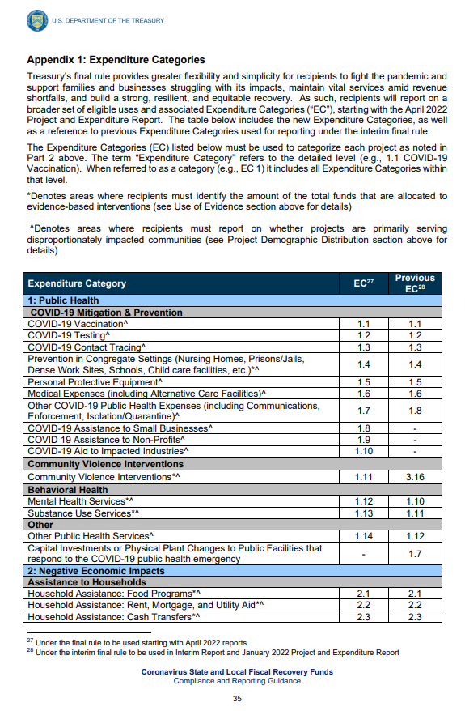
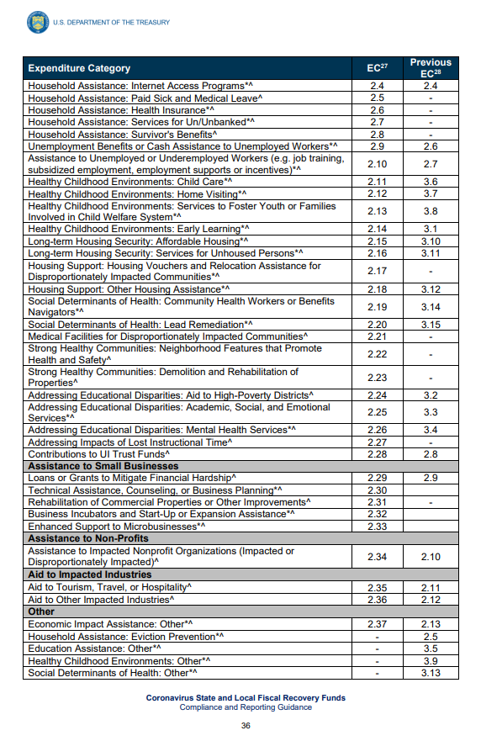
Appendix 1

Slide 7
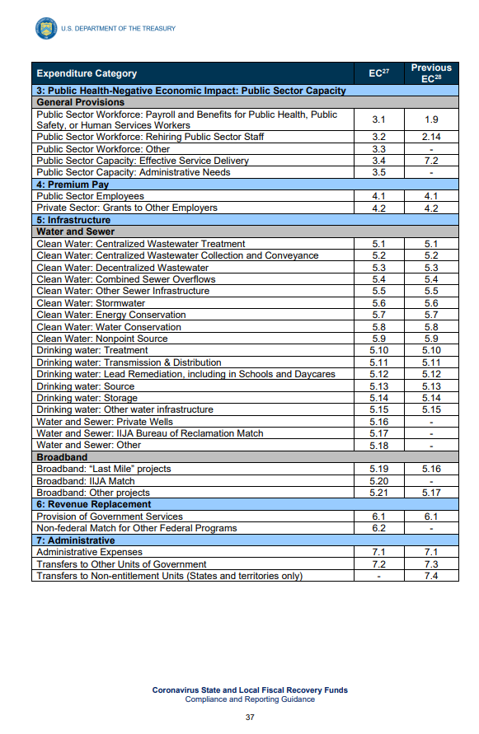
Appendix 1

Slide 8
Revenue Replacement Expenditure Category
Standard Allowance Election
--- one-time election to use up to $10 million, not to exceed the award allocation, to spend on government services during the period of performance (3/3/21-12/31/24)
Use of Allocated Amount for Permitted Government Services or for Eligible SLFRF Uses (31 CFR 35.6)
Reporting Permitted in the Revenue Loss Expenditure Category
Expenditure Governed by OMB’s Uniform Guidance (2 CFR 200) As Implemented by The Treasury Department

Slide 9
Further Document Project Activities
Required Reporting Data Elements
--- Financial
Narrative Project and Program Descriptions
--- Transfers to Other Parties
----- Subawards (Subgrants)
----- Purchase Contracts
----- Payments to Program Beneficiaries

Slide 10
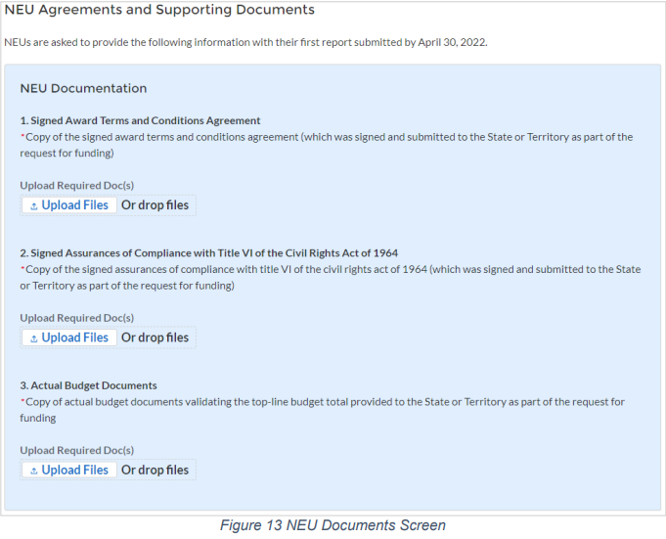
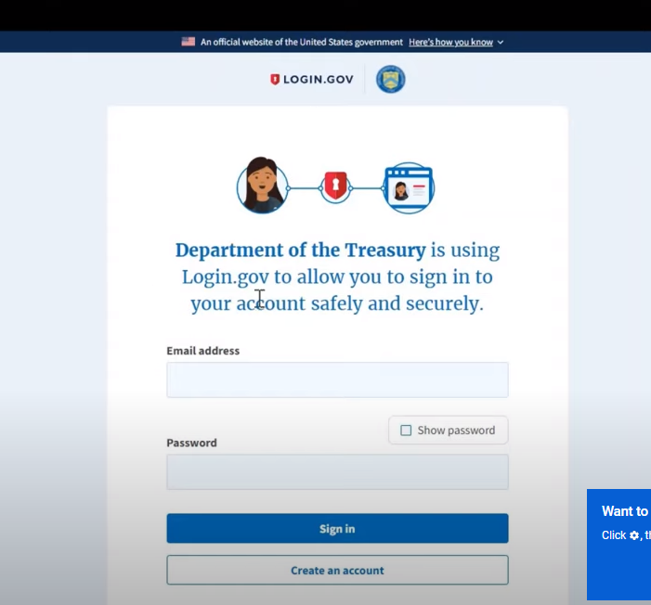
Report through Treasury Department Portal
Gain Familiarity Now
Set an Internal Reporting Deadline 7-10 Days Ahead of 4/30/22
“Get in the Herd”

Slide 11
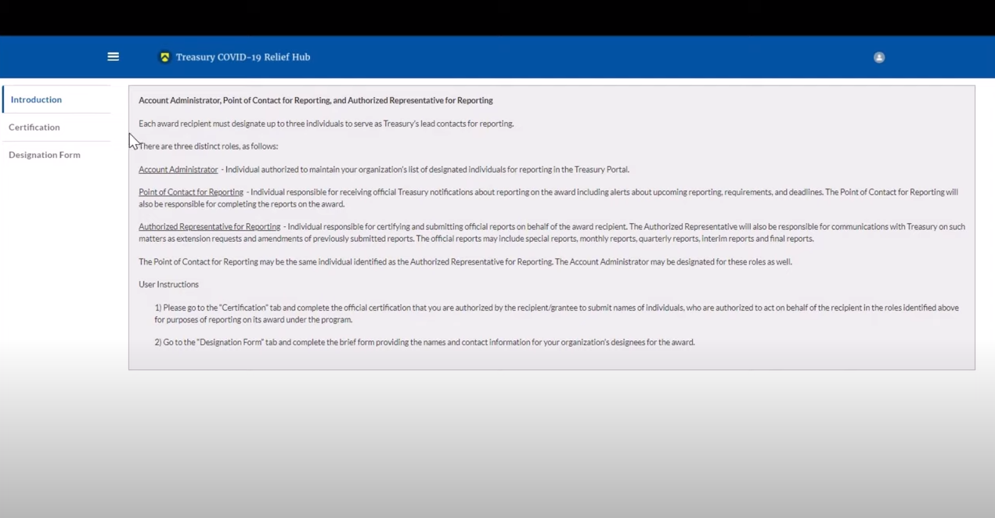
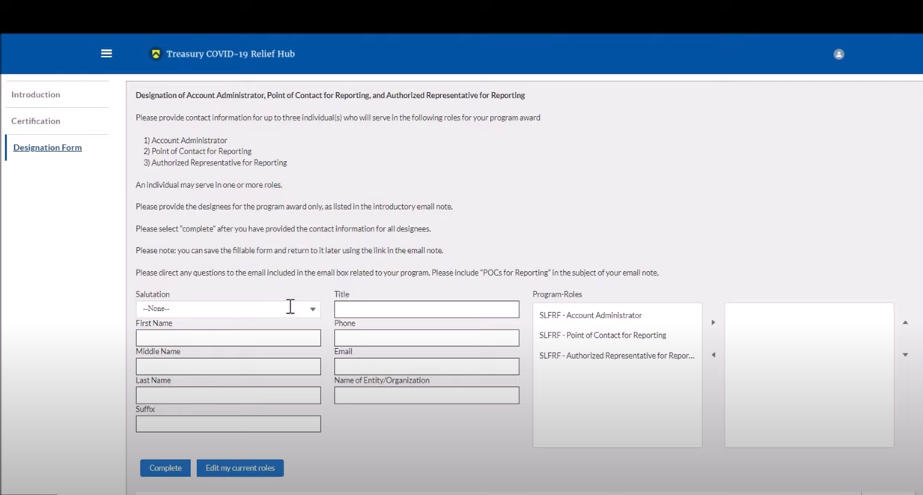
Report through Treasury Department Portal

Slide 12
Portal Troubleshooting
Email COVIDReliefITSupport@treasury.gov
In the subject line, include your city’s name and Georgia
In the body of the email, include
  DUNS
  EIN
  Clear description of the request/ error
  Screenshots of any errors

Slide 13
Prepare for Single Audit
Triggered by Federal Fund Expenditures > $750,000 During Your Fiscal Year
Be Prepared to Create a Schedule of Expenditures for Federal Awards (SEFA)
Engage Auditor with Appropriate Qualifications (2 CFR 200.509)
Review OMB Compliance Supplement Addendum #1
Record an Audit Reporting Package Submission Deadline (Nine Months After FYE)

Slide 14
Prepare for Possible Public Inquiry
National Media Attention on ARPA Funding
Local Press and Citizens Interest
Rationale for City Government Actions
--- “Prudent Person” Test
--- Slow and Continuing “Roll Out” of Treasury Department Regulations and Guidance
--- Treasury’s Announced Compliance Posture
-----Relationship Between Compliance with Interim and Final Regulations
--- Statutory Expenditure (Obligation) Deadline: 12/31/24

